Slide 1
JEA’s Initiatives and Capital Improvements Program
Society of American Military Engineers
Paul McElroy, JEA Managing Director CEO
March 22, 2017

Slide 2
**********************************************************************************************************************************************************************************************************************************************************************
JEA Electric System Overview
**********************************************************************************************************************************************************************************************************************************************************************
  Established in 1883, JEA is the nation’s 7th largest community-owned municipal utility
Service Territory
  Approximately 900 square miles
  All of Duval County; a portion of St. Johns County and Clay County
Serve 450,000 retail electric customers
  Combination of residential, business and industrial
  Wholesale service to the City of Fernandina (through 12-31-17)
System Peaks (Instantaneous)
  Winter 2009/2010: 3,250 MW
  Summer 2007: 2,937 MW
  For 2016—2,763 MW(w); 2,806 MW(s)

Slide 3
**********************************************************************************************************************************************************************************************************************************************************************
JEA Electric System Overview
Net Assets In-Service: $3.7B
Power Production Assets
  6 Plants (2 jointly owned), 18 Units
  Net Capacity: 3,408 MW Summer / 3,743 MW Winter
  Fuel Sources: Oil, Natural Gas, Coal, Petroleum Coke
  Renewables: Solar, Landfill Gas
Transmission System
  Voltage Levels (KV): 500, 230, 138 & 69
  745 Miles of Transmission
  74 Substations; 200 Transformers (high side >= 69kV)
Distribution System
  Voltage Levels (KV): 26.4, 13.2 & 4.16
  336 feeders (214 - 26.4kV; 95 – 13kV; 27 – 4kV)
  6,760 circuit miles (45% Overhead; 55% Underground)
  102,600 transformers, 200,900 poles
**********************************************************************************************************************************************************************************************************************************************************************

Slide 4
**********************************************************************************************************************************************************************************************************************************************************************
JEA Water System Overview
**********************************************************************************************************************************************************************************************************************************************************************
Net Assets In-Service $2.7B
in Water and Wastewater System
Provides drinking water for approximately 330,000 customers
Treat and produce over 105 mgd
Source of supply is the Floridan Aquifer
Supply is provided by 135 wells and 37 treatment plants
Water is distributed by over 4,300 miles of pipe
Water System

Slide 5
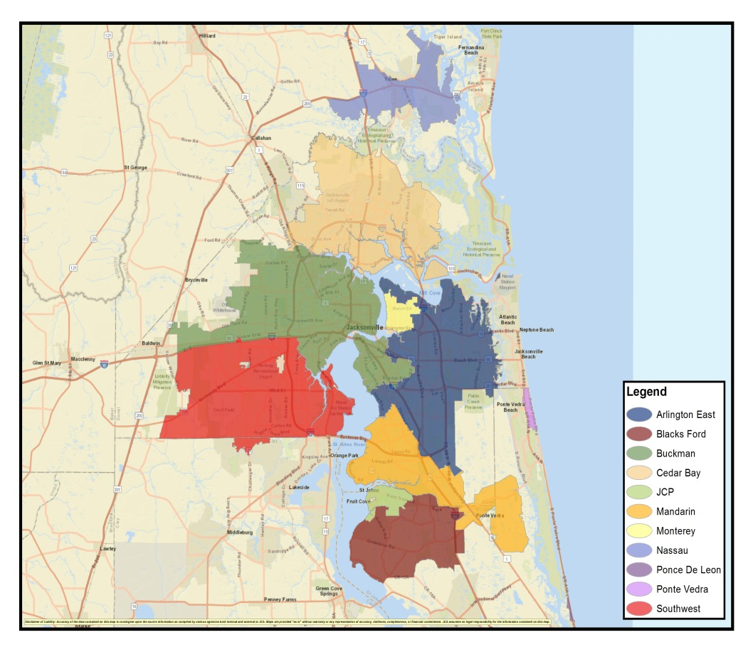
**********************************************************************************************************************************************************************************************************************************************************************
JEA Wastewater System Overview
**********************************************************************************************************************************************************************************************************************************************************************
Treat more than 75 mgd
Wastewater is collected by 3,800 miles of pipe and over 1,300 pump lift stations
Most of the treated water is discharged to the St Johns River
Due to enhanced treatment, the nutrient loading has been reduced from ~900 tons/year in 2006 to ~590 tons/year in 2015
Implemented a Reclaimed Water Program, 13.5 mgd of reclaimed water irrigating golf courses, ball fields, common areas and residential lawns
Wastewater System

Slide 6
**********************************************************************************************************************************************************************************************************************************************************************
Capital Spending & Projections - Electric System
**********************************************************************************************************************************************************************************************************************************************************************
91%
CAPEX (in millions)
% Debt to Asset Ratio
5 Year Avg.
CAPEX: $167M
Debt Funded CAPEX Cash Funded CAPEX Prior Year Carry Over % Debt to Asset
Notes:
Includes SJRPP and Scherer CAPEX

Slide 7
**********************************************************************************************************************************************************************************************************************************************************************
JEA Electric Five-Year CAPEX Projection
**********************************************************************************************************************************************************************************************************************************************************************
Asset Category (Costs in $1000's) | FY17 | FY18 | FY19 | FY20 | FY21
Generation Projects | $21,323 | $26,631 | $25,384 | $17,534 | $18,632
Substation & Transmission Projects | 35,405 | 42,889 | 24,146 | 16,160 | 21,403
Distribution Projects | 55,256 | 51,888 | 48,738 | 47,351 | 44,263
Other (Fleet, Facilities, Meters, IT, etc.) | 54,425 | 73,733 | 53,548 | 29,370 | 28,303
Subtotal | $166,409 | $195,141 | $151,816 | $110,415 | $112,601
SJRPP | 9,381 | 9,564 | 10,027 | 14,532 | 11,276
Scherer | 10,185 | 19,210 | 3,764 | 8,330 | 3,441
Total | $185,975 | $223,915 | $165,607 | $133,277 | $127,318
Forecast: $150,000 $185,000

Slide 8
**********************************************************************************************************************************************************************************************************************************************************************
JEA Electric Major Projects
**********************************************************************************************************************************************************************************************************************************************************************
Substations
Point Meadows
Dinsmore
Nocatee
Cecil Commerce Center South
Distribution
Downtown Network Distribution Improvements
Generation Power Purchase Agreements
Solar PV
  Montgomery
  Old Plank
  Imeson
  Blair
  Simmons
  Starratt
  Old Kings
  Yellow Water
Nuclear - Plant Vogtle

Slide 9
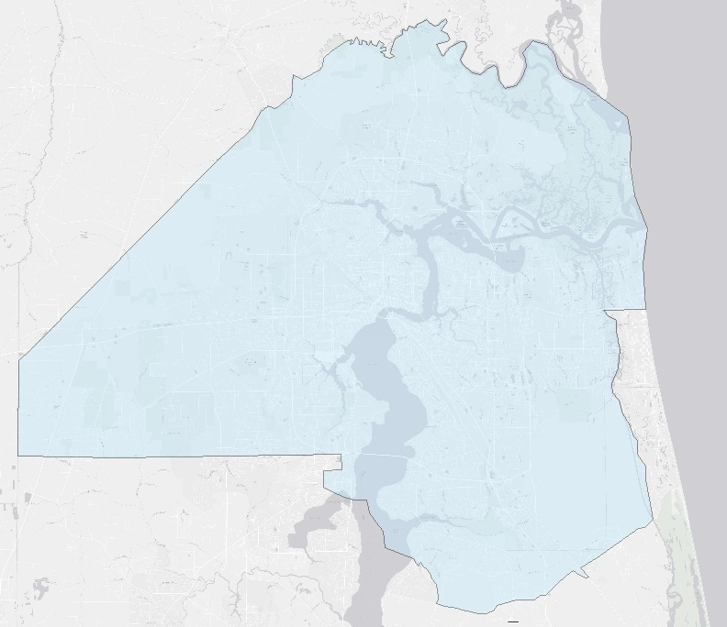
**********************************************************************************************************************************************************************************************************************************************************************
JEA Future Substation Projects
**********************************************************************************************************************************************************************************************************************************************************************
Dinsmore
Fall 2018
Substation | Estimated Cost
Pt. Meadows | $14 Million
Nocatee | $10 Million
Dinsmore | $11 Million
Cecil Commerce Center South | $14 Million
Cecil Commerce Center South
TBD
Point Meadows
Spring 2017
$49 Million
Nocatee
Fall 2020

Slide 10
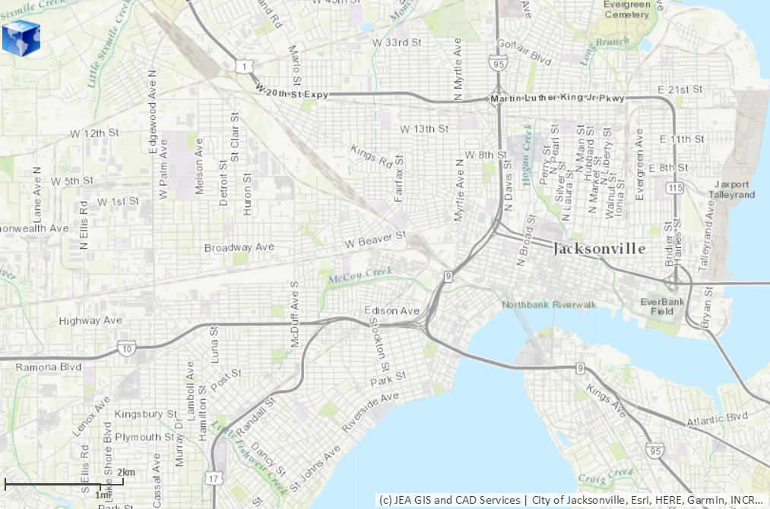
**********************************************************************************************************************************************************************************************************************************************************************
Downtown Network Distribution Reliability and Improvements
**********************************************************************************************************************************************************************************************************************************************************************
The Downtown Network Offers:
Highest Reliability
Best Power Quality
Benefits:
Increased Capacity
Improved Resiliency
Reduced Maintenance Costs
Replacement of Old Equipment
Improved Safety
Estimated Cost: $7.9 Million
Project Length: 3 Years

Slide 11
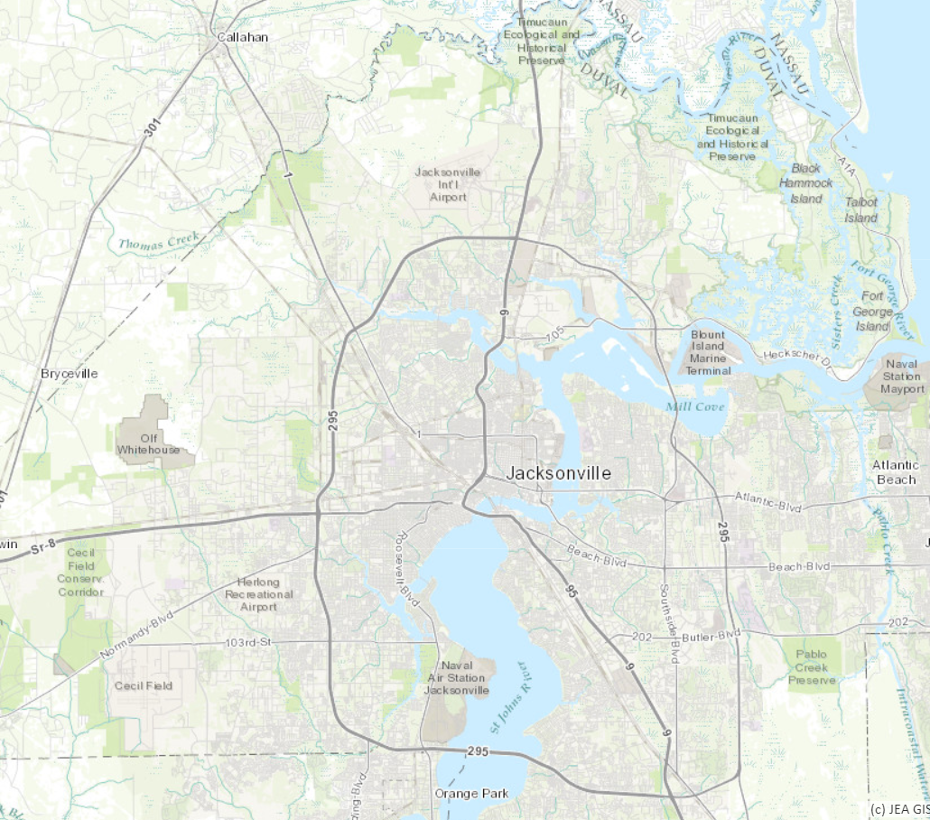
**********************************************************************************************************************************************************************************************************************************************************************
Solar Facilities (PPA)
**********************************************************************************************************************************************************************************************************************************************************************
Montgomery Solar
Solar Facility | In-Service
JAX Solar | Existing
Montgomery | Spring 2017
Old Plank | Summer 2017
Imeson | Fall 2017
Blair | Winter 2017
Simmons | Winter 2017
Starratt | Winter 2017
Old Kings | Winter 2017
Yellow Water | 2018
Simmons Solar
7 MW
5 MW
Old Kings Solar
Starratt Solar
2 MW
5 MW
1 MW
Old Plank Solar
Imeson Solar
3 MW
4 MW
5 MW
Blair Solar
Yellow Water Solar

Slide 12
**********************************************************************************************************************************************************************************************************************************************************************
Capital Spending & Projections – Water and Wastewater System
**********************************************************************************************************************************************************************************************************************************************************************
67%
% Debt to Asset Ratio
5 Year Avg.
CAPEX: $185M
Debt Funded CAPEX Cash Funded CAPEX Prior Year Carry Over % Debt to Asset

Slide 13
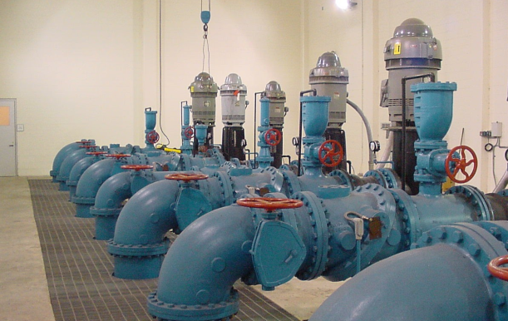
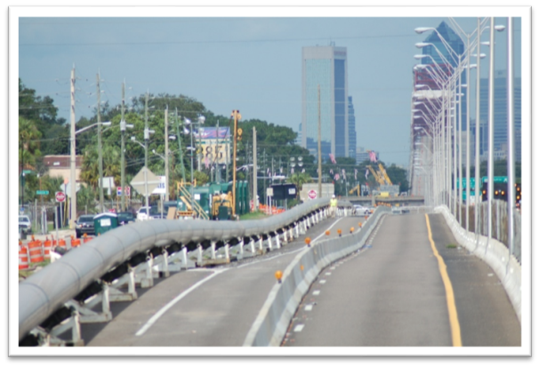
**********************************************************************************************************************************************************************************************************************************************************************
JEA Water/Wastewater Five-Year – CAPEX Projection
**********************************************************************************************************************************************************************************************************************************************************************
Asset Category (Costs in $1000's) | FY17 | FY18 | FY19 | FY20 | FY21
Wastewater Treatment Projects | $ 76,127 | $ 66,918 | $ 48,662 | $ 38,084 | $ 50,082
Water Treatment Projects | 34,386 | 25,777 | 27,649 | 21,422 | 14,430
Delivery & Collection Piping Projects | 25,318 | 24,560 | 27,461 | 25,387 | 27,282
Interagency Piping Projects | 9,952 | 10,817 | 4,117 | 4,006 | 4,000
Plants/Pump Stations R&R | 15,039 | 14,865 | 12,521 | 13,815 | 11,790
Delivery & Collection Piping R&R | 15,400 | 25,650 | 24,699 | 34,700 | 28,701
Development | 8,636 | 2,100 | 2,130 | 2,520 | 650
System Control Upgrades | 750.33 | 750.00 | 750.00 | 750.00 | 1,250.00
Subtotal | $ 185,609 | $ 171,437 | $ 147,989 | $ 140,684 | $ 138,185
Other (Fleet, Facilities, Meters, IT, etc.) | 38,054 | 29,194 | 32,362 | 28,644 | 29,245
Total | $ 223,663 | $ 200,631 | $ 180,351 | $ 169,328 | $ 167,430
Forecast: $205,000 $205,000

Slide 14
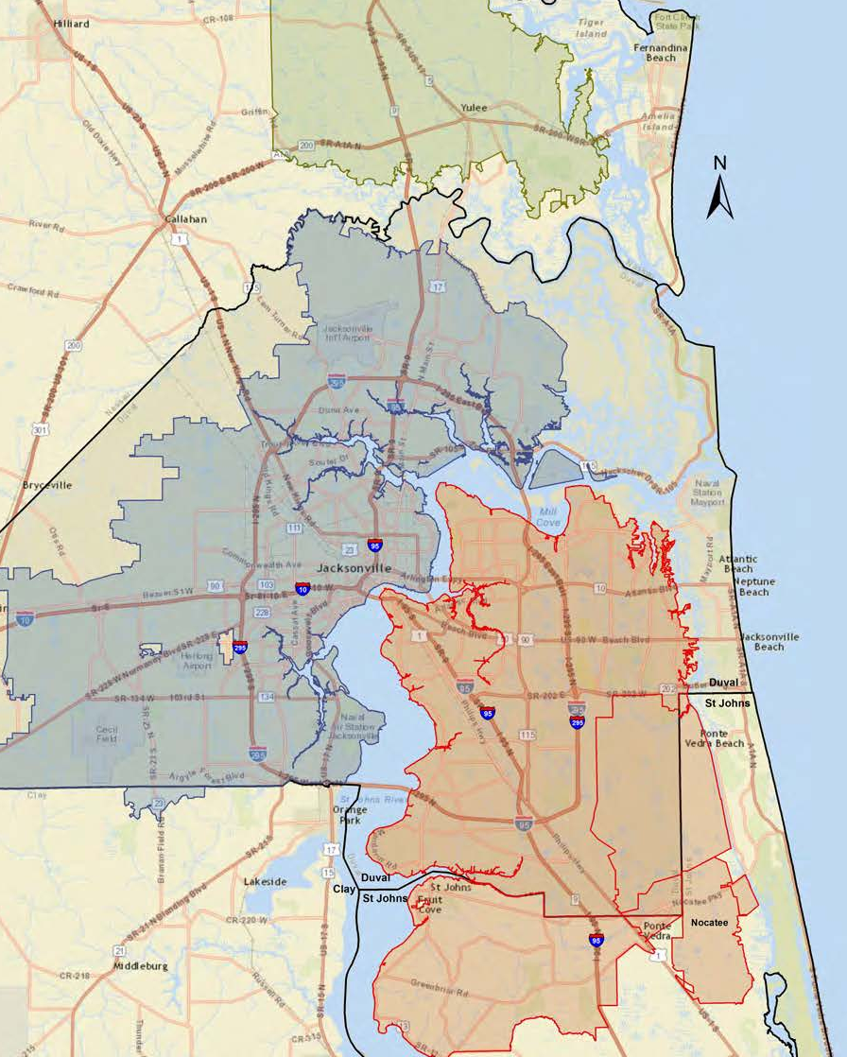
**********************************************************************************************************************************************************************************************************************************************************************
Water CAPEX Highlights – Water Treatment Plants
**********************************************************************************************************************************************************************************************************************************************************************
($ in millions) | FY 17 | FY18 | FY19 | Total
West Nassau WTP | 4 | 4 | -- | $8
Northwest WTP | 7 | 2 | -- | 9
Fairfax/Norwood WTP | 2 | 1 | -- | 3
Rivertown WTP | 1 | 3 | 8 | 12
US 1 Booster Station | -- | 1 | 5 | 6
 | $14 | $11 | $13 | $38
NASSAU
$8M
Totals =
Northwest
New WTP in the North Grid, 6.0 mgd capacity
Fairfax/Norwood
Upgrade WTP storage and pumping capabilities
Rivertown WTP
Construct new WTP, 6.0 mgd capacity
US 1 Booster Pump Station
Upgrade the existing booster station to provide additional flow to the south grid
West Nassau WTP
Expand the existing WTP from 1.0 to 5.0 mgd
NORTH GRID
$12M
SOUTH GRID
$18M
14
Notes:
UPDATED – G. Porter

Slide 15
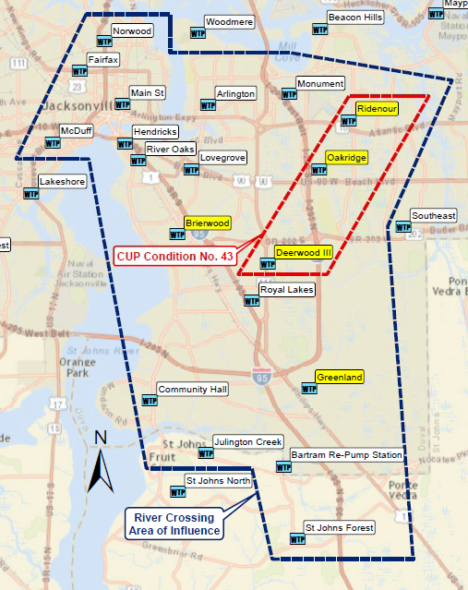
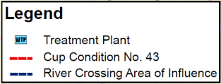
**********************************************************************************************************************************************************************************************************************************************************************
Water Supply CAPEX – Westfield Production, Sustainability & Water Quality
**********************************************************************************************************************************************************************************************************************************************************************
 | FY17 | FY 18 | FY19 | Total
WTP Improvements | $9M | $4M | $9M | $22M
Well Improvements | $2M | $4M | $2M | $8M
Totals = | $11M | $8M | $11M | $30M
Water Management Plan
Treatment Plants that are influenced by the river crossing transmission mains. Focus on Wellfield production capacity and sustainability, water quality, well and storage rehabilitation in conjunction with high service pump capacity and sulfide removal.
Condition 49: Water Quality data for 3 water treatment plants and 21 wells assessing the status and potential for saline water intrusion.
Condition 50: The entire river crossing area of influence encompasses 14 Water Treatment Plants and 83 of JEA’s 138 wells.
CUP Condition 49
CUP Condition No. 50
49
Notes:
Includes SJRPP and Scherer CAPEX

Slide 16
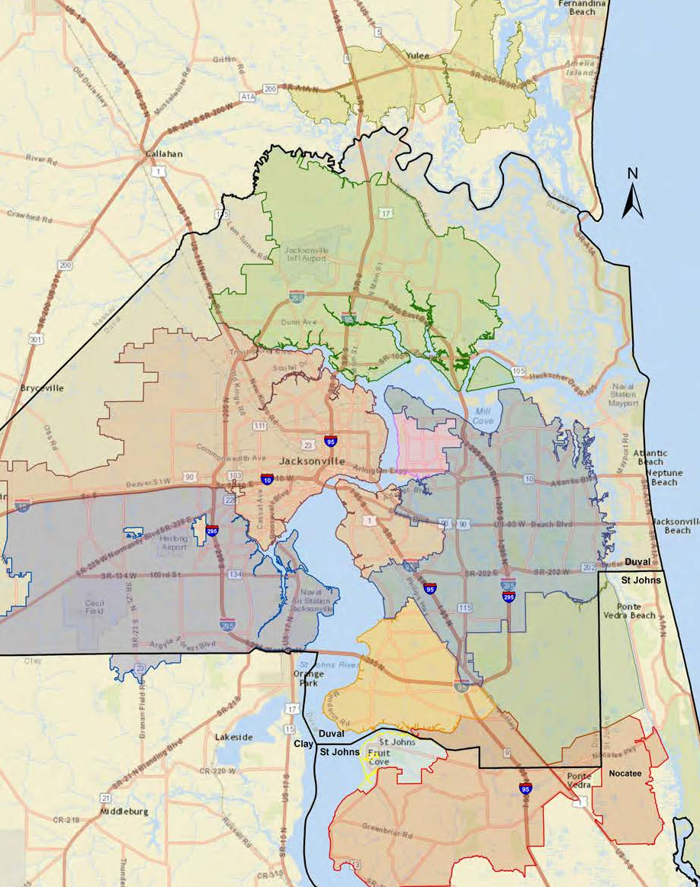
**********************************************************************************************************************************************************************************************************************************************************************
Water CAPEX Highlights – North/South/Nassau Service Area
**********************************************************************************************************************************************************************************************************************************************************************
($ in millions) | FY 17 | FY18 | FY19 | Total
Arlington East | 10 | 5 | 2 | $17
Blacks Ford | 37 | 15 | -- | 52
Greenland | 0 | 14 | 2 | 16
Nassau Regional | 1 | 5 | 11 | 17
Pump Station Upgrades | 10 | 10 | 19 | 39
Pump Station Reliability | 2 | 2 | 1 | 5
 | $60 | $51 | $35 | $146
NASSAU
$17M
Totals =
Arlington East
WWTF upgrades to maximize plant capacity to 25 mgd
Blacks Ford WRF
Expand the existing plant from 3.0 to 6.0 mgd
Greenland
New WWTP with a capacity of 4.0 mgd, ($28M beyond FY19)
Nassau Regional
Expansion from 2.0 to 4.0 mgd, ($40M beyond FY19)
Pump Station Upgrades
Upgrade Class III/IV pump stations (McMillan, Alachua, Bradley Rd, Spring Park, 118th Street)
Pump Station Reliability
Upgrade electrical & backup power capabilities
PUMP STATIONS
ARLINGTON EAST
$44M
$17M
GREENLAND
$16M
BLACKS FORD
$52M
16
Notes:
UPDATED – G. Porter

Slide 17
**********************************************************************************************************************************************************************************************************************************************************************
Questions?
**********************************************************************************************************************************************************************************************************************************************************************

