Slide 1


How to Access Procurement Opportunities
Chasity Ash, Lead Procurement Analyst & SBTA
Region 4 Office of Small & Disadvantage Business Utilization
U.S. General Services Administration

Slide 2



AN OVERVIEW FOR NEW VENDORS
Expanding Opportunities for Small Businesses
Shares ideas and best practices for small businesses throughout the country
Works with the small business community to strengthen partnerships and support the success of our vendors
Works with businesses to make sustainable products and services readily available and affordable to our buyers
Drives down prices, deliver better value, and reduce costs to our customer agencies
Creates new ways that the government can purchase resources smarter and more efficiently
Develops innovative cost-saving solutions that will be shared across the government

Slide 3
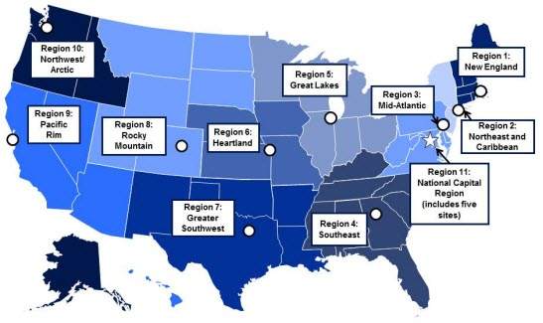
AN OVERVIEW FOR NEW
VENDORS
“The mission of GSA is to deliver the best value in real estate, acquisition, and technology services to government and the American people.”
Region 1: Boston, MA
Region 2: New York, NY
Region 3: Philadelphia, PA
Region 4: Atlanta, GA
Region 5: Chicago, IL
Region 6: Kansas City, MO
Region 7: Ft. Worth, Texas
Region 8: Denver, CO
Region 9: San Francisco, CA
Region 10: Auburn, WA
Region 11: Washington, DC

Slide 4

AN OVERVIEW FOR NEW
VENDORS
Office of Small Business Utilization at GSA
While GSA’s main role in the government is to ensure our buyers have the best choices when spending tax payer dollars, we are also here to help buyers identify small businesses who can meet their requirements.
In order to ensure buyers see small businesses as a resource, we educate our vendors on GSA programs and initiatives so that they can be prepared for new opportunities.
To learn more about the resources GSA provides to small businesses, please visit www.gsa.gov/small-business
Notes:
Introduction can serve to introduce yourself and discuss amazing work OSBU does for small businesses throughout the country.
Each Federal agency has an Office of Small Business Utilization put in place by Congress “…to promote the maximum practicable use of all designated small business categories within the Federal Acquisition process…” These advocates report to the head of their agency on the success of this partnership.
Finding creative new ways to educate
Sponsoring and delivering business development training
Integrating low-cost networking events into established venues
Providing free counseling and more…

Slide 5







1/3 Billion square feet of office space
210,000 vehicles
$60 Billion in acquisitions
GSA
GSA
GSA
44 Million square feet of office space
40,000 vehicles
$10 Billion in acquisitions
R4
R4
R4
Notes:
All agencies play an important role in our governments effort to protect, serve and develop our country.
GSA’s role is to make sure those agencies have the tools they need to meet their mission successfully. In most cases we design and build the place where they work, provide the technology they use, access to the services and products they need and more.
We do all this to achieve efficiencies in the performance of administrative functions as well as savings in the cost of operations.

Slide 6
AN OVERVIEW FOR NEW
VENDORS
GSA Business Lines
GSA is comprised of both the Federal Acquisition Service (FAS) and Public Buildings Service (PBS)
PBS: 1) Manages construction, architecture, real estate and interior design, and 2) Develops procurement programs for construction, architecture, real estate and interior design.
FAS: 1) Oversees the commercial acquisition part of GSA, and 2) Develops procurement programs for products, services, fleet and technology.
Notes:
Introduction can serve to introduce yourself and discuss amazing work OSBU does for small businesses throughout the country.
Each Federal agency has an Office of Small Business Utilization put in place by Congress “…to promote the maximum practicable use of all designated small business categories within the Federal Acquisition process…” These advocates report to the head of their agency on the success of this partnership.
Finding creative new ways to educate
Sponsoring and delivering business development training
Integrating low-cost networking events into established venues
Providing free counseling and more…

Slide 7
AN OVERVIEW FOR NEW VENDORS
Are You Ready?
Locating small business opportunities can often be a tedious task and getting a piece of the pie may seem next to impossible.
The following slides are designed to provide insight and to highlight small business resources and links to assist you in locating small business opportunities in your endeavor to do business with the Government.

Slide 8

AN OVERVIEW FOR NEW VENDORS
Small Business Procurement Opportunity Resources
SBA Subcontracting Directory (SUB-Net)
System for Award Management (SAM)
Dynamic Small Business Search (DSBS)
Federal Business Opportunities (betaSAM)
Federal Procurement Data System (FPDS)
USASpending.Gov
GSA Multiple Award Schedule (MAS) Program
GSA eLibrary
GSA eBuy (Applicable to GSA Contract Holders)
GSA Advantage Spend Analysis Program (ASAP)
GSA Forecast of Contracting Opportunities - Agency-wide
Notes:
Note, all federal agencies have subcontracting directory. We strongly suggest SBA’s subcontracting Directory as they have a Prime Contractor list seeking subcontractors. www.sba.gov/subnet

Slide 9

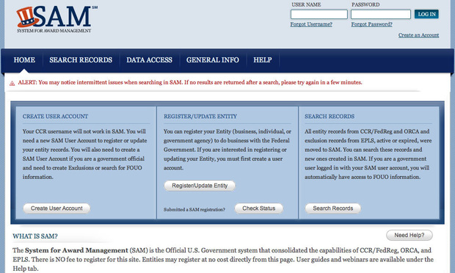
AN OVERVIEW FOR NEW VENDORS
System For Award Management (SAM)
www.sam.gov
The System for Award Management (SAM) is the primary database used by federal agencies to locate contractors.
Vendors are required to “Create a User Account & Register their Entity” (business, individual, or government agency) in order to compete and submit bids for federal opportunities.
Notes:
Vendors are required to submit a business resume & register a business profile in SAM. This allows agencies to search businesses based upon numerous identifiable factors such as name, capabilities, NAICS, business size, location, experience and ownership in locating potential small businesses for opportunities. The information on SAM must be maintained by the vendor (current, accurate, & complete information).
Vendors doing business with the federal government "will be able to log into one system to manage their entity information in one record, with one expiration date. The site is used by federal agencies to obtain pre-award information in considering vendors for small business opportunities.
As a small business registers in the System for Award Management, there is an opportunity to fill out your small business profile. The information provided populates DSBS. DSBS is another tool contracting officers use to identify potential small business contractors for upcoming contracting opportunities. Small businesses can also use DSBS to identify other small businesses for teaming and joint venturing. Dynamic Small Business Search http://dsbs.sba.gov/dsbs/search/dsp_dsbs.cfm

Slide 10
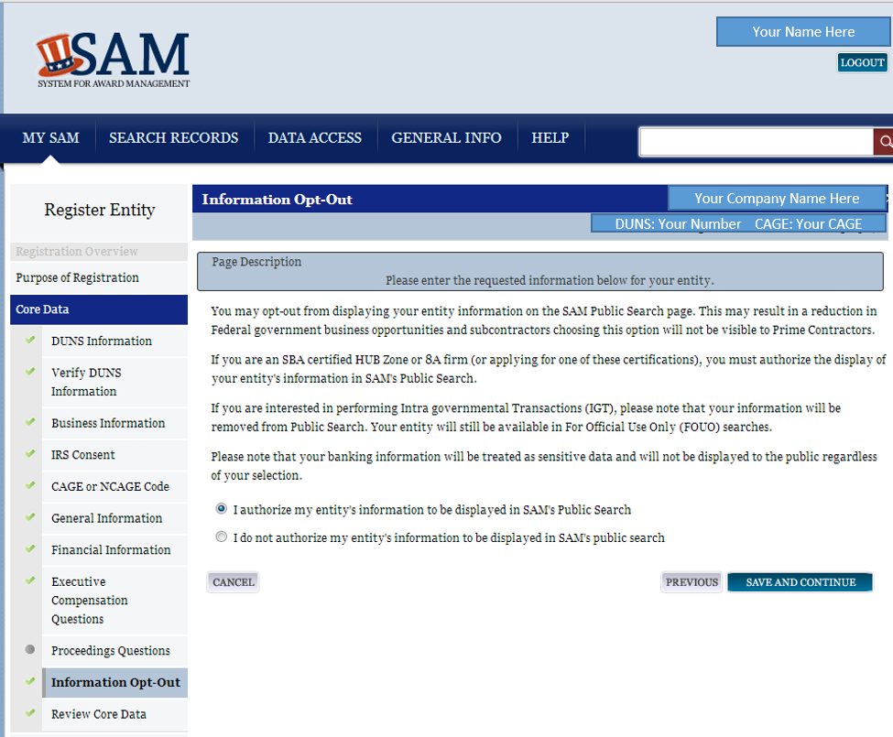
AN OVERVIEW FOR NEW VENDORS
Dynamic Small Business Search
http://dsbs.sba.gov/dsbs
The Dynamic Small Business Search is a database manned by The Small Business Administration.
The tool is used by Contracting Officers to identify potential vendors for small business contracting opportunities.
Notes:
The information provided populates DSBS. DSBS is another tool contracting officers use to identify potential small business contractors for upcoming contracting opportunities. Small businesses can also use DSBS to identify other small businesses for teaming and joint venturing.
Small businesses should review their registration to ensure the information on their company is complete and updated. The contracting workforce uses DSBS to conduct market research.

Slide 11
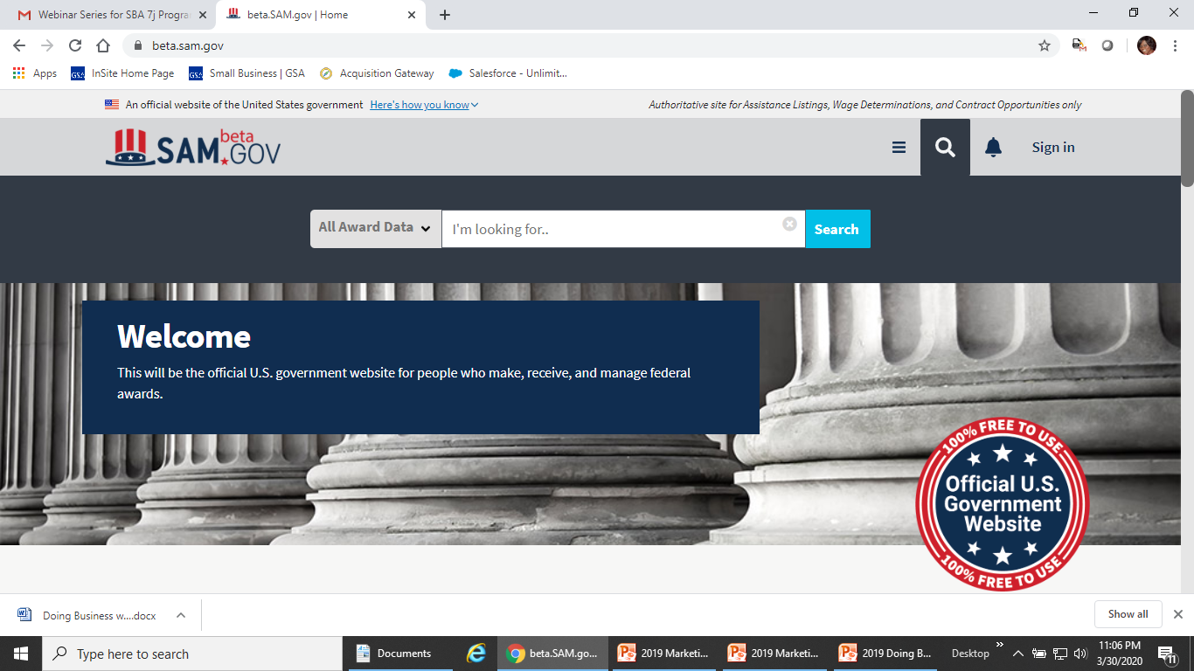
AN OVERVIEW FOR NEW VENDORS
Federal Business Opportunities (beta.SAM.gov)
www.beta.SAM.gov
Beta.SAM.gov is the official government website (point of entry) used to post all federal procurement opportunities in excess of $25,000
Small Businesses may seek business opportunities to bid on here.
It is known as a central location in searching for Request for Proposals (RFP’s)
Highly suggested to use tutorial
Notes:
Federal agencies are required to use this site to communicate available procurement opportunities and their vendor requirements to the public and interested potential vendors for all contracts valued over $25,000.
Be sure to use the tutorial to learn how to set up search agents so you can receive automatic emails daily when there are projects that your company may be interested in bidding on. This information can always be used for marketing to other contractors for possible subcontracting opportunities also.

Slide 12

AN OVERVIEW FOR NEW VENDORS
Federal Procurement Data System (FPDS)
www.fpds.gov
The Federal Procurement Data System (FPDS) is the repository of all federal contracting data whose estimated value is $3,000 or more . Every modification to that contract, regardless of dollar value must be reported to FPDS-NG. .
Small Business may use this tool to track business opportunities agency by agency. The system data provides historical data of Federal purchases.
Check out FAQ’s for more details on the value of this source https://www.fpds.gov/wiki/index.php/FPDS-NG_FAQ
Notes:
Vendors can learn the following about federal contracting opportunities and increase your market capability:
Which agencies have contracts and with whom
What agencies buy
Which contractors have contracts
In the ezSearch box use a keyword or NAICS Code to search and you will find numerous results. Then you can drill into the results to obtain more information. Click View on an award and you will see the agency that made the award. When viewing an award in FPDS you can also find information about the award that you can use to search for it in Federal Business Opportunities web site www.fbo.gov to find the point of contact for that particular award.

Slide 13
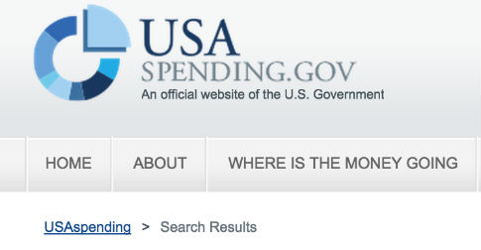
AN OVERVIEW FOR NEW VENDORS
USA Spending
www.usaspending.gov
Provides detailed data regarding actual Federal Government dollars spent i.e., award recipient, amount of award, recipient's location, and place of performance location as well as other information to assist you in tracking future potential business opportunities.
Notes:
You can locate all government spending including grants, small and large purchases, etc.
For more information on grants www.grants.gov
Grant holders consider small businesses in subcontracting opportunities.

Slide 14

AN OVERVIEW FOR NEW VENDORS
GSA Multiple Award Schedule (MAS) Program
GSA Releases Consolidated Schedule Solicitation Merging 24 Multiple Awards Schedules into Single Schedule. As of Oct. 1, 2019
At this time, only new contracts will be placed on the consolidated Schedule solicitation, which streamlines and simplifies the order process for new contractors. Contractors already on Schedule will not be affected by the new solicitation until the mass modification takes effect in calendar year 2020. Federal agencies should see no disruptions to their purchasing practices during the transition.
Notes:
About GSA MAS Schedule
GSA offers over 40 million supplies and services
34 Schedules
Over 17,000 Schedule contracts
80% of GSA MAS contracts go to small businesses
$50 billion total annual spend or 10% of overall federal procurement spending
The GSA Schedules program is the premier acquisition vehicle in government, with approximately $50 billion a year in spending or 10 percent (10%) of overall federal procurement spending.

Slide 15
AN OVERVIEW FOR NEW VENDORS
GSA Multiple Award Schedule (MAS) Program
You Do NOT have to be a schedule holder to do Business with GSA
If you are interested in the Medical Schedules you have to contact the VA National Acquisition Center
The GSA Schedule is NOT a mandatory source
Notes:
About GSA MAS Schedule
GSA offers over 40 million supplies and services
34 Schedules
Over 17,000 Schedule contracts
80% of GSA MAS contracts go to small businesses
$50 billion total annual spend or 10% of overall federal procurement spending
The GSA Schedules program is the premier acquisition vehicle in government, with approximately $50 billion a year in spending or 10 percent (10%) of overall federal procurement spending.

Slide 16
AN OVERVIEW FOR NEW VENDORS
GSA Multiple Award Schedule (MAS) Program
GSA Schedule Contracts, also known as GSA Schedules or Federal Supply Schedules, are indefinite delivery, indefinite quantity (IDIQ), long-term contracts under the General Services Administration's Multiple Award Schedule (MAS) Program.
GSA establishes long-term government wide contracts with commercial companies to provide access to government agencies to millions of commercial products and services at volume discount pricing.
Notes:
About GSA MAS Schedule
GSA offers over 40 million supplies and services
34 Schedules
Over 17,000 Schedule contracts
80% of GSA MAS contracts go to small businesses
$50 billion total annual spend or 10% of overall federal procurement spending
The GSA Schedules program is the premier acquisition vehicle in government, with approximately $50 billion a year in spending or 10 percent (10%) of overall federal procurement spending.

Slide 17

AN OVERVIEW FOR NEW VENDORS
GSA eLibrary
www.gsaelibrary.gsa.gov
GSA eLibrary is the official online source for complete GSA and VA Schedules information including awards. It provides a centralized source for researching Schedules that include basic ordering guidelines, complete Schedule listings and a powerful search engine.
Small Businesses can use this as a tool to locate contractors for potential teaming arrangements and/or subcontracting opportunities.
Notes:
Be sure to take the OSBU Pursuing a GSA Schedules Training which includes going to readiness assessment tool.
The list of GSA Schedule contract holders can be found on elibrary.
GSA eLibrary provides an Alphabetical Listing of Contractors that are on each schedule contract with GSA. You will find links to contractor websites, email addresses, and text files containing contract terms and conditions,
You can go into the appropriate category for the type of work you are looking to do and click on it to research companies for possible subcontracting opportunities or type in a keyword.
Note, for each Schedule you can download the contract holder list which can be used for subcontracting opportunities for non schedule holders.
From there you can review which businesses are currently under the contract. Once in the Schedule Summary for a contract you can view the businesses and you can also download a list by clicking on Download Contractors (Excel).

Slide 18

AN OVERVIEW FOR NEW VENDORS
GSA eBuy
Applicable to GSA Contract Holders
www.eBuy.gsa.gov
eBuy is an online Request For Quote (RFQ)/Request For Proposal (RFP) system.
The online system allows government buyers (ordering activities) to request information, find sources, post requirements, obtain quotes and proposals, as well as issue orders electronically.
Notes:
Posting on eBuy satisfies all requirements for fair notice to potential offerors, even if fewer than three offers have been received.
Millions of products and services offered through GSA's Multiple Award Schedule (MAS) and GSA Technology Contracts can be funneled through this online site. Vendors may take advantage of this tool in locating potential Small Business opportunities.

Slide 19

AN OVERVIEW FOR NEW VENDORS
Readiness Assessment: Using the Vendor Toolbox
The Vendor Toolbox contains the Readiness Assessment, a mandatory self-evaluation tool, aimed to help potential contractors decide whether their offerings meet the needs of the federal government.
The Vendor Toolbox contains training materials that will help you learn more about the Federal market, tools that will help you uncover opportunities, and links to resources that can assist you in being a successful MAS contractor.
You can access the Vendor Toolbox through
our Vendor Support Center at https://vsc.gsa.gov/.
Notes:
Research, Analyze and Decide
The Vendor Toolbox is divided into three steps; Research, Analyze and Decide. It is designed to help you learn about and understand the Federal market while you walk through a process that will enable you to Research, Analyze, and ultimately Decide whether to submit a proposal to GSA (i.e. apply to get on schedule). It is also worth noting that GSA does not seek task orders and business for contractors.

Slide 20
Get Ready: Train
Pathways to Success Training
Explains MAS and specific requirements.
Visit our Vendor Education to take the course.
Save your completion certificate. You will upload it to eOffer.
If you have any problems with the course, email pathwaytosuccess@gsa.gov
Readiness Assessment Training
Ensures you’re ready to submit an offer for the right MAS contract and SIN.
Visit our Vendor Education to take the course.
Save your completion certificate. You will upload it to eOffer.
If you have any problems with the course, email pathwaytosuccess@gsa.gov
20
Notes:
Introduction can serve to introduce yourself and discuss amazing work OSBU does for small businesses throughout the country.
The Office of Small Business Utilization connects small business with people and resources to help them grow. We are your advocates.

Slide 21
AN OVERVIEW FOR NEW VENDORS
GSA Forecast of Contracting Opportunities (Agency-wide)
www.gsa.gov/small-business
The GSA Forecast of Contracting Opportunities informs vendors of anticipated contracts offered by GSA for the current fiscal year.
GSA's agency-wide Forecast, can be sorted and searched by GSA Organization and Region, NAICS Code, Place of Performance, Contract Dollar Value, Quarter, and other criteria.

Slide 22



AN OVERVIEW FOR NEW VENDORS
GSA OSBU on Social Media
www.gsa.gov/small-business
@GSAOSBU
@USGSA
@USGSASchedules
@gsapbsIRD
GSA YouTube Channel
https://interact.gsa.gov/

Slide 23



Additional Solutions:
www.gsa.gov/events
www.gsa.gov/smallbusiness
Notes:
With all that GSA is doing to work with small business, we can’t forget our advocacy partners who are hosting events, inviting us to the table and helping us to help small business. These partners continue to grow and we invite you to visit their sites and get to know all the opportunities they have waiting for you.
Small Business Administration (www.sba.gov , www.green.sba.gov)
SBA provides business counseling and training, including online sessions under their Learning Center link and a Business Guide. Their website covers guidance on managing, growing, and financing your business, as well as preparing a business plan. The SBA business development specialists provide free and low-cost services in your area. Contact 1-800-U-ASK-SBA (1-800-827-5722)
The Association of Procurement Technical Assistance Centers (http://www.aptac-us.org/new)
PTACs provide a wide range of assistance, most free of charge, to businesses through one-on-one counseling sessions, classes, seminars and matchmaking events. This organization is funded in part by the Department of Defense. Contact your local PTAC for help.
Minority Business Development Agency (http://www.mbda.gov)
MBDA, a part of the U.S. Department of Commerce is an entrepreneurially focused organization committed to wealth creation in minority communities. The Agency's mission is to actively promote the growth and competitiveness of large, medium and small minority business enterprises (MBEs).

Slide 24
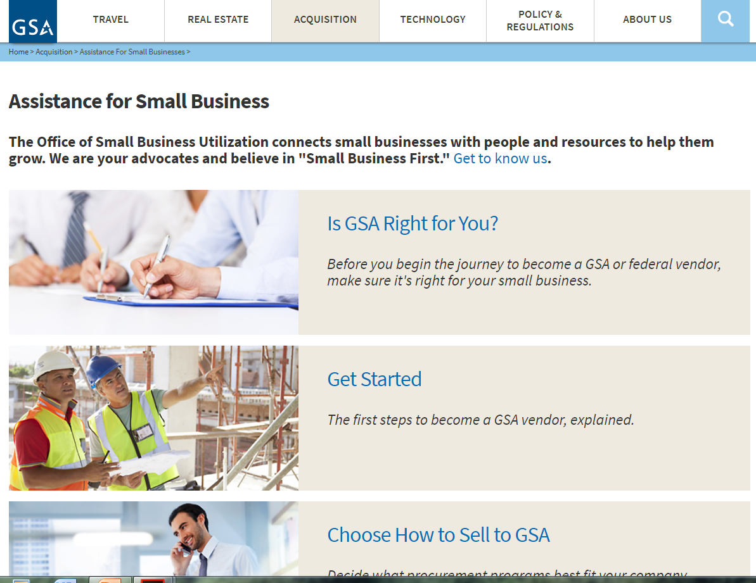
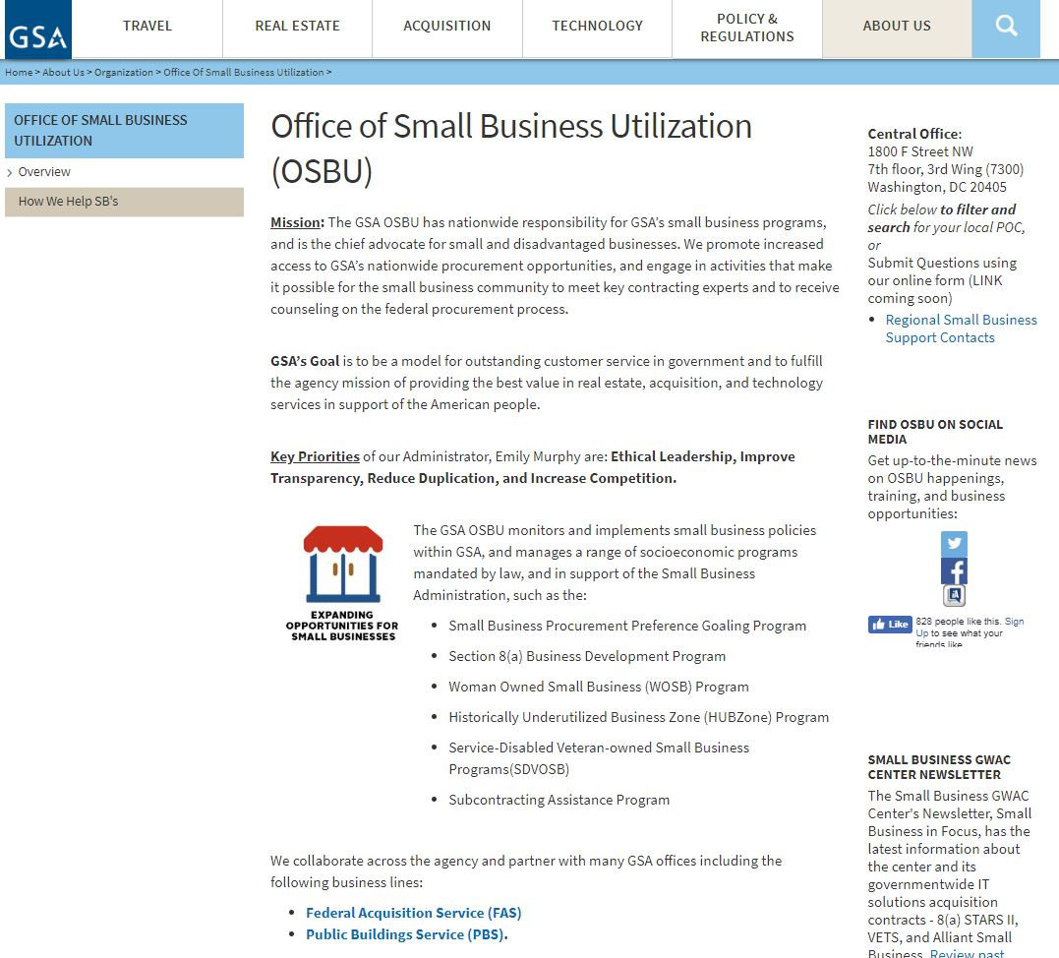
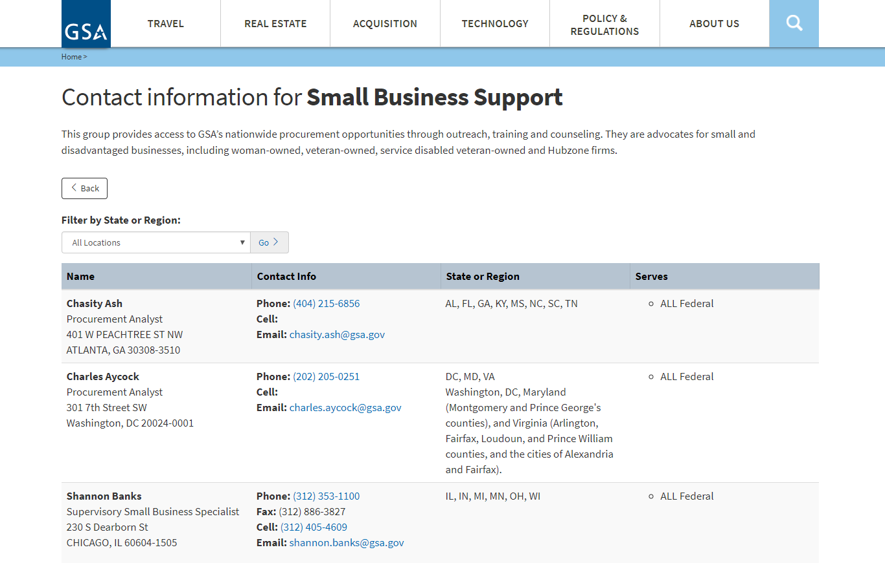
Contact Our Regional Staff
Still Have Questions?
Select Regional Small Business Support Contacts
Go to gsa.gov/osbu, then select “Get to Know Us.”
Choose your location for the OSBU POC.
Notes:
Go to gsa.gov/osbu, then select “Get to Know Us.”
Select Regional Small Business Support Contacts
Choose your location for the OSBU POC

Slide 25
AN OVERVIEW FOR NEW VENDORS
GSA Region 4 OSBU
www.gsa.gov/r4
GSA Region 4 OBSU
r4smallbiz@gsa.gov
www.gsa.gov/small-business
https://interact.gsa.gov/

