Slide 1


How to do Business with
Network Contracting Office (NCO) 8
Trina Berry
Small Business Liaison

Slide 2
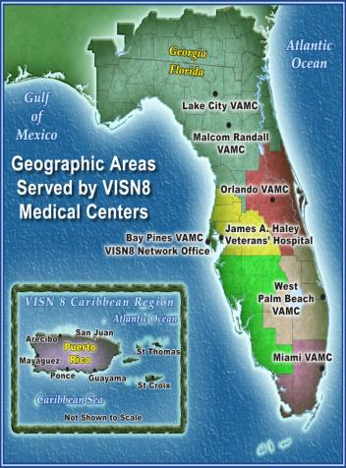
VISN 8 Geographics / Demographics
Veteran Population: 1.6M
Major Hospitals 8
Clinics 60
2018 Total Outpatient Visits: 8.8M
Square Miles: 64,153
States/Territories:
- Florida Counties (60)
- Georgia Counties (19)
- Puerto Rico
- USVI
VBA Regional Offices: 2
VA National Cemeteries: 8
4th Largest Veteran Population in the U.S.
VISN 8 treats 10% of all Veterans Receiving
VA Care
The Nation’s Largest Network of VA Hospitals and Clinics
http://www.visn8.va.gov/VISN8/index.asp

Slide 3
Small Business Programs
Service-Disabled Veteran-Owned Small Business and Veteran-Owned Small Business Set-Asides or Sole Source (Public Law 109-461, FAR 19.14, and VAAR 819)
Section 8(a) Program (FAR 19.8)
Historically Underutilized Business Zone (HUBZone)
Set-Asides or Sole Source (FAR 19.13)
Women-Owned and Economically Disadvantaged Women-Owned Set-Asides or Sole Source (FAR 19.15)
Small Business Set-Asides (FAR 19.5)

Slide 4



Public Law 109-461 Set-Aside Authorities
U.S. Supreme Court Decision: Contracting Officers “shall award contracts” by restricting competition to Veteran-Owned Small Businesses based on the “Rule of Two”
Acquisition Policy Flash 16-20: http://www.va.gov/oal/business/pps/flash16-20.asp
Service Disabled Veteran Owned Small Business (SDVOSB) and Veteran Owned Small Business (VOSB):
  Competitive – Unlimited by dollar value
  Sole Source – Limited to $5M

Slide 5
Steps to Doing Business with VISN 8 and Our Facilities
1.Register with Beta.Sam https://beta.sam.gov/ . You must have a D&B DUNS number in order to register. The D-U-N-S Number is a unique 9-digit identification sequence, which provides a unique identifier of single business entities, while linking corporate family structures together. Go to http://www.dnb.com/ for information on how to obtain a DUNS number.
2. Visit GSA eBuy, NASA Solutions for Enterprise-Wide Procurement (SEWP), or FBO to search for NCO8 solicitations.
3. Review the VISN 8 Forecast of Contracting Opportunities (FCO) for potential business opportunities.
4. Include your DUNS number and/or CAGE Code when marketing to the federal government and develop a 1-2 page capability statement for marketing purposes.
5. Develop an easy-to-navigate company website that includes your products or services, pricing, and point of contact information.
6. Additional certifications can give your small business a competitive edge when pursuing government work. These programs include 8(a) Business Development Program, Historically Underutilized Business Zones (HUBZone) Program, Small Disadvantaged Business, and Woman-Owned Small Businesses. NOTE: If you are claiming SDVOSB or VOSB status, you must be certified in the Vendor Information Pages (VIP) https://vip.vetbiz.va.gov/

Slide 6
The organizations identified below are specifically designed to assist small businesses within the State of Florida. They also sponsor small business events throughout the year to help small businesses grow their businesses:
-Procurement Technical Assistance Centers (PTACs): www.fptac.org
or search for your nearest PTAC: http://www.aptac-us.org/new/
-Small Business Development Center (SBDC): http://www.sbdctampabay.com/
or search for your nearest SBDC: http://www.sba.gov/tools/local-assistance/sbdc
-Small Business Administration (SBA): http://www.sba.gov/

Slide 7
Locating Contracting Opportunities
GSA eBuy
  https://www.ebuy.gsa.gov/ebuy/
NASA SEWP
  http://www.sewp.nasa.gov/
Beta Sam
  https://beta.sam.gov/
Forecast of Contracting Opportunities (FCO)
  https://www.vendorportal.ecms.va.gov/eVP/fco/VisnMap.aspx

Slide 8


VISN 8: VA Sunshine Healthcare Network
VISN 8: VA Sunshine Healthcare Network
Network Contracting Office 8 (NCO 8)
Trina Berry
Small Business Liaison
U.S. Department of Veterans Affairs
Veterans Health Administration (VHA)
Service Area Office (SAO) East
Phone: 813.972.2000 ext. 7504
Email: trina.berry@va.gov

