Slide 1

TASK FORCE VIPR
2024 SAME INDUSTRY DAY
JACKSONVILLE POST
Notes:
Good afternoon – Jackie Keiser, Deputy for PPMD,, TF VIPR
Task force VIPR is a new organization within USACE but the mission is not new.

Slide 2





WHY TASK FORCE VIPR?
Provide additional leadership bandwidth and focus on priority missions
in Puerto Rico and the USVI
Improved communication with Sponsors, Communities, and stakeholders
150 Civilians: Leverage existing expertise of Jacksonville Team
Prioritized Implementation
One Team, One Mission
One Door to USACE
First USACE Army Colonel Commander in Puerto Rico
Expanded San Juan Headquarters office

Slide 3
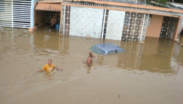
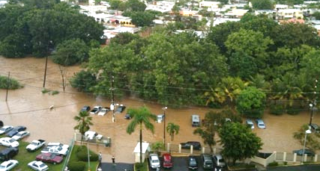
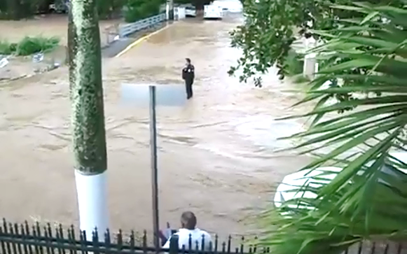
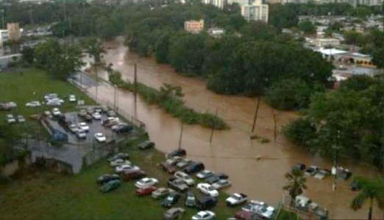
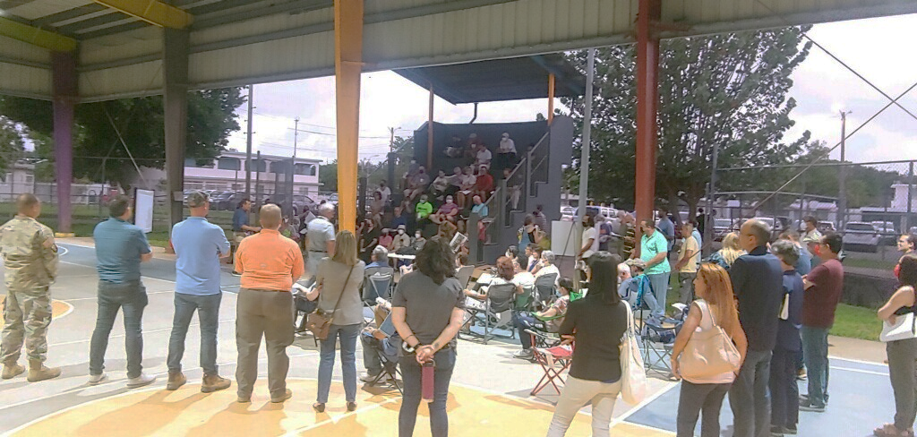
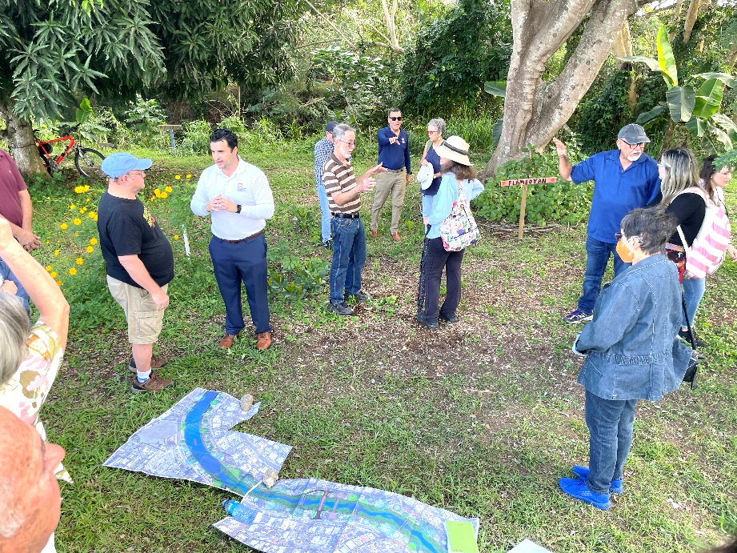
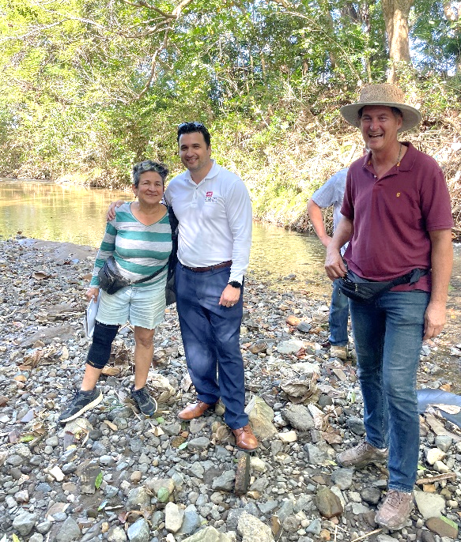
WHY TASK FORCE VIPR?

Slide 4
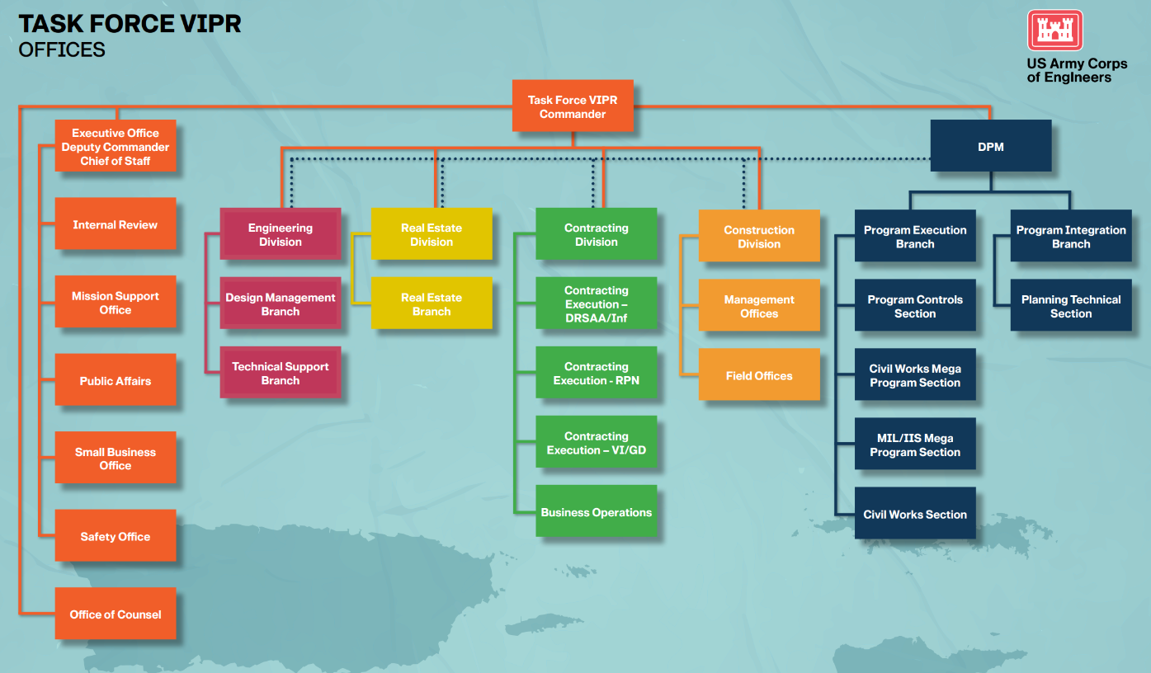
MAJ Ricardo Herrero
Steve LaValle
COL Charles Decker
Jackie Keiser
Chad Gillan
Cassie Norris
Travis Specht
Maricarmen Crespo
In Progress
Office Locations:
San Juan: Humana Complex (expanded)
383 Franklin D. Roosevelt Ave
Jacksonville: Currently co-located with Jacksonville District
701 San Marco Blvd
Notes:
Who is Task Force VIPR
We look very much like a District, organized the same.
Commander that reports directly to BG Hibner in SAD, treated like a District.
GS15- Corporate board. Some reachback to SAJ support offices, big difference is we share RM with SAJ.
Commander – COL lives in Puerto Rico 6+ years
MAJ Ricardo Hererro

Slide 5

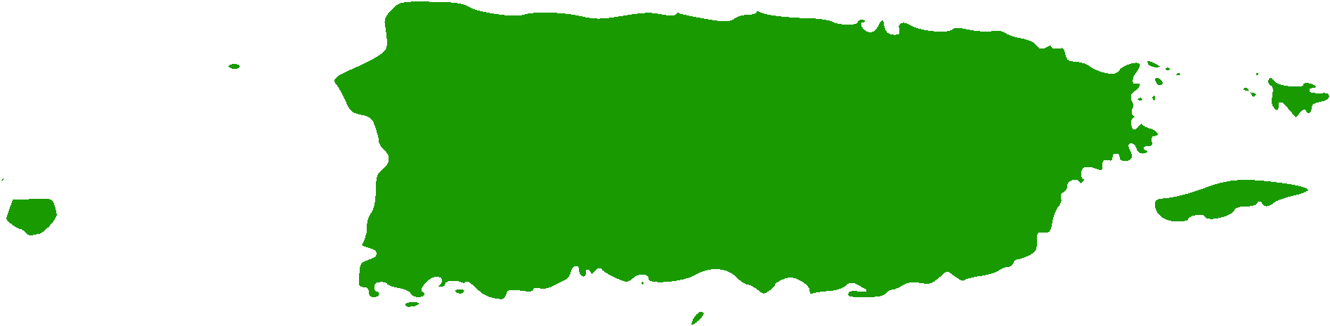
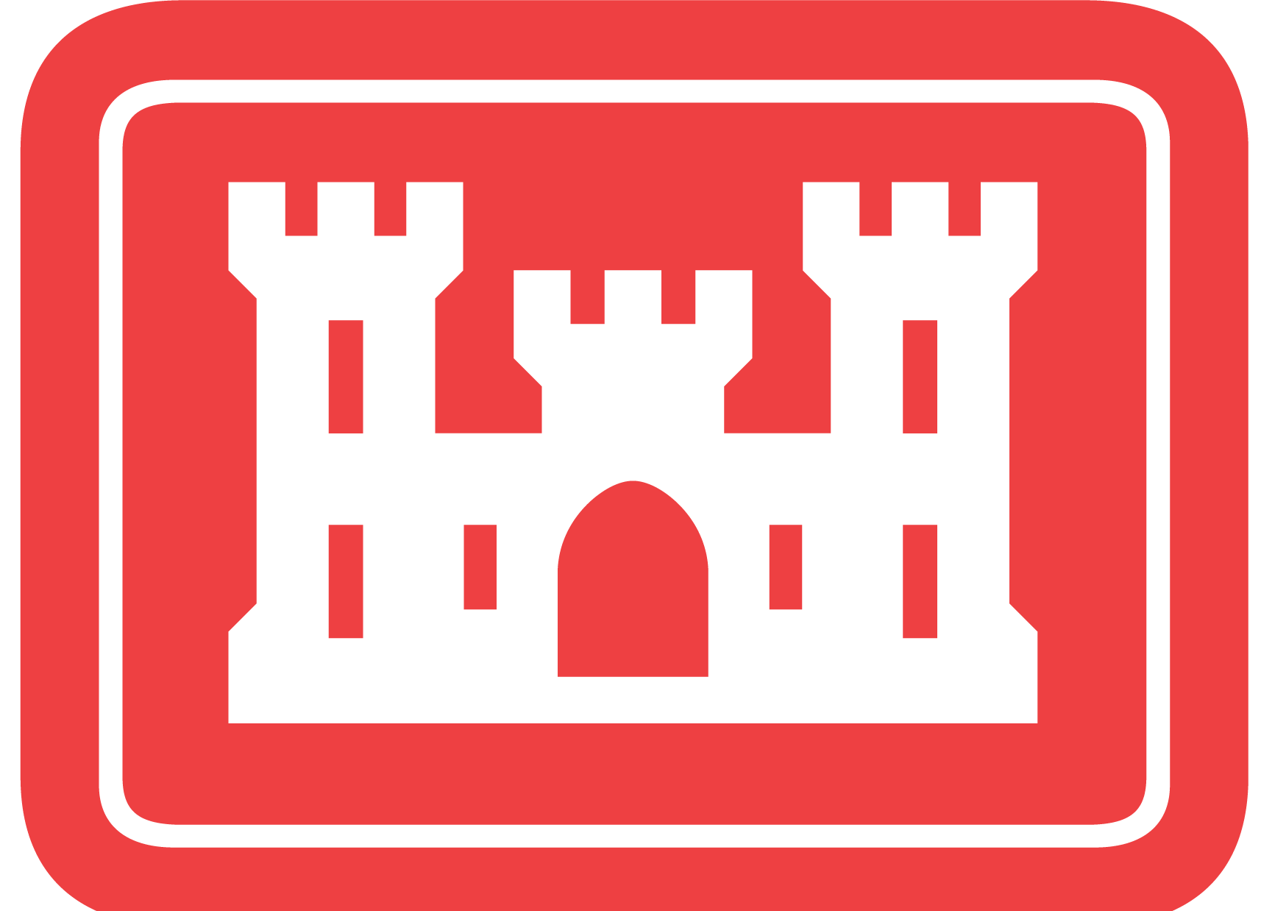
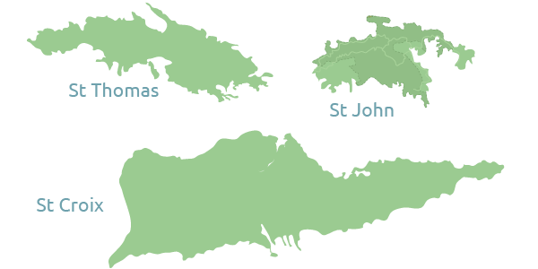
WHAT IS TASK FORCE VIPR?
PROGRAM VALUE IN EXCESS OF $6B
PUERTO RICO
TASK FORCE VIPR:
Responsible for all Civil Works and some Infrastructure Support for Others
Serves as Point of Contact for USACE (One Door to the Corps)
Responsible for all USACE Construction
Stakeholder Coordination and Integration
CIVIL WORKS & PUBLIC INFRASTRUCTURE
MILITARY & WORK FOR OTHERS
USVI
(Multiple MIL Projects in San Juan Area)
Notes:
CG: Speak to massive mission set in Puerto Rico, unprecedented funding, critical need to get flood risk measures in place ASAP.
Stand up of TF VIPR to provide focused leadership for CW and one door to the Corps for the islands. VIPR will oversee all construction.

Slide 6
POTENTIAL INDUSTRY OPPORTUNITIES
PUERTO RICO
RIO PUERTO NUEVO $1.585B
RIO DE LA PLATA $485M
RIO GRANDE DE ARECIBO $174M
RIO CULEBRINAS $40M
RIO GRANDE DE MANATI $14.8M
SAN JUAN HARBOR $45.6M
CANO MARTIN PENA $163.3M
RIO GUAYANILLA $60.6/220M
RIO GUANAJIBO $107M
RIO NIGUA AT SALINAS $47.8M
GUAJATACA DAM* $1B
SAVAN GUT $90M
TURPENTINE RUN $45M
ESTATE LAGRANGE $10M
USVI
* Original approved costs, updates not releaseable at this time.
Notes:
Highlighted in yellow are the potential opportunities within the VIPR workload.
The following slides talk about a few of these

Slide 7
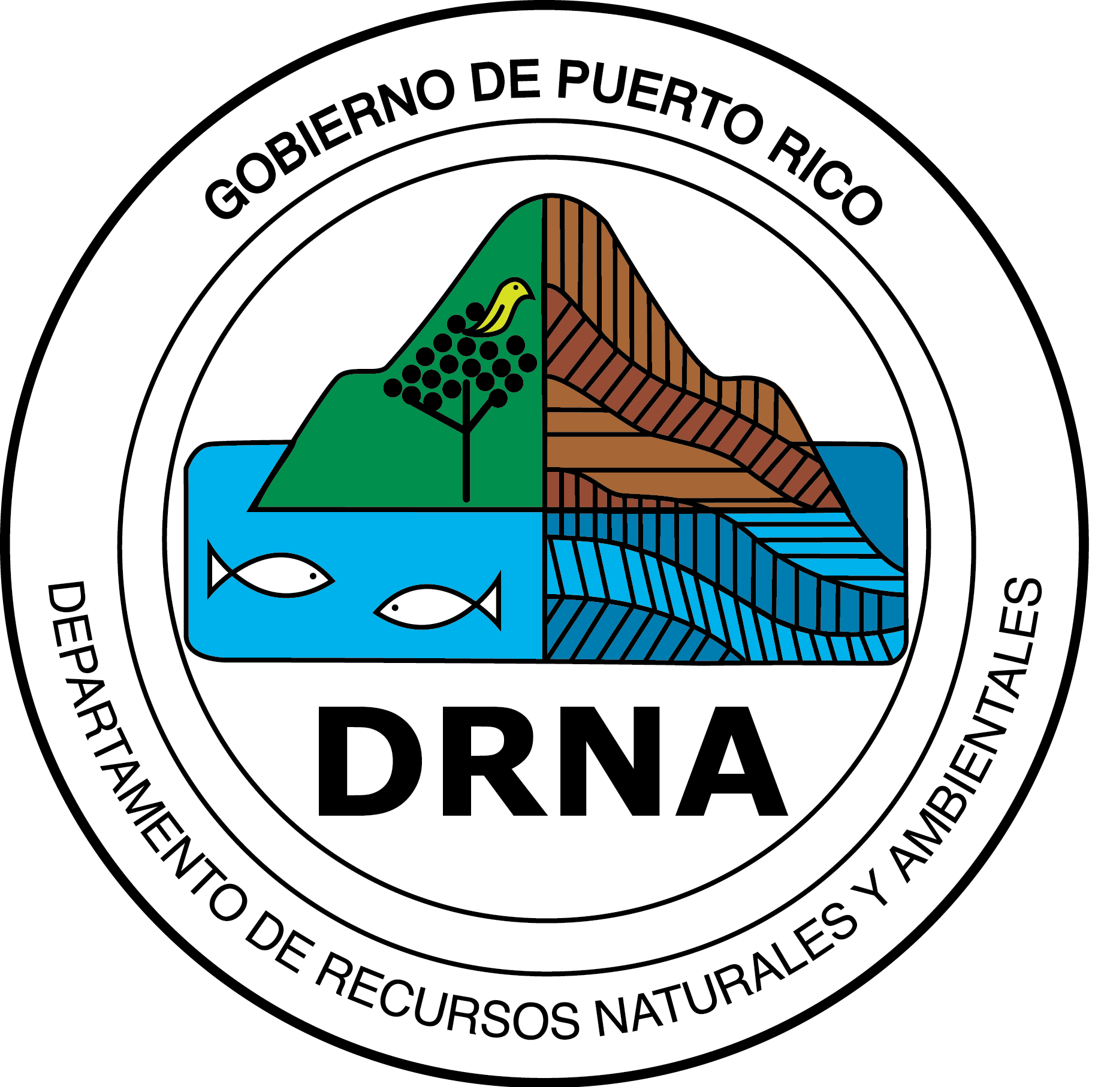
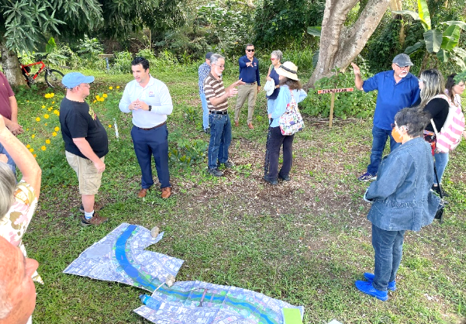
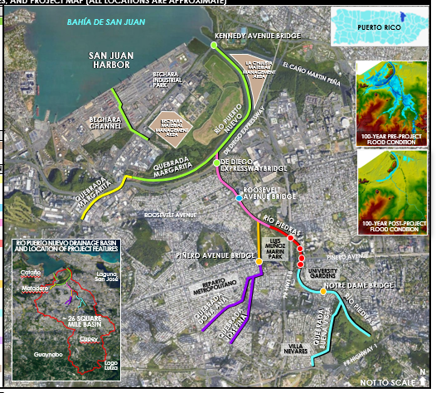
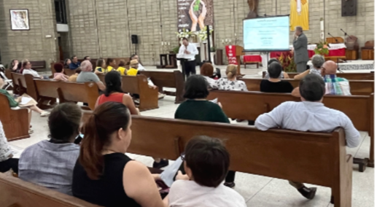
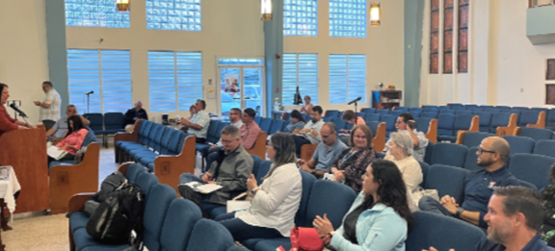
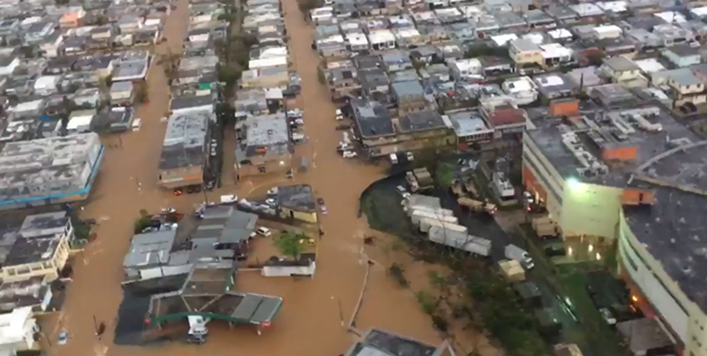
Rio Puerto Nuevo
Flood Risk Management Project
Project Implementation
CNT- La Chuleta MMA
CNT-1: Upper Margarita Channel
CNT-2 : Roosevelt Bridge
CNT-3: Main Channel (Rio Piedras)
CNT-4: Las Americas Bridges
CNT-5: Notre Dame & W. Piñero Bridge
CNT-6: Main Channel / Buena Vista
CNT-7: Josefina & Doña Ana Channel
CNT-Bechara MMA
Currently Funded at
$1.6 Billion
Funding (Remaining Project)
100% Funded Under The Bipartisan Budget Act Of 2018 Addressing Damages From Hurricanes Harvey,
Irma, And Maria
*Pending certified costs
Notes:
Contract 2 and 3 FY24

Slide 8



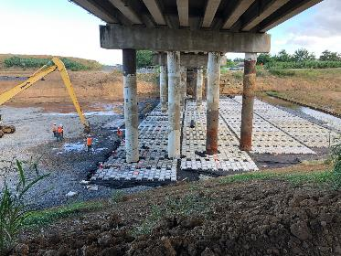
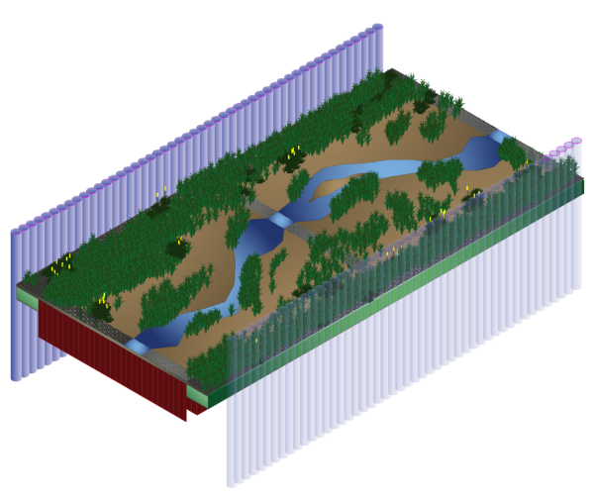
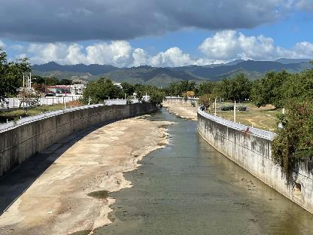
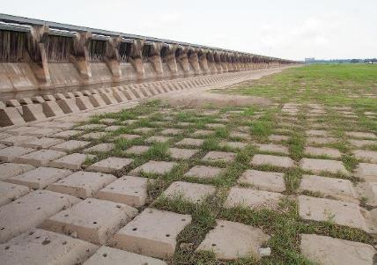
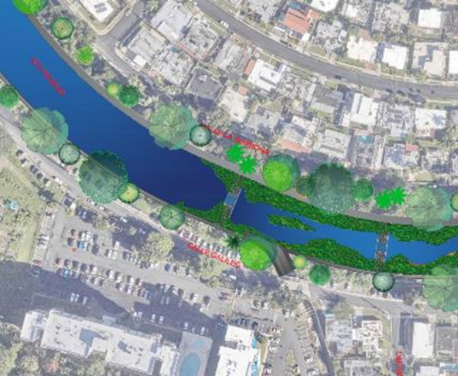
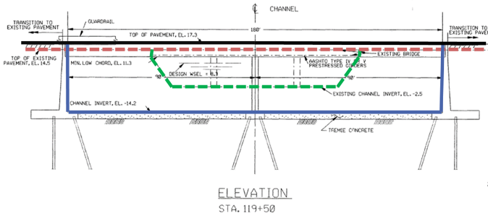
INNOVATION, INNOVATION, INNOVATION
Articulated Concrete Block Mattress Channel Bottom
U-Frame Concrete Channel Bottom
Grade Control/Natural Channel Bottom
University Gardens Area
Area adjacent to Dona Ana & Josefina Channel
OLD DESIGN 1991
DESIGN UPDATE 2021-2022
NEW DESIGN - 2023

Slide 9
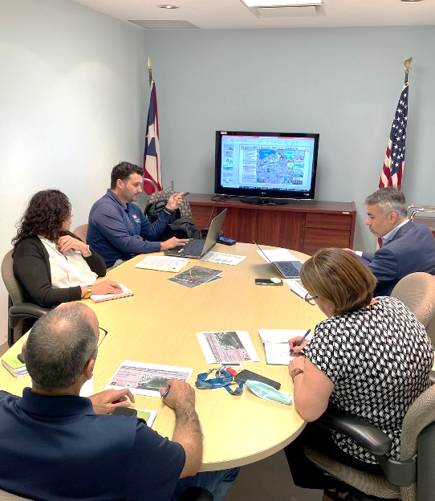
CONTRACTING
>51 Actions currently in pre-award phase
    19 A/E
      Initial efforts have relied on MATOC
    27 Construction
    5 Other
27 Industry days are planed for projects in 2024
VIPR Contracting Division is COMMITTED to thorough market research and will reach out to industry through SAM. Gov to solicit routine feedback on many facets of the program
We are working toward a projected requirement tracker posted on SAM.Gov for awareness
Notes:
TF VIPR is growing with it’s program and is constantly exploring new methods of soliciting and executing work. We have put in place several vehicles in order to support the mission as it navigates these critical early stages of growth. As the program progresses we anticipate maintaining constant communication with industry both with the vendors on existing vehicles as well as the community at large. We are committed to receiving this critical feedback in order to ensure we are taking the most advantage of innovation and resources available to us. We do anticipate there will be many opportunities in the coming 1-3 years to work with the Government and other industry partners in support of the VIPR mission.

Slide 10
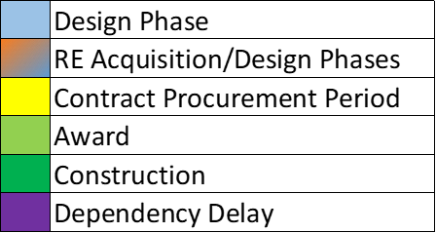
Puerto rico integrated delivery schedule
Schedule updates in progress

Slide 11
Other contracts forecast
Related Contract | Contract Action | Forecast Award
Rio de La Plata - SUPP - CNT 1 | West Bank Riverbed Delineation Survey Award [MS] | 2-Jan-24
Turpentine Run - St. Thomas | AE Design Contract Award [MS] | 31-Jan-24
Rio Guayanilla | Aerial (LiDAR and Imagery) Survey Award [MS] | 31-Jan-24
Cano Martin Pena - CNT 3 Ph 1 | Excavated Materials Tech Services Award [MS] | 31-Jan-24
Rio Guayanilla | FRS and Conventional Surveys Award [MS] | 16-Feb-24
Rio Puerto Nuevo -Bechara MMA | Bechara Design Environmental Assessment Award [MS] | 29-Feb-24
Rio Culebrinas | 2024 Geotech Contract Award [MS] | 29-Mar-24
Rio Puerto Nuevo -Bechara MMA | Bechara Design AE Contract Award [MS] | 3-Apr-24
Rio Grande de Arecibo - CNT 1 | Elec Support AE Contract Award [MS] | 11-Apr-24
Rio Guayanilla | Subsurface Contract Award [MS] | 29-Apr-24
Rio Puerto Nuevo | Landscape Architect Award [MS] | 3-May-24
Cano Martin Pena - CNT 3 Ph 1 | AE Design Contract Award [MS] | 28-Jun-24
Rio Grande de Arecibo - CNT 2 | Geotech Support Contract Awd [MS] | 28-Jun-24
Rio Culebrinas | Cultural Resources Contract Award [MS] | 28-Jun-24
Rio Grande de Arecibo - CNT 1 | Cultural Resources Contract Award [MS] | 10-Jul-24
Estate Lagrange | AE Design Contract Award [MS] | 31-Oct-24

Slide 12
OTHER POTENTIAL CONTRACT OPPORTUNITIES
Project Management Support Services
  Scheduling
  Data Management
  Visualization
Public Outreach and Communications
Technical Services
  Surveying
  Lidar
  Geotechnical
  Environmental
  Cultural

Slide 13

THANK YOU!
STAY INFORMED:
https://www.saj.usace.army.mil/TASK-FORCE-VIPR/
ONE TEAM – be part of it!

Slide 14
PROJECT SLIDES

Slide 15
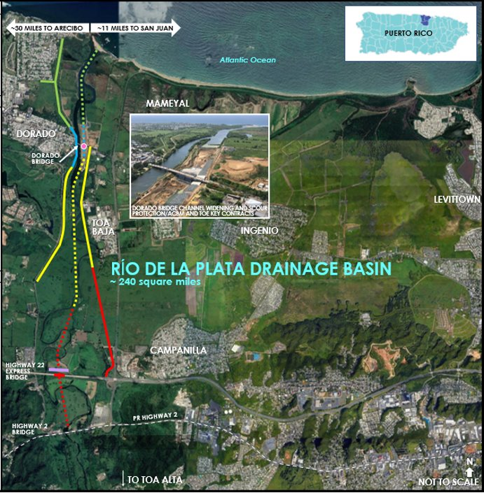
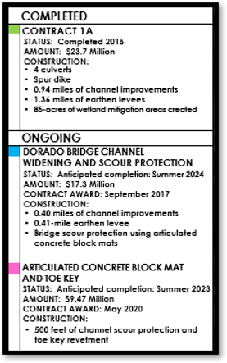
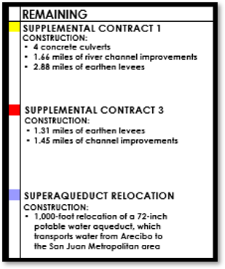
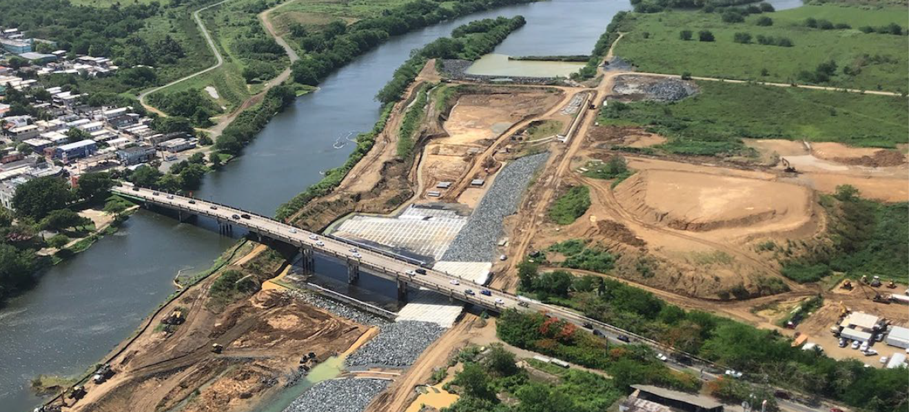
RÍO DE LA PLATA
Flood Risk Management Project
Notes:
Contract 1 FY24

Slide 16
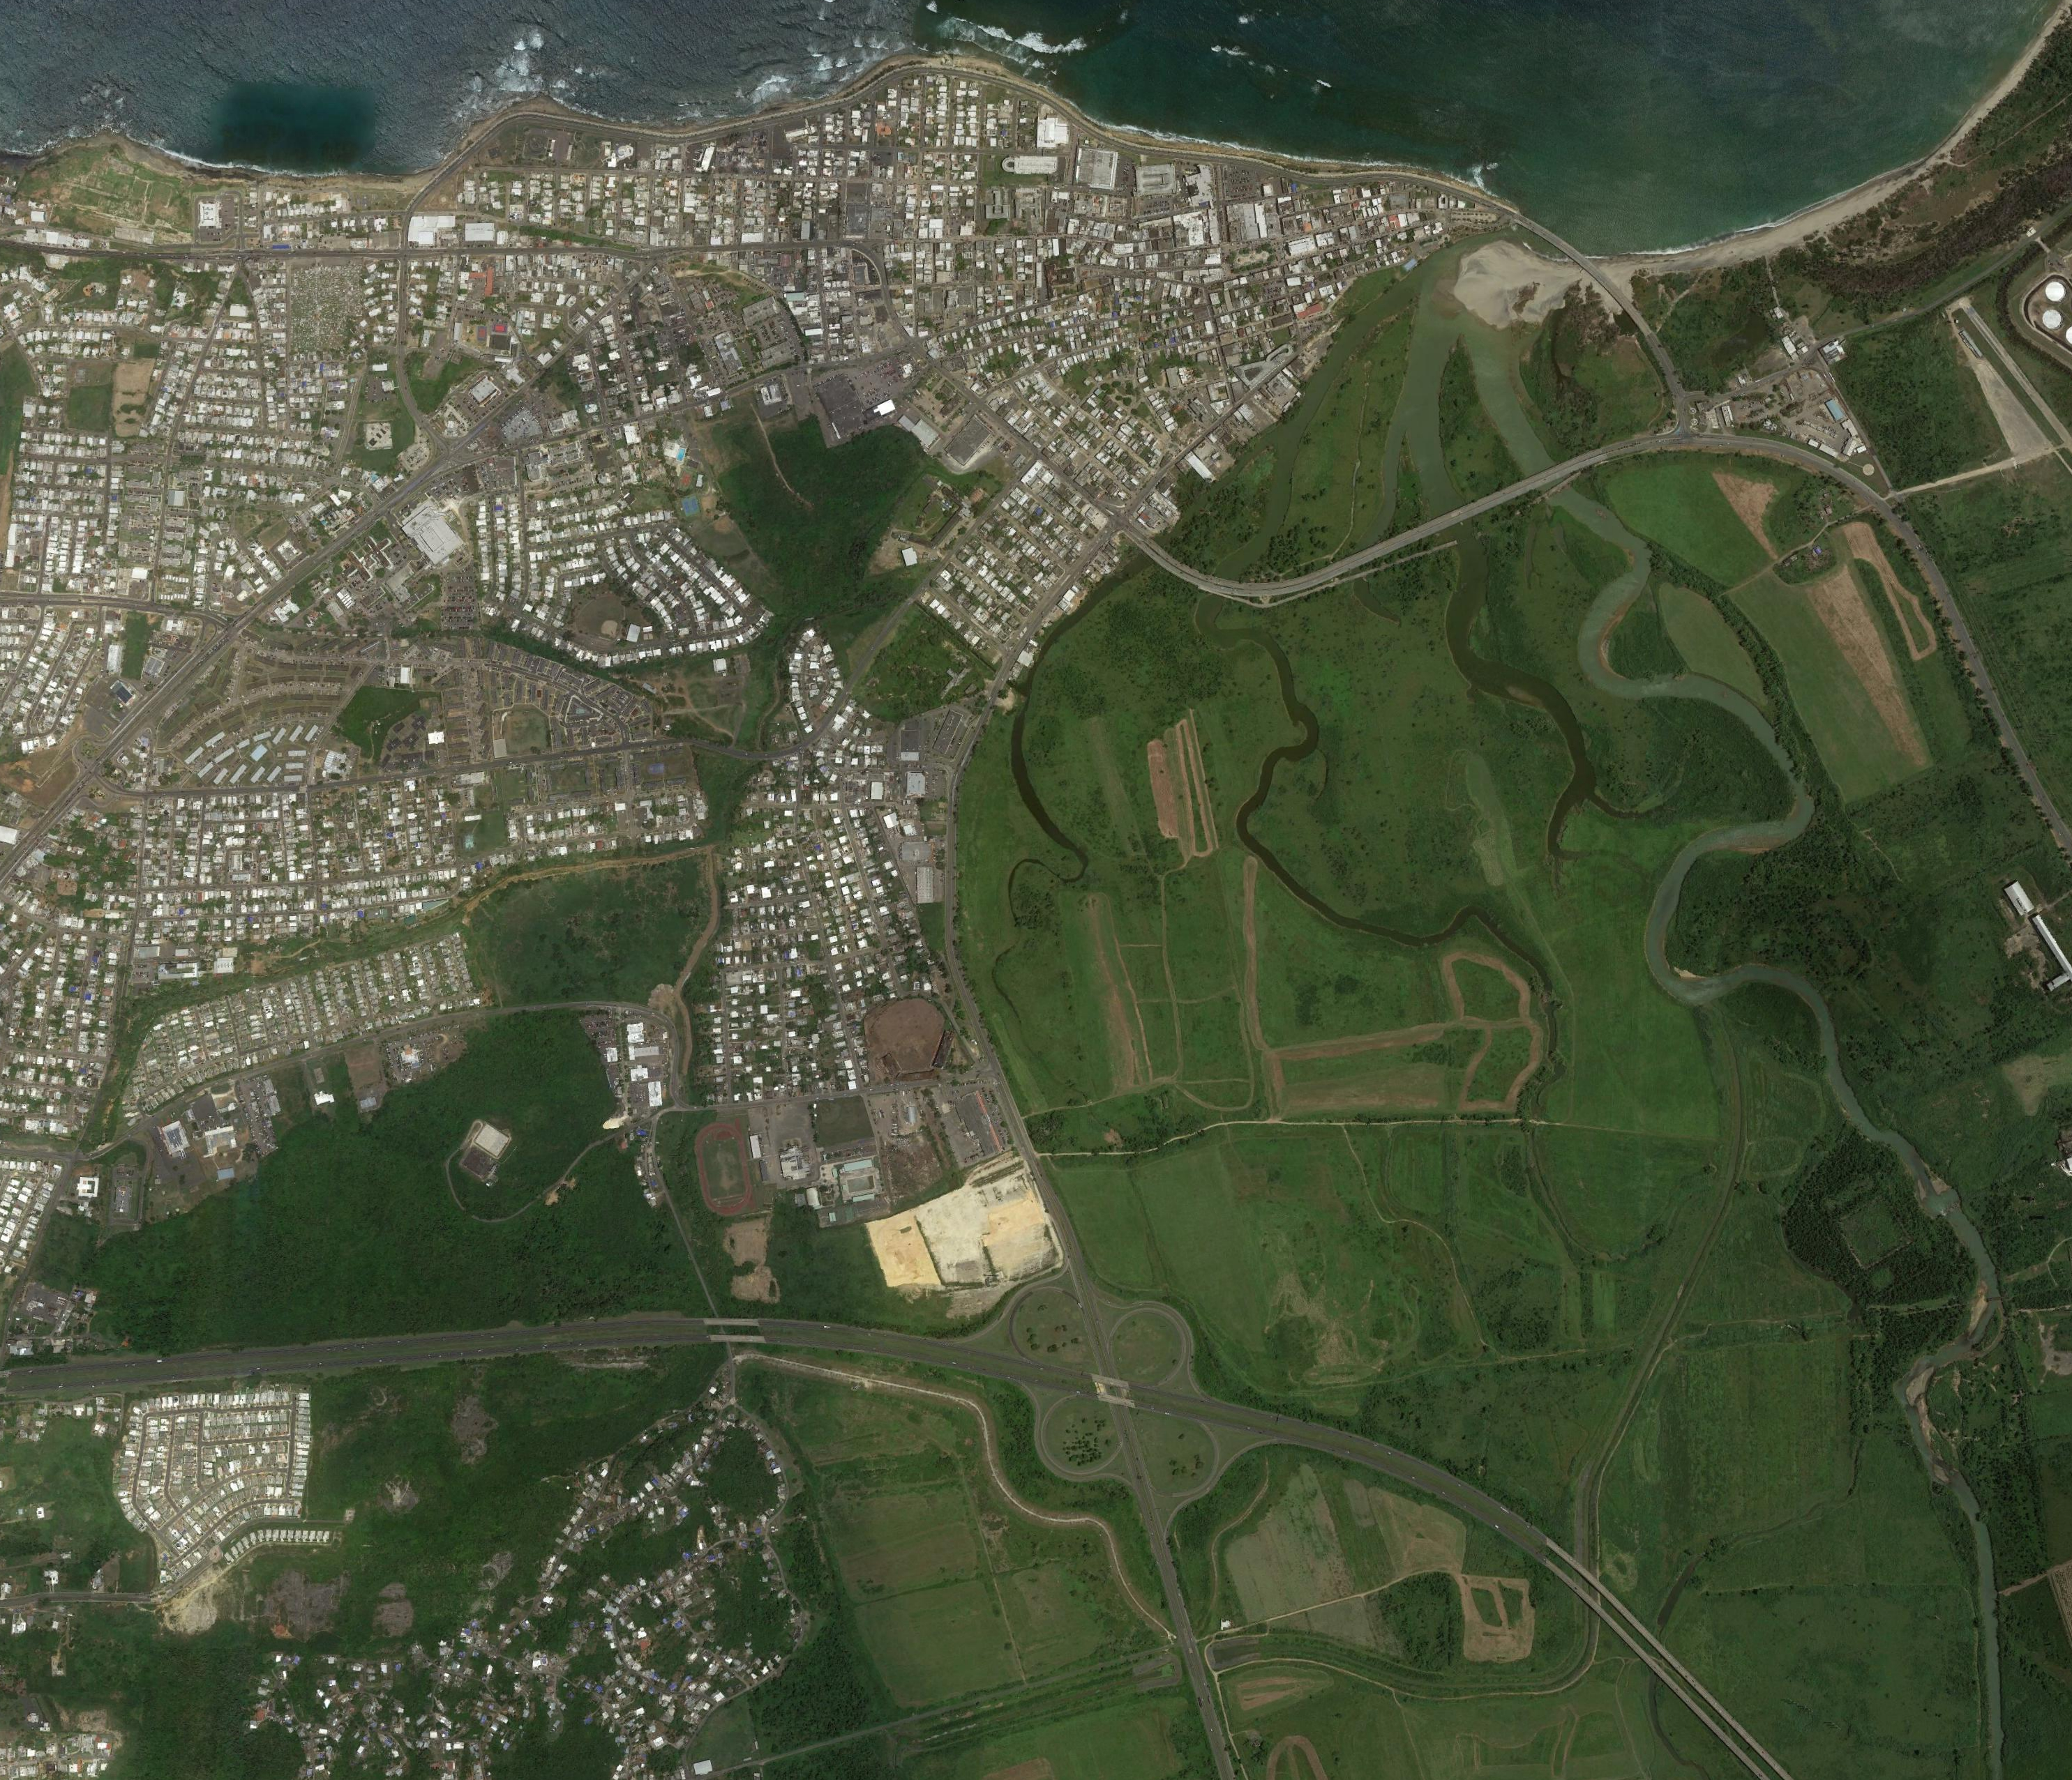
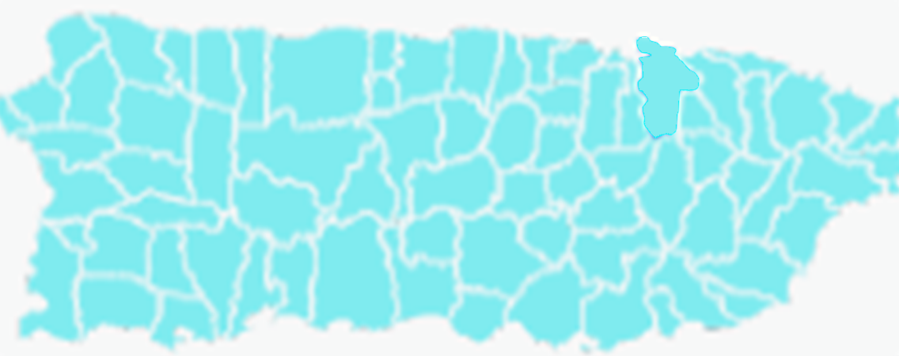
RÍO GRANDE DE ARECIBO
Flood Risk Management Project
Arecibo
~ 29 MILES TO SAN JUAN
PUERTO RICO
COMPLETED
CONTRACTS
Contract 1
  Rio Santiago Diversion Channel
  Rio Tanama Levee & Channel Improvements
  South PR-22 Levee
  PR-10 Culvert
Disposal Area
Dorado Bridge
PR-2
East Levee
PR-10
ON-GOING
SUPPLEMENTAL CONTRACTS
Contract 1: Levee Construction and Flood
Contract 2: Santiago River Channel Improvements
Contract 3: Concrete channel and outflow culvert (A/E services required)
West Levee
PR HWY-2
Channel
PR-2 Bridge and Road Re-alignment
Channel
Disposal Area
Channel
PR-22 BRIDGE
RÍO SANTIAGO
DIVERSION CHANNEL
East Levee
PR-22
72” Water
Line
PR HWY-22
Disposal
Area
SOUTH
PR-22
LEVEE
REFER TO INSET FOR LOCATIONS OF
RÍO TANAMÁ LEVEE/CHANNEL IMPROVEMENTS
N
~ 2,000 FEET

Slide 17
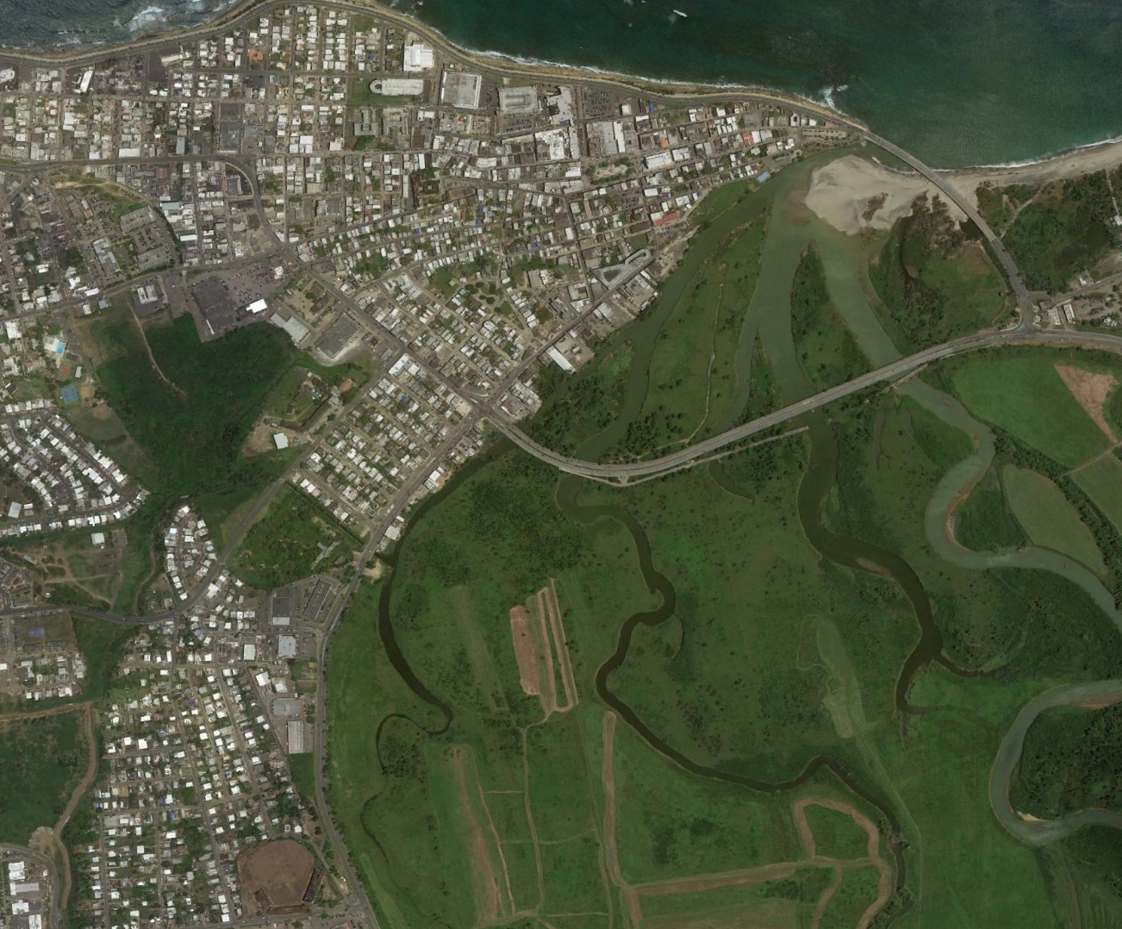
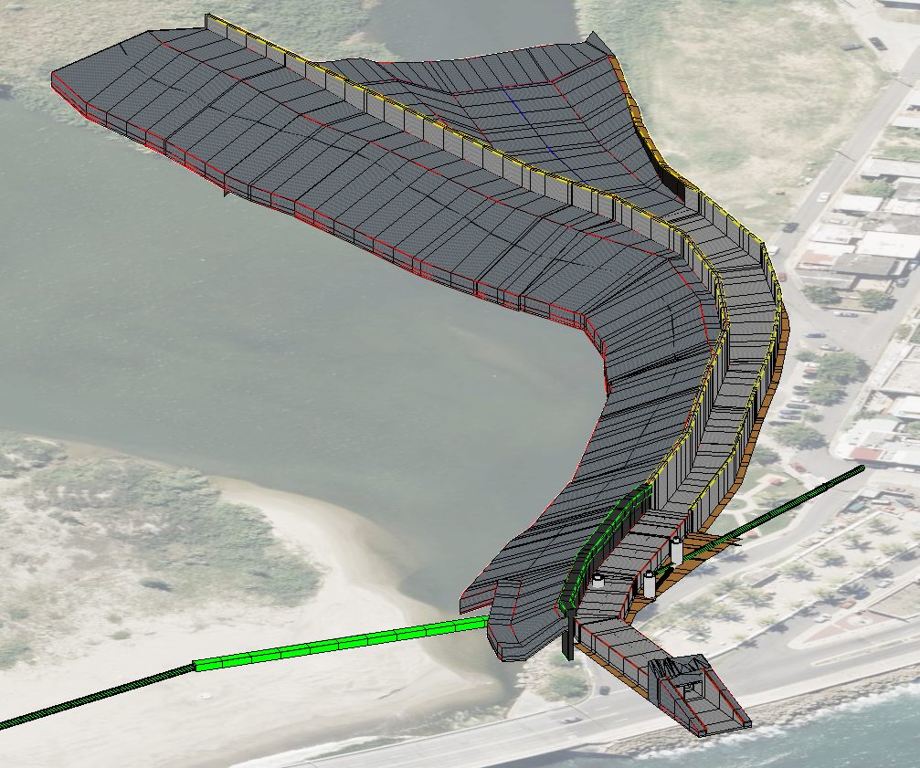
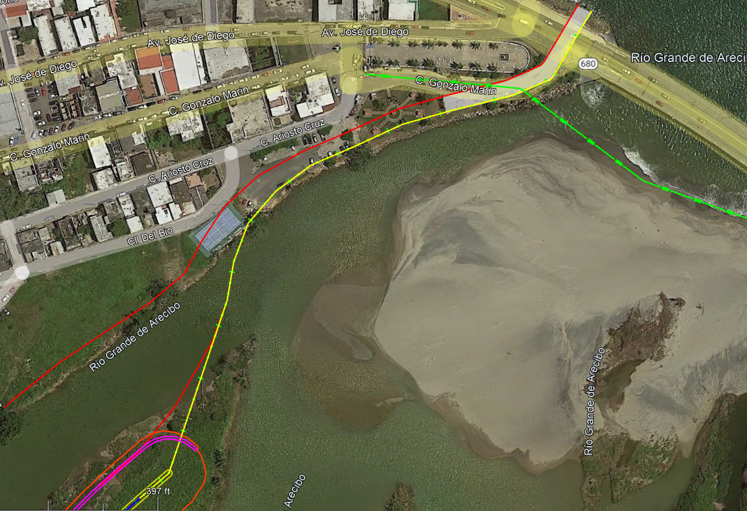
RÍO GRANDE DE ARECIBO
Contract 3: Concrete U-channel and Culvert
Arecibo
CNT-3 ENGINEERING FEATURES
Concrete U-Channel
Culvert Under Bridge
Downstream Floodwall
Sewer Siphon
PR-2
PR-10
CULVERT
UNDER
BRIDGE
CONCRETE U-CHANNEL
SEWER
SIPHON
DOWNSTREAM
FLOODWALL
CNT-3 u-channel bypass
3d MODEL Representation
Potential A/E award mid-end 2024 (MATOC)
Notes:
A/E Services expected to be awarded between mid to late 2024

Slide 18

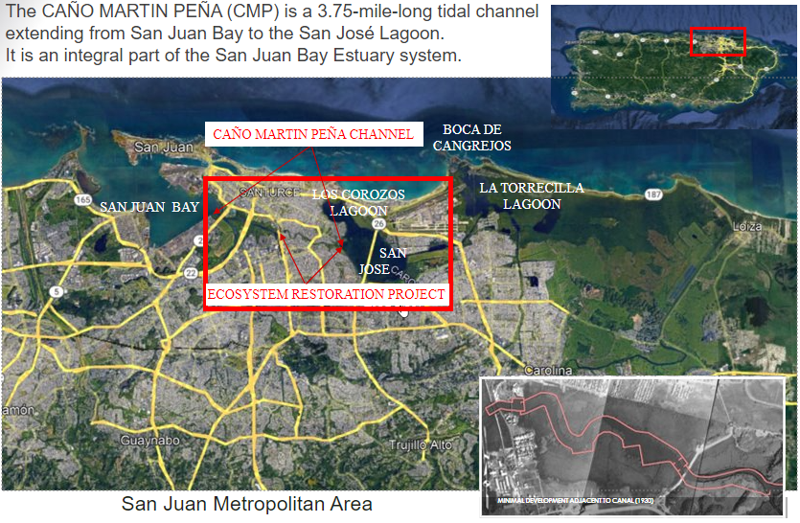
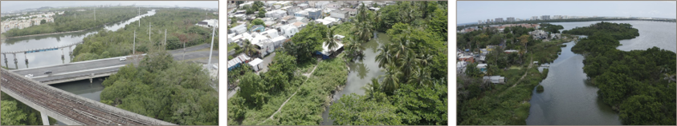
CAÑO MARTIN PEÑA (CMP)
Ecosystem Restoration Project
  The CAÑO MARTIN PEÑA (CMP) is a 3.75-mile-long tidal channel extending from San Juan Bay to the San José Lagoon.
  It is an integral part of the San Juan Bay Estuary system.
Notes:
Ctr 2 FY24

Slide 19
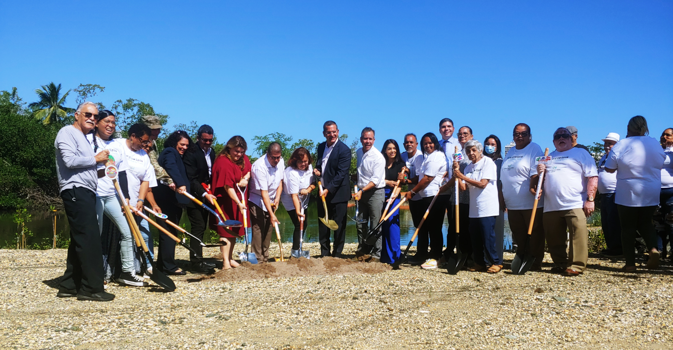
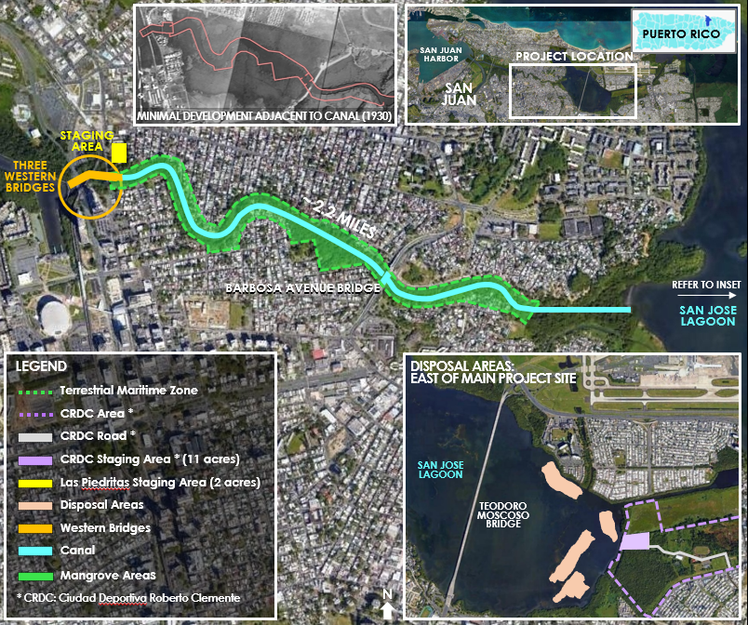
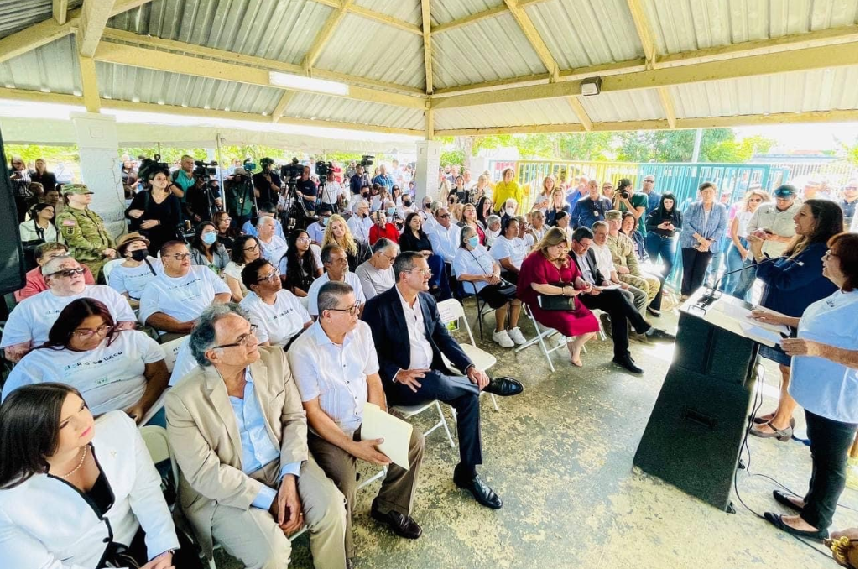
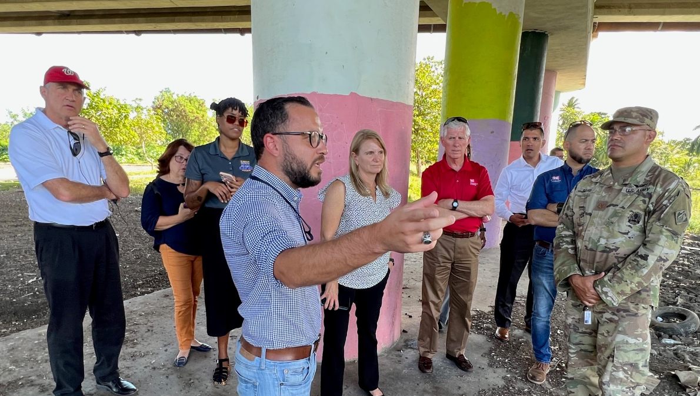
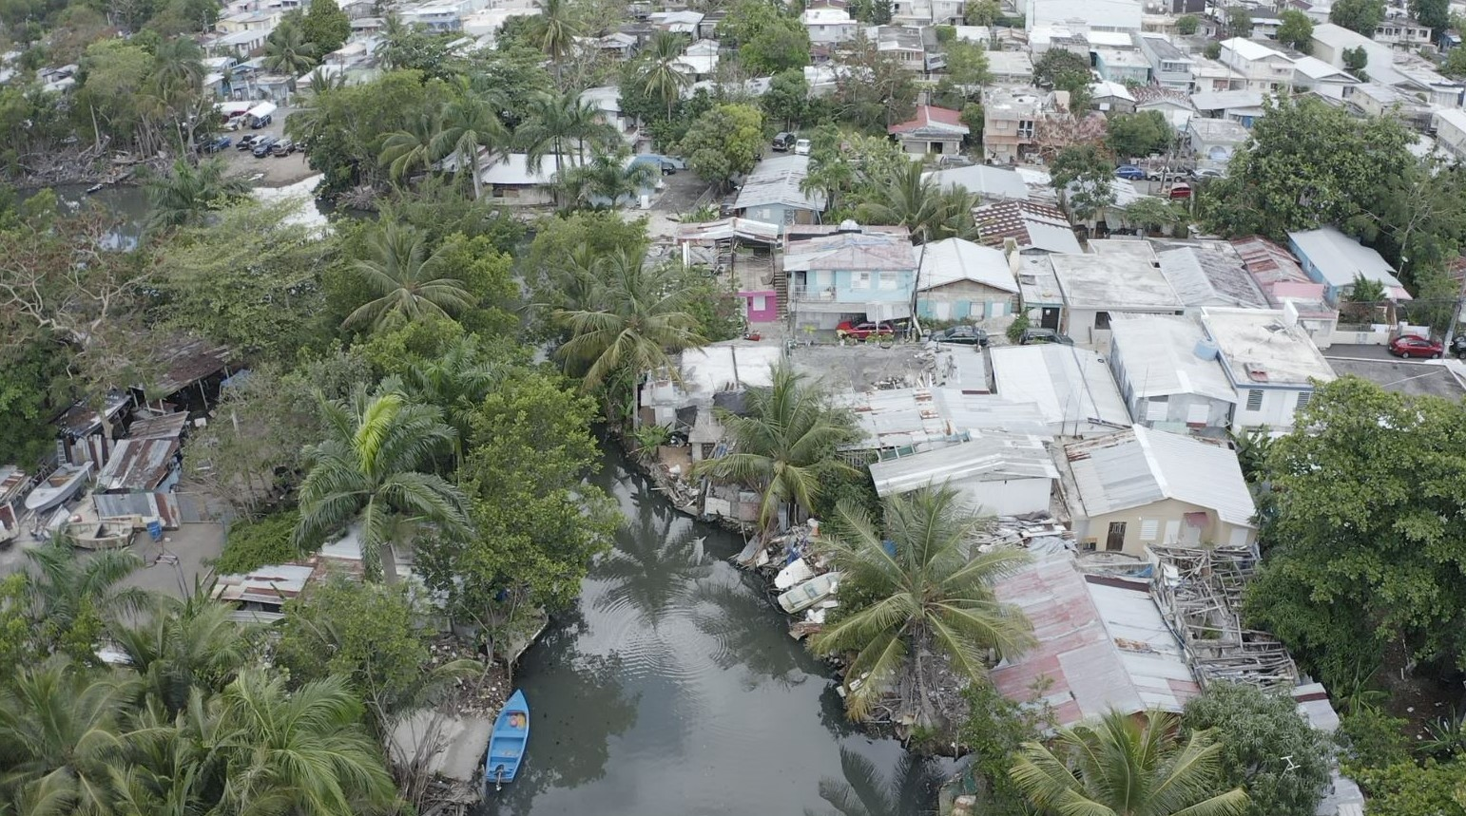
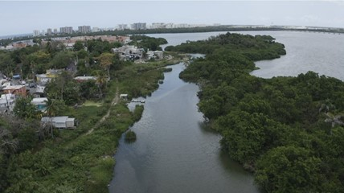
CAÑO MARTIN PEÑA (CMP)
Ecosystem Restoration Project
Project Implementation
Contract 1 Vegetation Removal
Contract 2 Western Bridges Scour Protection
Contract 3 Channel Excavation:
  2.5 miles channel dredging (~550K CY from main channel & ~ 190K CY from transition channel to the San Jose Lagoon)​
  2 miles access channel dredging from staging area to eastern end of CMP (~ 268K CY) ​
  Bank stabilization to include sheet pile​
  Barbosa Bridge scour protection ​
  ~ 35 acres Mangrove/wetland restoration for entire channel​
  Recreation features​
Notes:
Ctr 2 FY24

Slide 20
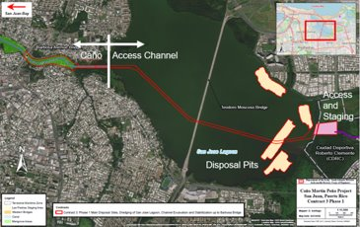
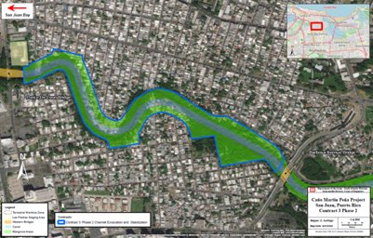
CAÑO MARTIN PEÑA (CMP)
Contract 3: Channel Excavation and Stabilization
Channel Improvement
  Dredging of 1-mile-long channel (100 ft x 10 ft)
  Steel sheet pile walls with concrete cap (40 ft deep)
  Scour protection for Barbosa Bridge (riprap)
Disposal Pits
  To receive unsuitable dredged material
Access Channel Construction
  Dredging
  Moscoso Bridge Piers will be protected
Magnitude of Construction: $100M to $250M
Channel Improvement
  Dredging of 1.2 miles long channel (100 ft x 10 ft)
  Steel sheet pile walls with concrete cap (40 ft deep)
Mangrove/Wetland Restoration for Entire Channel
  35 acres
Recreation Features
Magnitude of Construction: $100M to $250M
A/E award expected mid 2024 (MATOC)
Notes:
Ctr 2 FY24

Slide 21

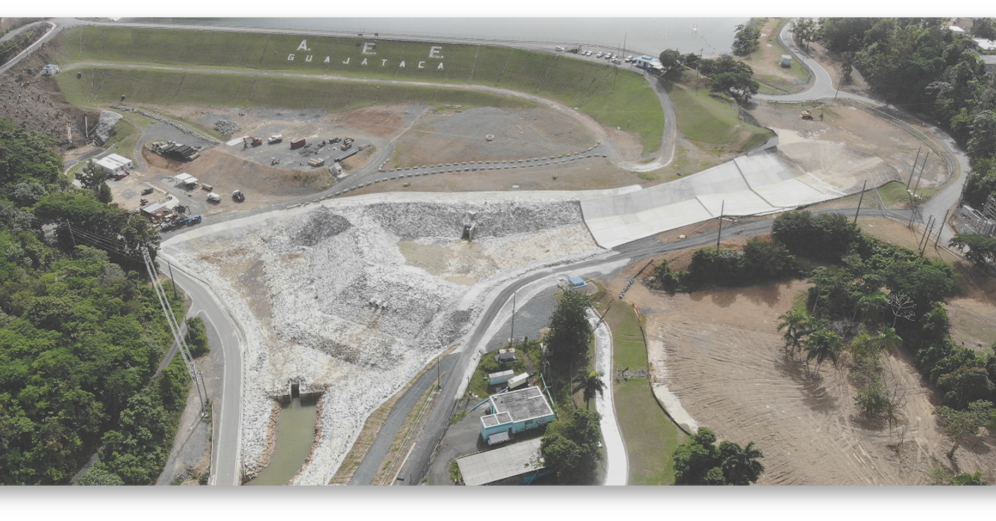
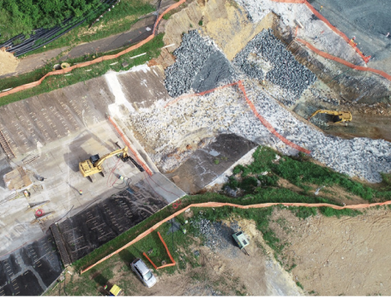
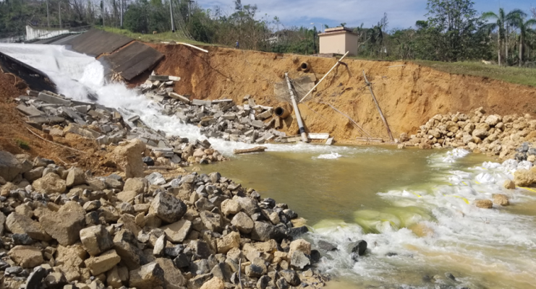
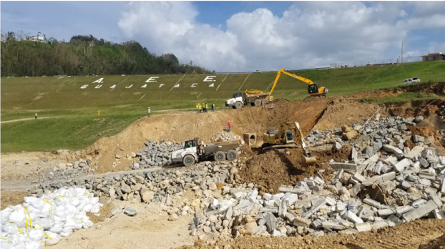
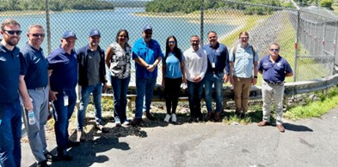
GUAJATACA DAM
Stage 3 Permanent Repairs
In Partnership with PREPA
Project Implementation
Phase I – Risk Assessment: Site-Specific Studies, Engineering Analyses, Alternatives Analysis, and Development.
Phase II – Design: Design Of Selected Project Features Required to meet Dam Safety Criteria.
Phase III – Construction: Construction Contract(s) Acquisition and Implementation.
Estimated Project Cost
$1 billion
*Public infrastructure for PREPA, pending updated costs
Funding (Remaining Project)
Project funded under FEMA Recovery Efforts
Funds already granted for Phase I and II efforts.
PREPA to fund up front and then reimbursed by FEMA for Phase III efforts
Potential Needs ~2025

