Slide 1
Sharon Krock, F.SAME
President-Elect
Schnabel Engineering
Notes:
Recognize Planning Committee

Slide 2
SAME - We're more than our name!

Slide 3
Society of American Military Engineers
Mission: To build leaders and lead collaboration among government and industry to develop multidisciplined solutions to national security infrastructure challenges.
Our Enduring Purpose: “To promote solidarity and cooperation between engineers in civil and military life, to disseminate technical knowledge bearing upon progress in the art of war and the application of engineering science thereto, and to preserve and maintain the best standards and traditions of the profession, all in the interests of patriotism and national security.”

Slide 4
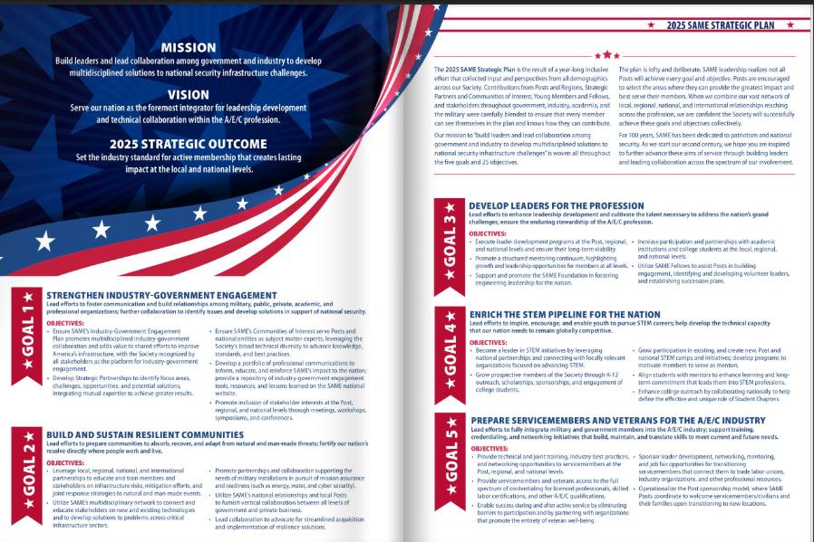
2025 Strategic Plan & Beyond

Slide 5
Recognizing Volunteer Leaders
Randy Tompkins – Vice President & Industry Day Chair
Ashley Greaves – Young Professional Chair, Networking Reception Lead
Stacie Weber – Membership Vice Chair, Industry Day Volunteer
Mike Holm – Golf Tournament Chair

Slide 6
Communities of Interest
18 COIs
Architectural Practice
Camps
College Outreach
Construction
Energy & Sustainability
Enlisted
Environmental
Facility Asset Management
Joint Engineer Contingency Operations
Leader Development
Membership
Resilience
Small Business
STEM Outreach
Young Professionals
Others: Geospatial WG, Health Engineering TF, Marketing/BD WG
Notes:
With the infrastructure stimulus bill, our nation will see extensive investments to advance our built environment. Our Architecture, Engineering and Construction Profession will play a big part in executing these programs. With that, come many challenges. We heard throughout JETC from our Service leaders about the challenges of building better, collaborative transparency, shortage of skilled worker, cyber risks, just to name a few. Our strategic partners, members (military and private sector) and industry COUNT ON US to lead collaboration to strengthen our National Security.
(IGE) remains “mission-essential” for our organization and as the first goal of the Society’s 2025 SAME Strategic Plan --- so that will be our top priority this year – fostering Industry-Government Engagement with an added emphasis on the local posts.

Slide 7

STEM Camps
Start Your STEM Journey
Jacksonville SAME/NAVFAC SE Camp starting this summer!

Slide 8



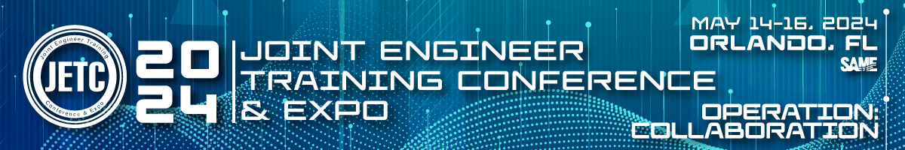
Upcoming!

