Slide 1

Office of Construction & Facilities Management
VA
Office of Construction
and Facilities Management
Jacksonville, FL
January 10, 2024

Slide 2
VA Leasing Opportunities
Dr. Katrina Baptiste, Department of Veterans Affairs, Office of Construction & Facilities Management / Office of Real Property

Slide 3
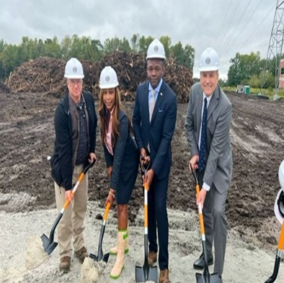
Speaker
Katrina Baptiste, Ph.D.
Sports Teams: New Orleans Saints
Vacation Spots: Anywhere with clear blue water
Did you Know: I was an Army Ordnance Officer
Hobbies: Gardening, Cooking, and trying new red wines

Slide 4
Overview
Mission and Purpose
Program Overview
Small Business Information
  Public Law (PL) 109-461 aka “Veterans First”
  Types of Procurements acquired by ORP
  Opportunities

Slide 5
CFM Mission
Advance VA’s mission in support of our Nation’s Veterans by planning, designing, constructing and acquiring major facilities, and setting design and construction standards.
ORP Mission and Purpose
Advance VA's mission by acquiring and disposing of land and acquiring leasing space for the construction of medical of land and leased space for medical facilities.
“The Office of Construction & Facilities Management (CFM) is responsible for the planning, design, and construction of all major construction projects greater than $20 million. In addition, CFM acquires real property for use by VA elements through the purchase of land and buildings, as well as long-term lease acquisitions. Through the construction and real property programs, CFM delivers to Veterans, high quality buildings, additions, large scale renovations, and structural enhancements. CFM also manages facility sustainability, seismic corrections, physical security, and historic preservation of VA’s facilities.”

Slide 6
Mid Level/Major Level Lease Thresholds
Mid Level Lease Leases: (Leases between $1,000,000 and $3,159,999 in annual unserviced rent.
Major Level Leases: ( Any leases above $3,160,000 in annual unserviced rent.) PACT ACT has changed the definition to some of these terms.

Slide 7
Public Law (PL) 109-461
On December 22, 2006, President Bush signed Public Law (PL) 109-461, the Veterans Benefits, Health Care, and Information Technology Act of 2006. Title V, Specifically Sections 502 and 503 apply to VA acquisitions.
Effective June 20, 2007, this legislation authorizes a unique “Veterans First” approach specific to VA contracting. This approach changes the priorities for contracting preferences within VA, placing SDVOSBs and VOSBs first and second, respectively, in satisfying VA’s acquisition requirements.

Slide 8
What Does ORP Procure?
Construction of Medical Facilities
In addition to procurement, ORP is involved with intergovernmental transfers, and the granting of easements, licenses, and permits. ( This is handled by our Land and Utilization Team)
It also provides guidance to regional and local VA offices regarding real property.

Slide 9
Types of Procurements Issued or Administered by ORP
Indefinite delivery/indefinite quantity (IDIQ) (Administer CO for Broker and A&E contracts)
Commercial Items (CI)
Minor leases (Seldom)
Sole Source (based on specific requirements)

Slide 10
PACT Act
PACT Act, enacted August 10, 2022
1. Sections 702-707 of the Act provides resourcing to enable and fund leases and other agreements to accomplish VA’s mission.
Specifically authorizes leasing (in addition to planning, design, or construction) of a shared medical facility with DoD*
Sec. 704 addresses Academic Affiliates and other (covered) entities
2. Authorizes Secretary to enter into leases with academic affiliates to acquire space for the purpose of providing health-care resources to Veterans notwithstanding competitive procedures (i.e., sole source )
*This law authorized 31 leases a crossed 19 states.

Slide 11
Small Business Goals & Utilization
FY22/23
Business Type | ORP and 8 VISNs in VHA combined
 | Award SB Dollars | # of Actions | % SB | Target
8(a) | 0 | 0 | 0.00% | 0.00%
HUBZone | 424,570,325.22 | 5 | 10.41% | 3.00%
SDB | $121,092,062.68 | 3 | 46.35% | 25.00%
SDVOSB | $721,361,850.10 | 101 | 104.73% | 70.00%
VOSB | $220,372,360.79 | 76 | 94.35% | 98.00%
WOSB | $68,939,830.05 | 15 | 8.42% | 5.00%
Small Business | $140,250,089.45 | 79 | 181.96% | 100.00%
Primary NAICS Code for Leasing 531120

Slide 12
How can SB, SDVOSB, VOSB assist with services needed?
Become Familiar with the Federal Acquisition Regulations/GSAR
Understand VA’s priority - Public Law (PL) 109-461 (Rule of two)
What is a SDVOSB or VOSB set-aside
Request for Lease Proposals
Due Diligence (Phase I,NEPA and CRS)
SAM.gov
PACT Model
Think Partnering/Teaming or Joint Venture
Understand the PACT ACT and the changes that applies

Slide 13
What is the “Rule of Two”?
Provides that “… a contracting officer of the Department shall award contracts” by restricting competition to Veteran-Owned Small Businesses if the officer reasonably expects that at least two such businesses “… will submit offers and that the award can be made at a fair and reasonable price that offers best value to the United States.” 38 U. S. C.§8127(d)
– Supreme Court of the United States, KINGDOMWARE TECHNOLOGIES, INC. v. UNITED STATES

Slide 14
52.219-73 VA Notice of Total Set-Aside for Verified Service-Disabled Veteran-Owned Small Businesses (Nov 2022)
Not less than 51 percent of which is owned by one or more service-disabled Veterans or, in the case of any publicly owned business, not less than 51 percent of the stock of which is owned by one or more service-disabled Veterans or eligible surviving spouses (see VAAR802.101, Surviving Spouse definition;
The management and daily business operations of which are controlled by service-disabled Veterans (or eligible surviving spouses) or in the case of a service-disabled Veteran with permanent and sever disability, the spouse or permanent caregiver of such Veteran;
(iii) The business meets Federal small business size standards for the applicable North American Industry Classification System (NAICS) code identified in the solicitation document;
(iv) The business has been verified for ownership and control pursuant to 38 CFR part 74 and is listed in U.S. Small Business Administration Veterans Small Business Certification (VetCert) database at https://veterans.certify.sba.gov/

Slide 15
52.219-74 VA Notice of Total Set-Aside for Verified Veteran-Owned Small Businesses (Nov 2022)
Not less than 51 percent of which is owned by one or more Veterans or, in the case of any publicly owned business, not less than 51 percent of the stock of which is owned by one or more Veteran(s)
The management and daily business operations of which are controlled by one or more Veteran(s);
(iii) The business meets Federal small business size standards for the applicable North American Industry Classification System (NAICS) code identified in the solicitation document;
(iv) The business has been verified for ownership and control pursuant to 38 CFR part 74 and is listed in U.S. Small Business Administration Veterans Small Business Certification (VetCert) database at https://veterans.certify.sba.gov/

Slide 16
Opportunities Forecast 2024
CFM – Office of Real Property (ORP)
Location | Proposed sized | New/Replacement
Cumberland County, PA | 218,708 | New
Sussex County, DE | 135,979 | Replacement
Southern New Jersey | 157,671 | Replacement
Charleston, SC Research | 139,953 | Replacement
Gainesville, FL | 188,418 | Replacement
Port Saint Lucie, FL | 119,009 | Replacement
New Orleans, LA RRTP | 97,743 | New
Conroe, TX OPC | 191,305 | Replacement
Conroe, TX CLC | 110,114 | Replacement
Katy, TX OPC | 146,088 | New

Slide 17
Opportunities Forecast 2024
CFM – Office of Real Property (ORP)
Location | Proposed sized | New/Replacement
Katy, TX CLC | 104,100 | New
Bangor, ME | 110,114 | Replacement
Keene, NH | 39,737 | Replacement
Burlington, VT | 39,737 | Replacement
New Albany, IN | 37,931 | Replacement
Columbia, TN | 48,794 | New
Bowling Green, KY | 41,337 | New
Junction City, KS | 25,000 | Replacement
Modesto, CA | 42,397 | Replacement
Murrieta, CA | 25,732 | New
Victorville, CA | 22,000 | New
San Diego, CA Research | 41,252 | Replacement

Slide 18
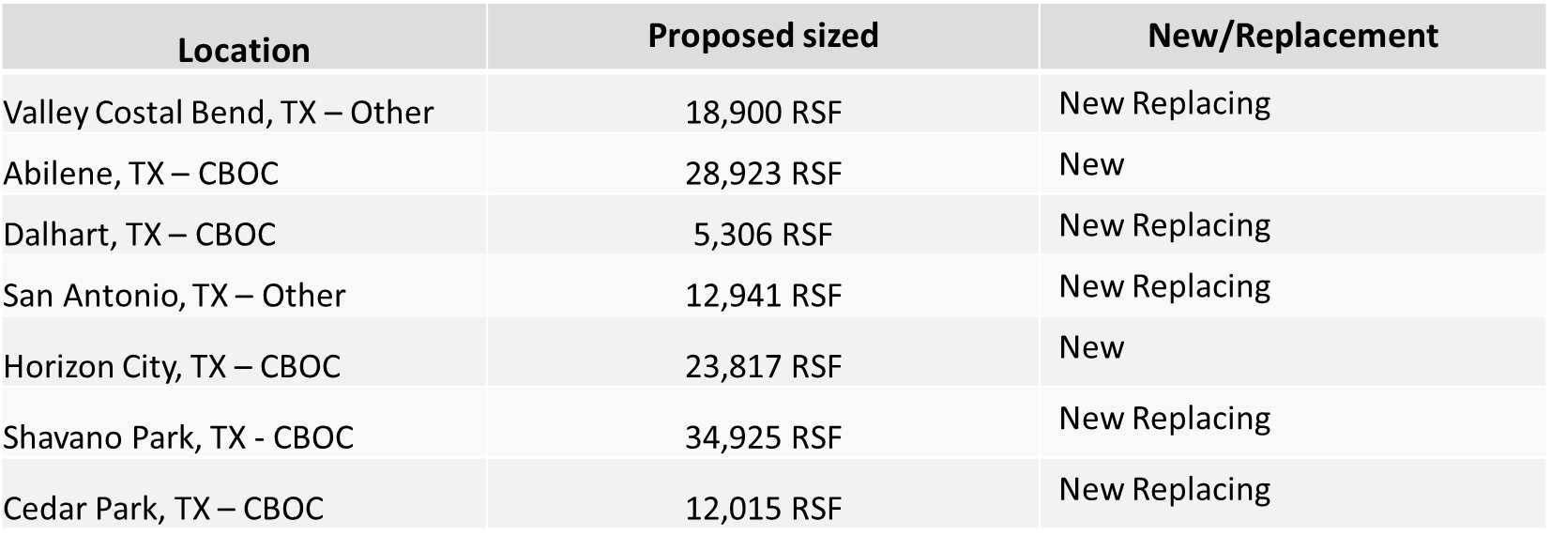
Leasing - TX
New – Lease with new terms and conditions and new lease contract number
New Replacing – Replace an existing expiring lease
Notes:
April 24, 2023
Dashboards are ready. Will demo on May 1st meeting.

Slide 19
Leasing – OK /CO /MT /ID
Location | Proposed sized | New/Replacement
OKC, OK - Other | 22,299 RSF | New
Norman, OK – CBOC | 20,535 RSF | New Replacing
Denver, CO – Other | 9,000 RSF | New Replacing
Miles City, MT – CLC | 18,000 RSF | New
Lewistown, MT – CBOC | 5,000 RSF | New Replacing
Boise, ID – Other | 20,875 RSF | New
New – Lease with new terms and conditions and new lease contract number
New Replacing – Replace an existing expiring lease
Notes:
April 24, 2023
Dashboards are ready. Will demo on May 1st meeting.

Slide 20
Leasing – NV /OR /WA /HI
Location | Proposed sized | New/Replacement
Reno, NV- East Campus CBOC | 15,000 RSF | New Replacing
Reno, NV- Other | 14,000 RSF | New Replacing
Carson Valley, NV- CBOC | 15,000 RSF | New Replacing
Eugene, OR – Other | 25,788 RSF | New Replacing
Grants Pass, OR – CBOC | 22,770 RSF | New Replacing
Mount Vernon, WA – CBOC | 18,340 RSF | New Replacing
Maui, HI- Other | 2-4 Acres | New
New – Lease with new terms and conditions and new lease contract number
New Replacing – Replace an existing expiring lease
Notes:
April 24, 2023
Dashboards are ready. Will demo on May 1st meeting.

Slide 21
Leasing – CA
Location | Proposed sized | New/Replacement
Murrieta, CA – CBOC | 25,732 RSF | New
Palm Desert, CA – CBOC | 29,000 RSF | New
Corona, CA – CBOC | 13,700 RSF | New
Rancho Cucamonga, CA – CBOC | 28,000 RSF | New
Victorville, CA – CBOC | 22,000 RSF | New
Gardena, CA – CBOC | 12,899 RSF | New
East Los Angeles, CA – CBOC | 13,963 RSF | New
Palo Alto, CA - Other | 385 Parking Spaces | New Replacing
New – Lease with new terms and conditions and new lease contract number
New Replacing – Replace an existing expiring lease
Notes:
April 24, 2023
Dashboards are ready. Will demo on May 1st meeting.

Slide 22
VA Opportunities - OFA
Andrew Page, Department of Veterans Affairs, Office of Construction & Facilities Management / Office of Facilities Acquisition

Slide 23
Office of Facilities Acquisition (OFA)
Responsible for acquisition and administration of procurements:
  Major construction,
  Architect - Engineer (AE),
  Support services – Construction Management, Lease Acquisition Support Services,
  Supporting VHA, NCA, and VBA
  Responsible for Major Construction Interagency Agreements
  FY23 $2.4B spend
  FY23 $151.3M spend to small businesses
Assists with construction procurements for other organizations (Minor and Non-reoccurring Maintenance projects - under $20M)
Promotes competition for small businesses (including Veterans First Program) in major construction, design, and support services:
  Over 66% of contract dollars awarded to SDVOSB/VOSBs in FY23
  Including Several Major Construction Projects
d) Promote Diversity, Equity, and Inclusion - host Women Owned Small Business Industry Day

Slide 24
OFA Top Priorities
Award and administer contracts for Veterans Health Administration, Veteran Benefits Administration, and National Cemetery Administration for Major construction projects and support services
Interagency Agreement with Non-Departmental Federal Entity
Increase Industry Engagement
  Seeking Feedback (Industry Days, Sources Sought, Targeted Outreach)
  Partnering
  Pathfinder – Vendor Management
Building capacity focused on speed and agility
  Category Management/Strategic Acquisition Vehicles
    Lease Acquisition Support Services IDIQ – FY22
    Construction Management Services IDIQ – FY22
    Cost Estimating – Planned award FY 23
    MASHO/VFT&HE – FY23
    A/E IDIQ contracts – Planned award FY24
    Design Build Multiple Award Contract – Planned award FY24
    Feasibility Studies – Planned award FY24
    A/E - Planned award FY24
  Socioeconomic Goals

Slide 25
Strategic Direction
Implementation of Design/Build Delivery methods
Increase industry engagement
Focus on Quality, Cost, and Schedule
Integrated Program/Project Management
Leveraging technology – for example Pathfinders
Process improvement focused on speed to market and agility
Implement Strategic Acquisition Vehicles – Category Management

Slide 26
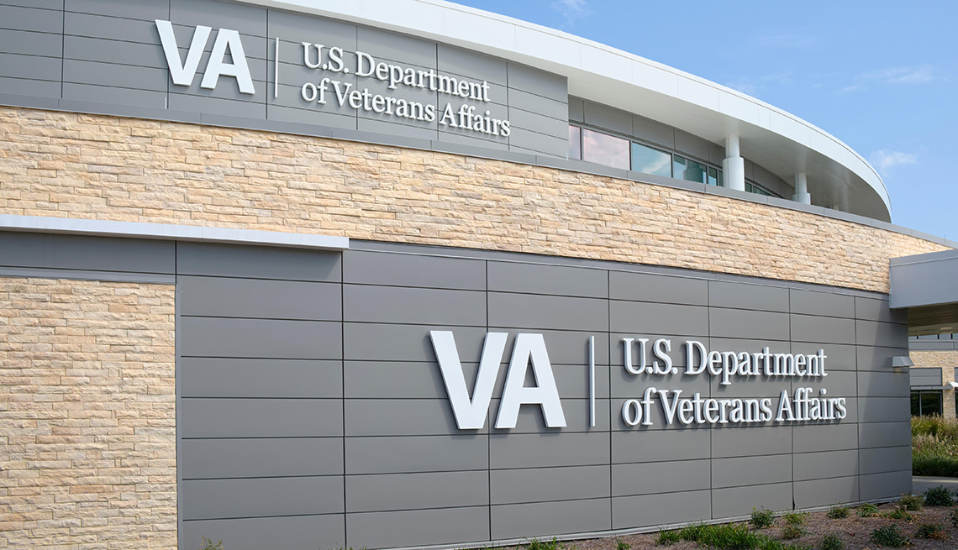
VA portfolio consists of over 8,000 facilities nationwide
Major Construction FY24
5 Major Construction healthcare projects valued at $2.4B
1 Chip-in Project at $221M
3 National Cemetery Administration (NCA) Major Construction projects valued over $170M
Minor Construction FY24
Veterans Health Administration (VHA)
450 Minor Construction projects valued at $5B
NCA Minor construction has 137 projects valued over $750M
5,113 NRM projects valued at $21.3B
20 Seismic Projects valued at $1.1B
CFM is managing 98 projects in planning, design, and construction valued at $12B.
VHA is managing 5,563 NRM and Minor projects in planning, design, and construction valued at $26.3B.
25 Super Construction projects (>$100M executed by the USACE valued at approximately $18B)

Slide 27
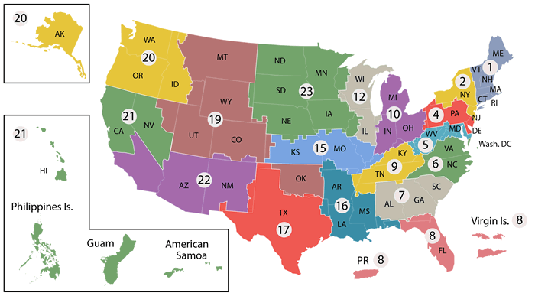
OFA has three regions, two functional areas
VHA has 22 Veterans Integrated Services Networks (VISN’s). VISN 20 is divided between the Central & Western VHA VISNs
Central Region
Gurnee, IL
Two functional areas:
National Region (Major Construction for Cemeteries)
A/E Construction Contracting Policy Service.
Western Region
Vallejo, CA
Eastern Region
Washington, DC

Slide 28
Major Construction Opportunities - VHA Projects
Project Books:
Charleston, SC - 155 Bed Tower Replacement
Indianapolis, IN - Acquire Replacement Medical Center
Long Beach, CA - Spinal Cord Injury/Disease, Physical Medicine & Rehabilitation, and Prosthetics Center
Phoenix, AZ - Construct Bed Tower, Emergency Department, Inpatient Mental Health
San Antonio, TX - New Medical Center
Construction Documents Awards
West Los Angeles, CA - Build New Critical Care Center

Slide 29
Major Construction Opportunities - VHA Projects
Construction:
Biloxi, MS - Restoration Of Hospital/Consolidation of Gulfport (Ph X Renovate Building 1)
Dallas, TX - Spinal Cord Injury Phase C LTSCI Warehouse
Livermore, CA - Phase B - Stockton Community Based Outpatient Clinic - Offsite Road Improvement
Manhattan, NY - Medical Center - Flood Recovery
Manhattan, NY - Medical Center - 10 West Construction

Slide 30
Interagency Agreement Orders Opportunities
Schematic/Design Development:
Seismically Upgrade and Renovate Building 2 and Replace Building 1
Portland, OR - Seismic Retrofit and Renovation
Construction:
Asheville, NC - Acquire Community Living Center and Renovate for Primary and Specialty Care Clinics
Gainesville, FL - Correct noncompliant Surgical, Emergency, Pharmacy and Sterile Process
Long Beach, CA - Spinal Cord Injury/Disease, Physical Medicine & Rehabilitation, and Prosthetics Center
Perry Point, MD - Replacement Community Living Center. Perry Point Replacement CLC

Slide 31
Interagency Agreement Orders Opportunities
Construction:
St. Cloud, MN - Residential Rehab Treatment Facility, St. Cloud, MN
Tampa, FL - Spinal Cord Injury and Polytrauma Transitional Rehab Program Beds Building 38
West Haven, CT - Construct New Surgical and Clinical Space Tower, Demolish Buildings 7, 8, 8.5 and 9
San Diego, CA - RFP Development: Phase C Building 11 Renovation
American Lake, WA - New Specialty Care Building 201, Renovation of Building 18 and Expansion of Parking Facilities
Dallas, TX – Clinical Expansion for Mental Health (CEMH). Phase A CEMH Parking Garage
Portland, OR - Seismic Retrofit and Renovation
San Diego, CA - SCI and Seismic Building 11
St. Louis (JC), MO - Replace Bed Tower, Clinical Bldg Expansion & Parking Garage
West Los Angeles, CA - Build new Critical Care Center, Central Utility Plant, Site Utilities

Slide 32
Interagency Agreement Orders Opportunities
Design Build:
San Juan - Correct Seismic Deficiencies at Building 16
San Juan - Correct Seismic Deficiencies at Building 18
San Juan - Correct Seismic Deficiencies at Building 24
San Juan - Correct Seismic Deficiencies at Building 30
San Juan - Correct Seismic Deficiencies at Building 40

Slide 33
Interagency Agreement Orders Opportunities
Seismic Plus Up Design Build:
San Juan, PR – Seismically Mitigate Main Hospital, Bldg 1
San Juan, PR – Seismically Mitigate Laundry, Bldg 2
San Juan, PR – Correct Seismic Deficiencies at Building 10
San Juan, PR – Correct Seismic Deficiencies at Building 26

Slide 34
Major Construction Opportunities – NCA Projects
Land Acquisitions:
Willimette OR - replacement Cemetery
Design Development:
Chattanooga National Cemetery - Gravesite Expansion
Leavenworth National Cemetery - Phase 5 Gravesite Expansion and Cemetery Improvements
National Cemetery of the Alleghenies - Phase 4 Expansion and Cemetery Improvements
National Cemetery of the Pacific - Gravesite Expansion
Quantico National Cemetery - Phase 5 Gravesite Expansion and Cemetery Improvements
Riverside National Cemetery - Gravesite Expansion

Slide 35
Major Construction Opportunities – NCA Projects
Construction:
Indiantown Gap National Cemetery - Phase 5 Expansion
Jefferson Barracks National Cemetery - Gravesite Expansion Sylvan Springs
Tahoma National Cemetery - Phase 3 Gravesite Expansion
Albuquerque-Area National Cemetery - Albuquerque-Area National Cemetery

Slide 36
Seismic – VHA Opportunities
Project Books:
Manchester, NH- Provide Seismic Bracing for Building 1
Nashville, TN - Correct Seismic Deficiencies for Building 1
North Little Rock, AR - Correct Seismic and Structural Deficiencies Building 66 (Outpatient Clinical Support)
North Little Rock, AR – Correct Seismic and Structural Deficiencies Building 69 (Boiler Plant)
North Little Rock, AR – Correct Critical Seismic Deficiencies in Building 22 (Fire Station)
North Little Rock, AR –Correct Critical Seismic Deficiencies in Building 39 (Psychiatric Residential Rehab Dormitory)

Slide 37
Seismic – VHA Opportunities
Project Books:
Long Beach, CA – Seismic Retrofit of Building 7
Long Beach, CA – Seismic Retrofit of Building 2
Long Beach, CA – Provide Seismic Bracing for Building 1
Design Build:
Roseburg,OR

Slide 38
Seismic – VHA Opportunities
Project Books:
Long Beach, CA – Seismic Retrofit of Building 7
Long Beach, CA – Seismic Retrofit of Building 2
Long Beach, CA – Provide Seismic Bracing for Building 1
Design:
Roseburg, OR – Seismic Retrofit Bldg 11 Laundry
Roseburg, OR – Seismic Retrofit Bldg 13 Warehouse
Roseburg, OR – Seismic Retrofit Bldg 16 Chapel and Auditorium
Albuquerque, NM – Seismically Mitigate Research-Rehabilitation Building, Bldg 11

Slide 39
Seismic – VHA Opportunities
Design Build:
Menlo Park, CA – Retrofit Seismically Deficient B114, Boiler House
Palo Alto, CA – Solicitation for DB contract-Seismic Retrofit Seismically Deficient Building 40, Boiler House
Construction:
Reno, NV – Replace Seismically Deficient Boiler Plant, Bldg 8

Slide 40
Plus Up Seismic – VHA Opportunities
Design Build:
Columbia, MO - Correct Seismic Deficiencies-Ph.1, Bldg 1. This project will address the various critical seismic deficiencies for structural, non-structural, related abatement efforts, infrastructure and equipment support for Building 39 in NLR
American Lake, WA - Seismic Upgrade and Renovation of Building 9, Auditorium
American Lake, WA – Seismic Upgrade and Renovation of Building 111, Chapel
Design Bid Build:
Albuquerque, NM – Seismic Corrections and Renovation for Bldg 1, Main Building
Albuquerque, NM – Seismic Corrections and Renovation for Bldg 3, Psychiatry Facility
Albuquerque, NM – Seismic Corrections and Renovation for Bldg 10, Research Building
Construction:
Poplar Bluff, MO - Correct Seismic Deficiencies Bldg 1. Project will correct seismic nonstructural components and equipment identified during the most recent FCA inspections.

Slide 41
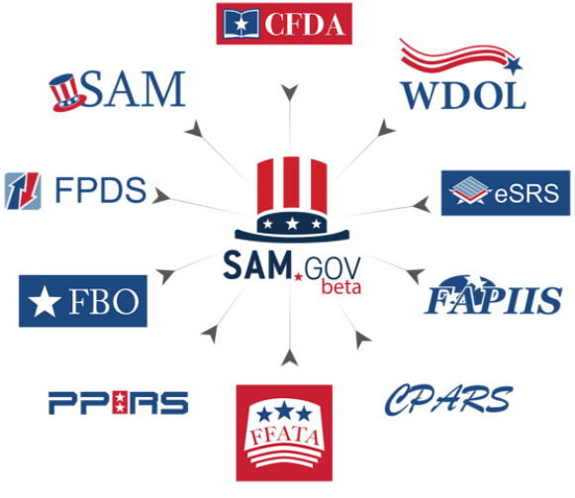
Resource Opportunities
Market Research - Meeting the challenges (Partnership and Participation)
  External research at https://sam.gov (System for Award Management) for:
    Sources Sought
      NAICS, Agency, Location, Set-Aside
    Industry Days
    Site Visits
    Previous Contracts (Government-wide)
    Contact a knowledgeable Persons in Government
U.S. Small Business Administration Contracting Guide
    https://www.sba.gov/federal-contracting
CFM Small Business Liaisons (SBLs)
  https://www.va.gov/osdbu/about/contacts.asp#sbl
    E.J. Jean-Jacques (Eastern Region)
    David Bullerwell (National Region)
    Andrea Morris (Central Region)
    Phyllis Jackson (Policy)

Slide 42


VA Valuable Websites
Vendor Management
Check out our website and look at our Vendor Management if you are interested in:
Resources on CPARS training
President’s Budget Request for VA
VA Forecast of Contracting Opportunities
Pathfinders – Interested in doing business with CFM
Find resources with the Office of Small and Disadvantaged Business Utilization (OSDBU)
SCAN ME

Slide 43
U.S. Department of Veterans Affairs
Office of Small and Disadvantaged Business Utilization Resources
Office of Small and Disadvantaged Business Utilization
www.va.gov/osdbu
Women Veteran-Owned Small Business Initiative
https://www.va.gov/osdbu/WVOSBI.asp
Upcoming Virtual Business Opportunity Sessions for a variety of business lines
www.vetbiz.va.gov/events
Small Business Training Resources
https://www.va.gov/osdbu/outreach/soc/training.asp
Upcoming Training Webinars
https://www.va.gov/osdbu/outreach/soc/webinar-schedules.asp
Acquisition Support
https://www.va.gov/osdbu/acquisition/index.asp
Upcoming Small Business Outreach Events hosted by Other Government Agencies
https://hallways.cap.gsa.gov/app/#/gateway/federal-osdbu-directors-interagency-council/79871/events-calendar
Direct Access Program (DAP) – Quarterly one on one with CFM Representative.
https://www.va.gov/osdbu/outreach/dap/index.asp

Slide 44
Other Sources of Procurement Information:
  System for Award Management (SAM) http://www.sam.gov
  https://www.cfm.va.gov/
  Veterans Small Business Certification (VetCert) https://veterans.certify.sba.gov/
  VA Forecast of Contracting Opportunities (FCO) https://www.vendorportal.ecms.va.gov/eVP/fco/FCO.aspx
  Https://www.cfm.va.gov/til/leasing.asp

Slide 45

QUESTIONS?

