Slide 1

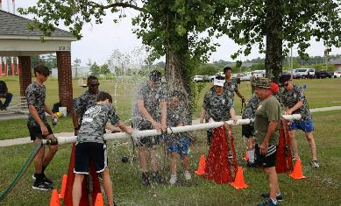
SAME STEM/ENGINEERING & CONSTRUCTION CAMPS
Start Your STEM Journey in Summer 2024!
https://www.same.org/camps/

Slide 2

OVERVIEW
  More than 20 years and thousands of alumni!
  High school students interested in STEM and curious about the military/government service
  Rising high school sophomores to rising seniors
  Students from all over the US and overseas
  Week-long camps
  Hands on engineering with leadership opportunities
  Teams of 10 campers compete against each other
  Cost is $100 - $800, with most campers receiving sponsorships from SAME Posts
  Five camps in 2023 with approximately 250 students

Slide 3
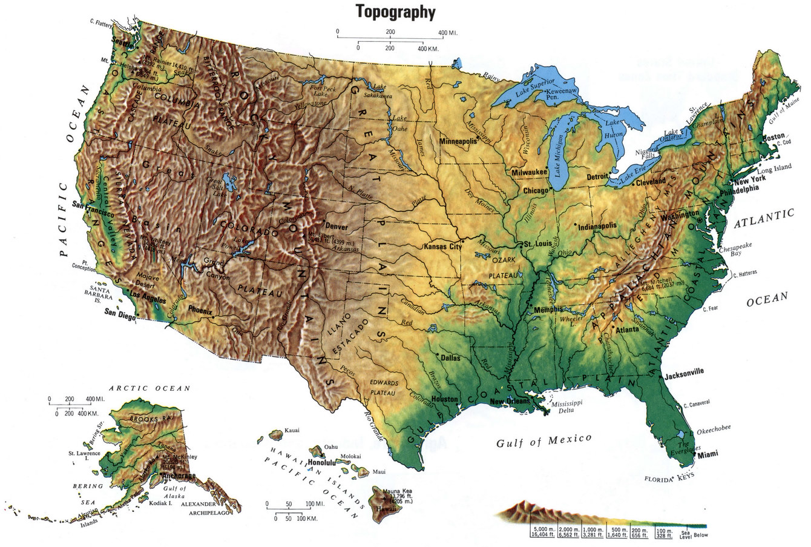
2023 CAMP LOCATIONS
USAFA
Scott AFB
MCB Camp Lejeune
NB Ventura County
Vicksburg

Slide 4
2024 CAMP LOCATIONS
USAFA
MCB Camp Lejeune
NB Ventura County
NAS Jacksonville
Vicksburg

Slide 5


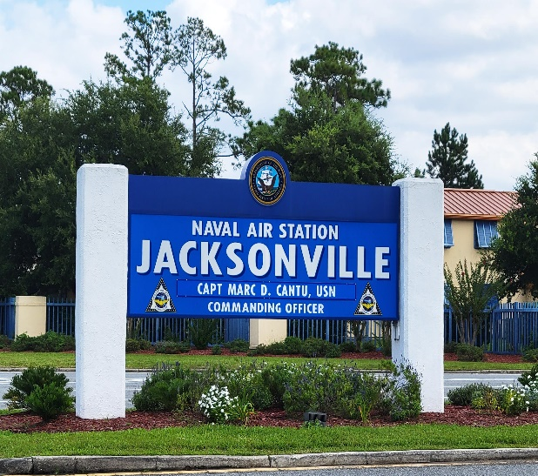
2024 CAMP LOCATIONS

Slide 6
OVERVIEW
Highlights:
Concrete Beam
Dog House
Cardboard Boat
Popsicle Stick Bridge
Reaction Course
Career Day
Site Tours
Guest Speakers
Beach Party

Slide 7
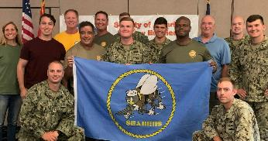
VOLUNTEER
Mentors
  We need 50 young professional mentors (2 mentors for every 10 students)
  Outstanding opportunity for leadership development
  SAME Foundation will reimburse for travel
Volunteer at the camp
  Volunteers needed in addition to mentors
  Volunteers for specific day(s) or event(s)
  Volunteers to transport food, materials, etc.

Slide 8
MARKET
Every person can help us with MARKETING!!
Talk to your family and friends about the camps
Talk to co-workers with high school students about the camps
Put up the flyers at your work
Go to local high schools, talk to counselors, and give them flyers
Email flyers to schools outside your area
Post on Facebook (SAME Marketing can assist)
If you know any students who attended over the last few years
  Contact them and have them talk to their friends Ask the students if they have any interested siblings
  Ask the parents if they can post the camps on Facebook

Slide 9
SPONSOR
Sponsoring campers
Many Posts sponsor students for the camps; Jacksonville sponsored nine in 2023!
Posts often pay half the registration fees and all the travel costs
Individuals and companies can also sponsor campers

Slide 10
SPONSOR

Slide 11
SPONSOR

Slide 12
SAME STEM CAMPS
THANK YOU!
NAS Jacksonville Camp Director: Brian Files
brian.k.files.civ@us.navy.mil
SAME STEM Camp COI Chair: Cindy Miller cindy.miller@Jacobs.com
Notes:
On the last page, put the QR code from the flyer and leave it on the screen. Tell everyone to use their phones with the QR code, go to the website and save the site so that when they talk to anyone who might be interested, they have the site on their phones. It gets people to actively do something!! If you are making a poster to display during both Industry Days, you can put the QR code from the flyer on it so folks can just scan it with their phones.

