Slide 2

The SBA works to ignite change and spark action so small businesses can confidently
START • GROW • EXPAND • RECOVER
Notes:
Talking Points:
Working with the SBA, small business owners and entrepreneurs are empowered to succeed with access to capital, valuable resources, business know-how, and the right expertise for each stage of the business lifecycle.
Where are you in your business lifecycle? What are you looking to achieve? (lead-in to following topic slides)

Slide 3
North Florida District Office
START • GROW • EXPAND • RECOVER

Slide 4
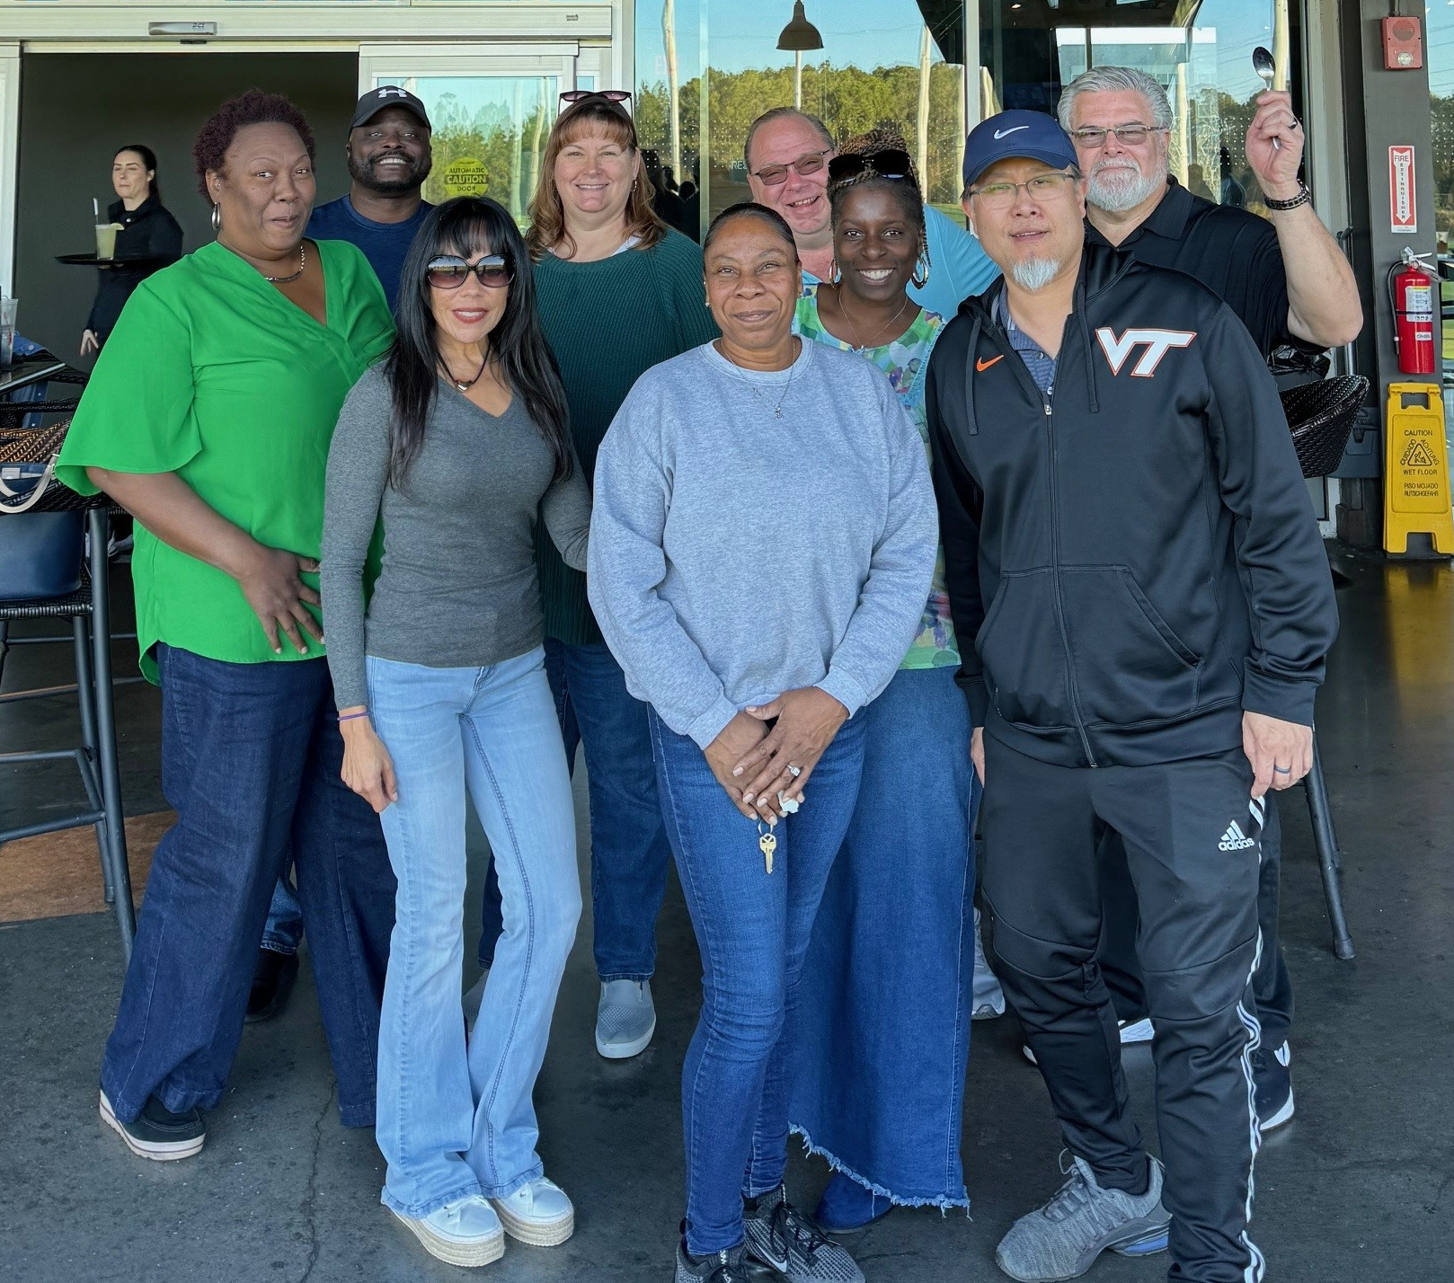
Your NFDO Team
Jonel Hein, District Director
Jeff Salzer – Deputy District Director
Ed Ramos – Senior Area Manager (Orlando)
Rosalind Bryant – Lender Relations Specialist
Natalie Hall – Economic Development Specialist
Carmen Gonzales – Business Opportunity Specialist
Jay Choi – Business Opportunity Specialist
Vacant – Business Opportunity Specialist (GS-12 will be on USAJOBS soon ☺)
Jackie Gardner – Administrative Officer
Cartina Austin – Program Support Assistant

Slide 5
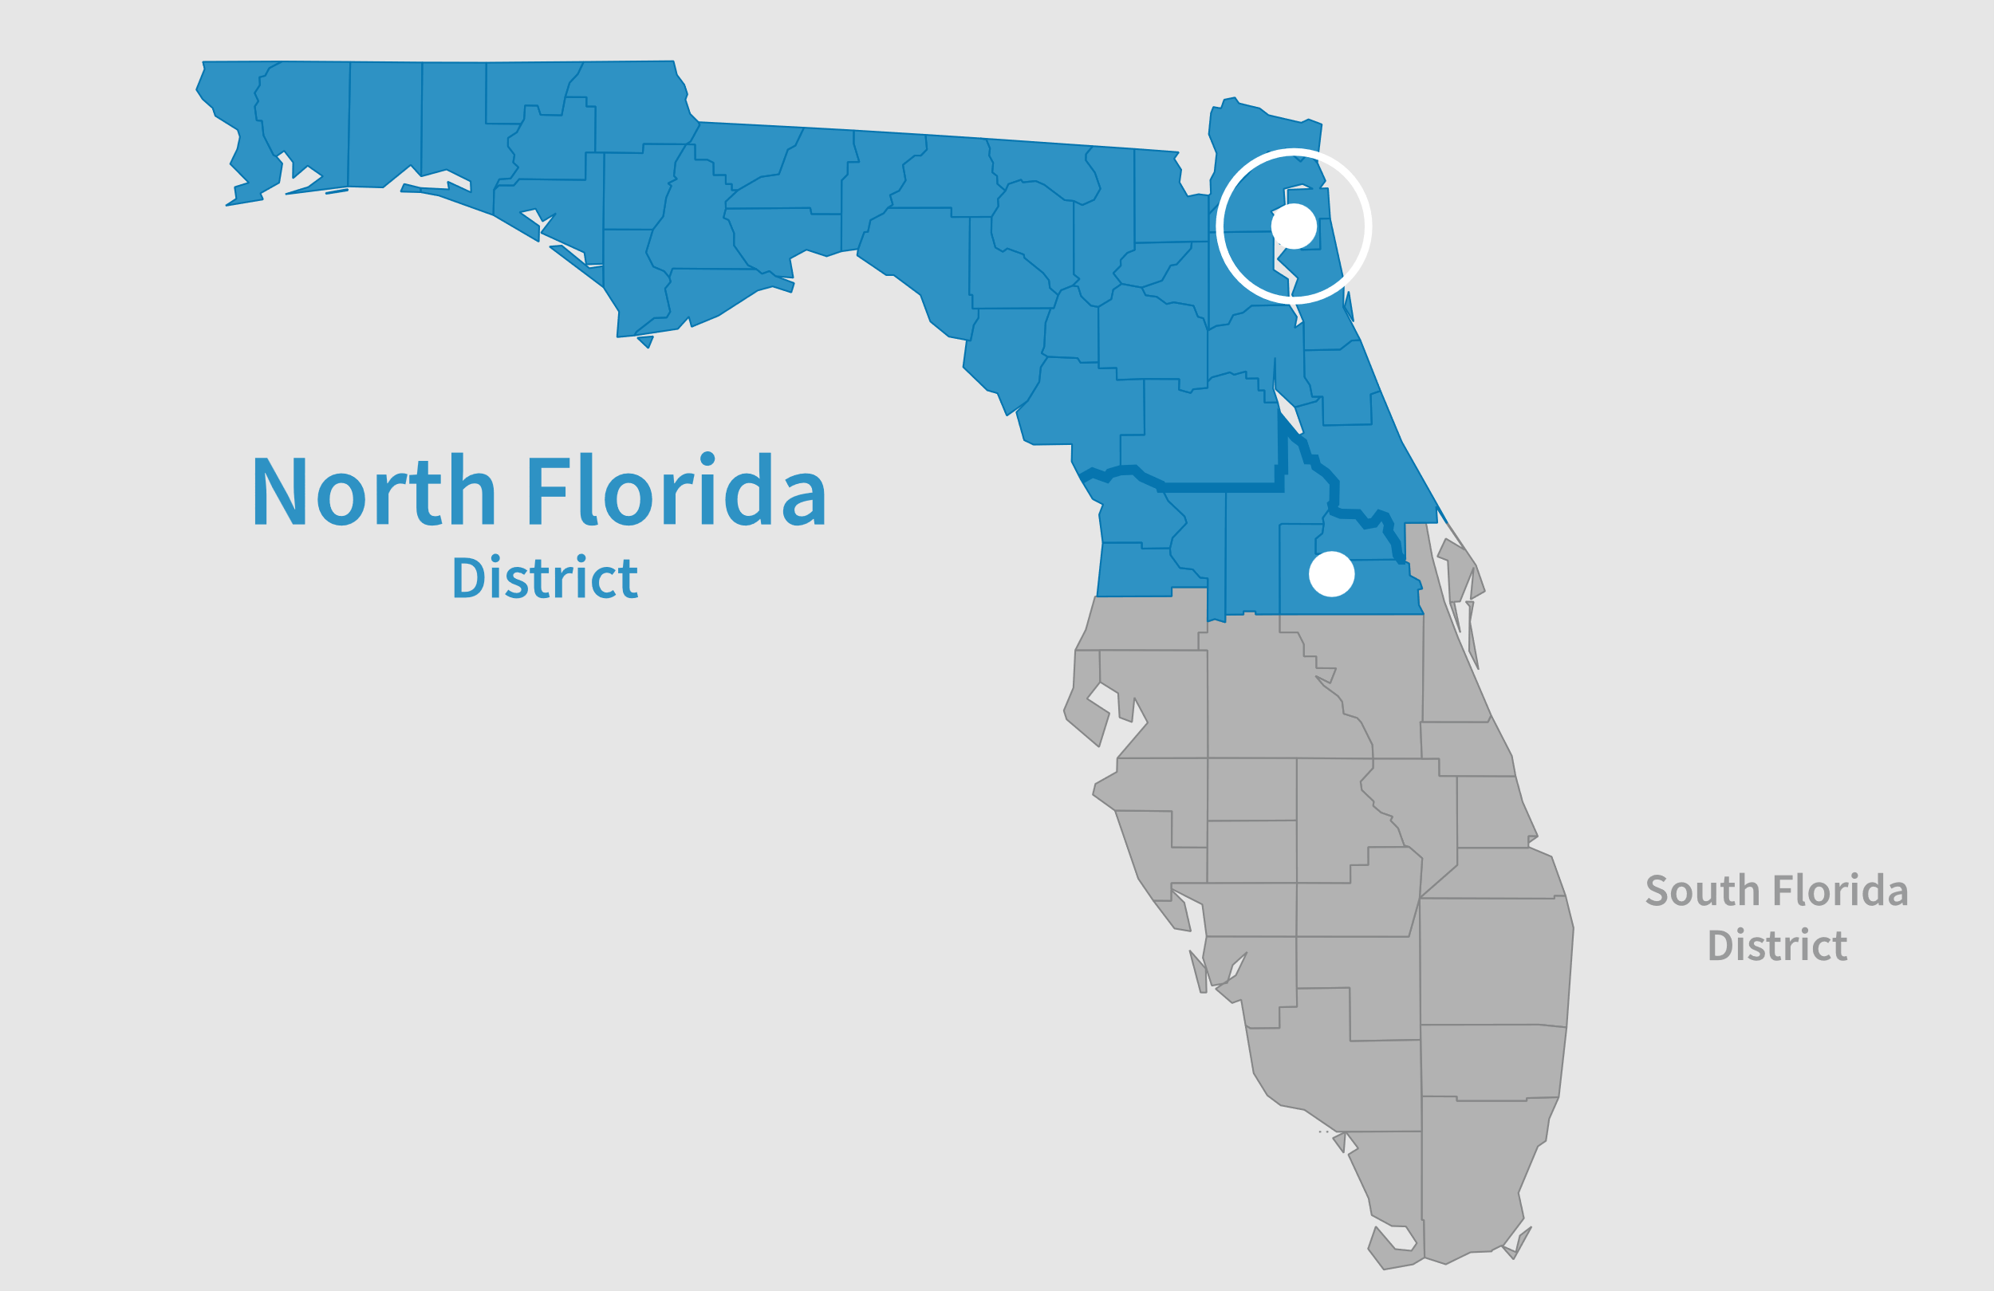
Mission and Small Business Support
We help American’s start, grow, expand and recover small businesses. We do this by providing access to:
Capital
Consulting
Contracting
Disaster Assistance
North Florida District Office covers 43 counties from Orlando to the Panhandle.

Slide 6

North Florida: A Diverse Small Business Ecosystem
3.1 Million Small Businesses in Florida (99.8% of all Florida Businesses are Small)
8,303 Small Businesses in NFDO Registered to do business with government.
  162 - 8(a) Firms
From Catering to Construction and almost everything in between NFDO 8(a) firms did over $1.2B in contracts in FY23.

Slide 7

Support Programs for Small Businesses
8(a) Participants – BOS and 7J Training
Workshops – SBA and Resource Partners
SBA Bonding Program
SBA Loan Programs
SBA Contract Line of Credit
Customized training and partnering with agencies.
  Are we working with your agency? Let’s talk!

Slide 8
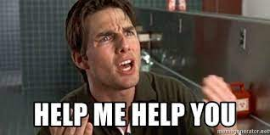
Contracting Certification Programs: A Gateway for Diversity and Innovation
8(a)
WOSB
SDVOSB
HUBZONE
For the CO/KO?
Vetted
District Office Supported Firms
Identifying firms in marketplace
We have FANTASTIC firms that CAN PERFORM!

Slide 9
Questions?
Jeffrey Salzer
Deputy District Director, North Florida District Office
904-443-1907 | Jeffrey.Salzer@SBA.gov

Slide 10
Powering the American Dream

