Slide 1
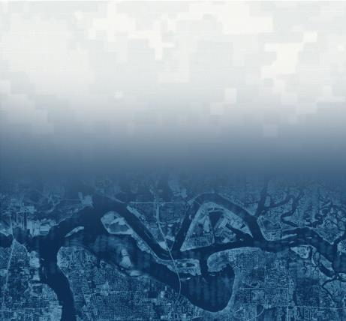
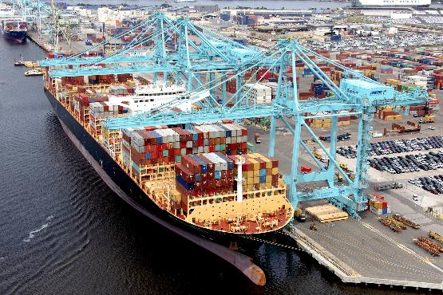

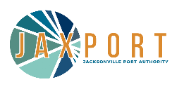
Society of American Military Engineers (SAME) Presentation
Jason Harrah, Senior Project Manager
U.S. Army Corps of Engineers
Jacksonville District
Jason.S.Harrah@usace.army.mil
JACKSONVILLE HARBOR DEEPENING PROJECT
September 21, 2022

Slide 2
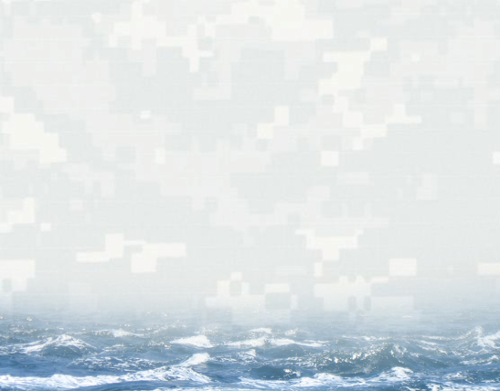
TRIVIA TIME (BIG PRIZES)!!!
Question #1
Cadets and midshipmen played the first Army-Navy football game Nov. 29, ______ on “The Plain” at West Point.
Question #2
USACE Major William R. King, in charge of improvements on the Tennessee and Cumberland rivers, filed an unusual report with the Chief of Engineers in 1881 stating a robbery of public funds had occurred by a masked gunman on horseback. This famous outlaw was _____________?
Question #3
The Port of ______ tops the list as the busiest in the world moving 37.1 Million TEUs of cargo volume annually?
1890 (24-0 Navy)
The Port of Shanghai
Jesse James, it ended up being James’ last crime before his death.

Slide 3
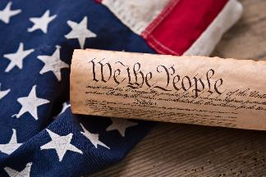
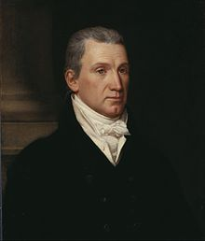
WHY IS THE CORPS INVOLVED IN NAVIGATION?
The Commerce Clause of the United States Constitution states: “The Congress shall have power…to regulate commerce with foreign nations, and among the several states, and with the Indian Tribes.
1824 – The Beginning of the Corps Navigation Mission:
  Supreme Court Opinion (Gibbons v. Ogden): Concluded that regulation of navigation by steamboat operators and others for interstate commerce was a power reserved to and exercised by Congress under the Commerce Clause.
  Justice Johnson argued that “the national government had exclusive power over interstate commerce, negating state laws interfering with the exercise of that power”.
  Congress passes General Survey Act (signed by President James Monroe): authorized president to have surveys made of routes for roads and canals of “national importance”.
  Another act appropriated $75,000 to USACE for improving navigation on the Ohio and Mississippi rivers by removing sandbars, snags, and other obstacles.
2022 – The Corps Navigation Mission Today:
  12,000 miles of commercial inland and intracoastal shallow draft navigation channels (9-14 ft.)
  13,000 miles of deep draft channels (greater than 14 ft.)
  190 locks on 41 waterways
  926 coastal, Great Lakes, and inland harbors
President James Monroe

Slide 4
OUR MISSION STATEMENT
The role of the U.S. Army Corps of Engineers with respect to navigation is to provide safe, reliable, and efficient waterborne transportation systems (channels, harbors, and waterways) for the movement of commerce, national security needs, and recreation.
The Corps accomplishes this mission through a combination of capital improvements (i.e., deepening) and the operation and maintenance of existing navigation projects.

Slide 5
UNITED STATES COASTAL AND INLAND PORTS
41 states are served directly by our ports & waterways!

Slide 6
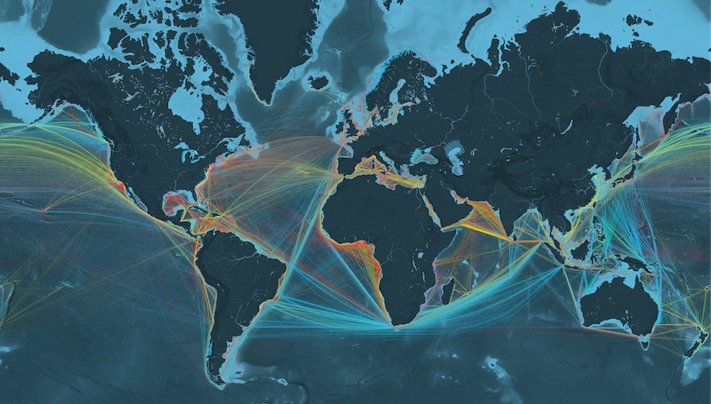
WORLD SHIPPING ROUTES
https://www.shipmap.org/
Containers
Dry Bulk
Liquids
Gas
Vehicles
Courtesy of KILN

Slide 7
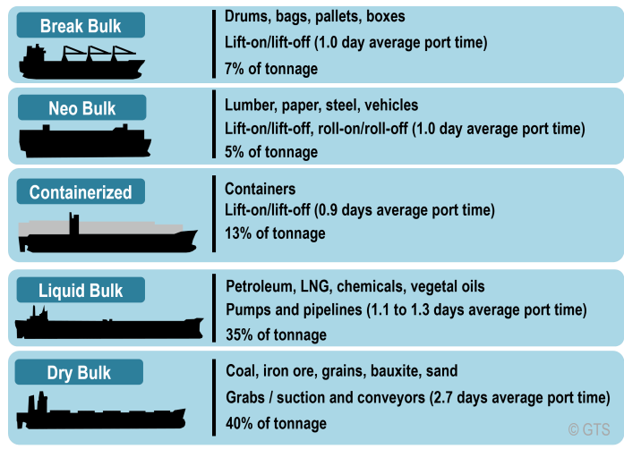
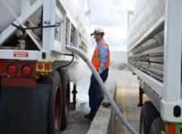
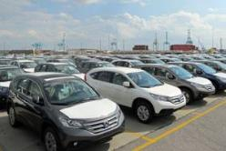
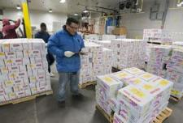
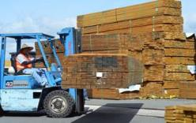
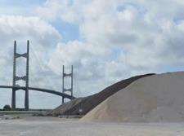
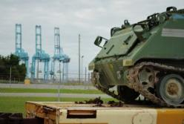
SHIPPING TERMINOLOGY 101
Liquid Bulk (LNG, Oils, Petroleum)
Roll-On Roll-Off (RORO)
Automobiles
Fresh and Frozen Foods
Forest Products
Dry Bulk (Coal, Sand, Rock)
Military Cargo
Courtesy of KILN

Slide 8
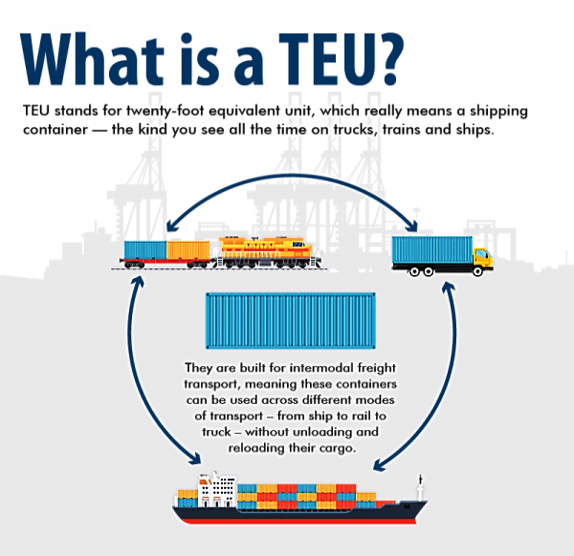
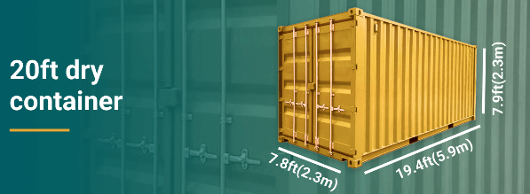
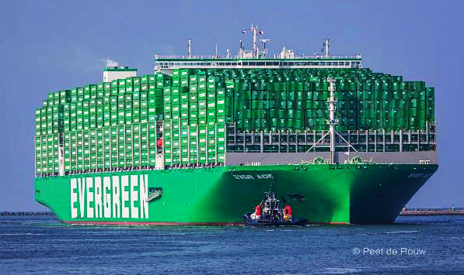
SHIPPING TERMINOLOGY 101
Port Seattle
Ever Ace Container Ship 23,992 TEUs
Courtesy of KILN

Slide 9
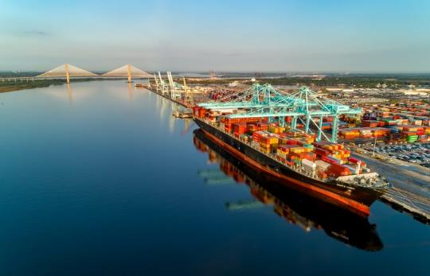
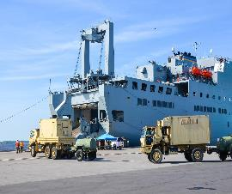
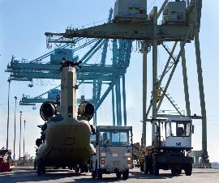
JACKSONVILLE HARBOR
Located in Duval County, Florida
20-mile federal channel beginning at the mouth of the St. Johns River where it empties into the Atlantic Ocean and extends to River Mile 20
Provides access to deep draft vessel traffic using public and private terminal facilities located in the City of Jacksonville, Florida
Non-Federal Sponsor: Jacksonville Port Authority
One of 17 U.S. Strategic Seaports on-call to move military cargo for national defense, foreign humanitarian assistance and disaster relief
  832nd Transportation Battalion
  Mayport Naval Station
  Marine Corps Blount Island

Slide 10
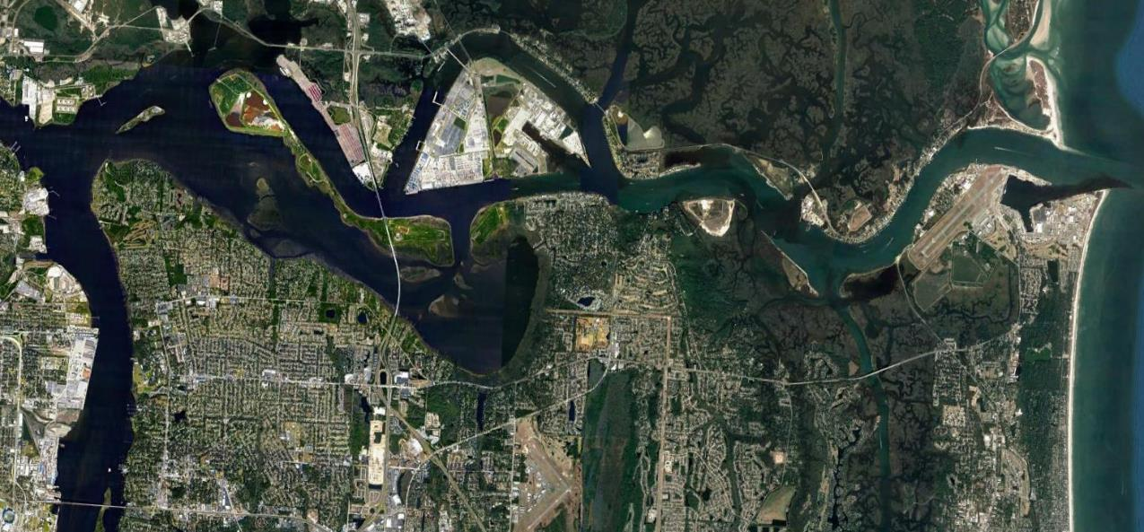
JACKSONVILLE HARBOR FEDERAL CHANNEL
Marathon Terminal
Cruise
Terminal
JEA
Ft. George Inlet
Navy Fuel Depot
Blount Island
Marine Terminal
Federal Channel
Dames Point
Marine Terminal
USMC Facility
Federal Channel
Bartram Island DMMA
JAX LNG
BAE Shipyard
Naval Station Mayport
Buck Island
DMMA
Federal Channel
Mile Point
Mill Cove
Talleyrand Marine Terminal

Slide 11
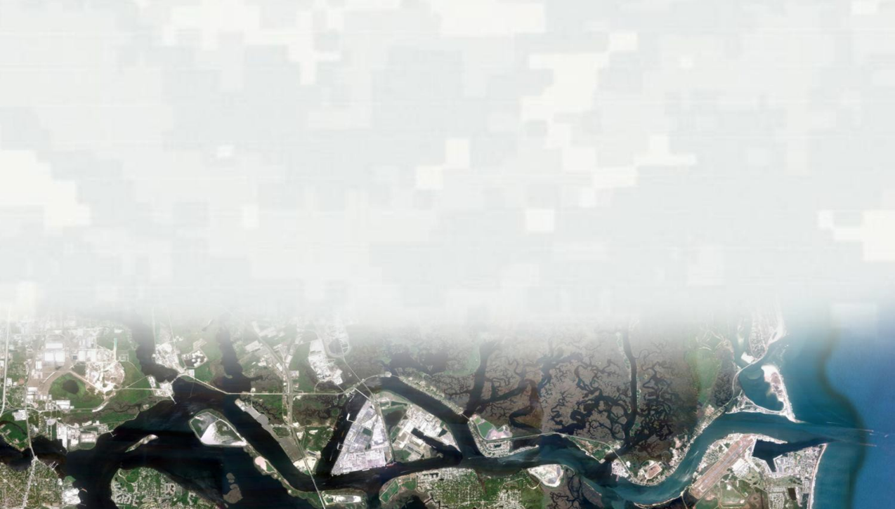

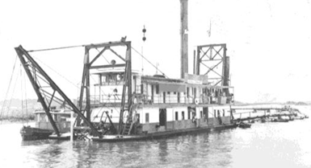
DEEPENING HISTORY
Dr. Abel Seymour Baldwin
$10K appropriated for surveys and planning to provide deep water at entrance bar
6-8 ft Depth
Channel Deepened
18 ft. depth
North and South Jetties Completed
Channel Deepened
30 ft. depth
Channel Deepened
38 ft. depth
Channel Deepened River Miles 14.7-20
40 ft. depth
1852
1880
1895
1904
1906
1916
1951
1978
2003
2010
2021
Congress adopts plan for two jetties w/$125,000 appropriations
Two dredges built (St. Johns & Jacksonville) to deepen the channel
24 ft. depth
Channel Deepened, Fulton Cut, Training Walls, Revetments
34 ft. depth
Channel Deepened, River Miles 0-14.7
40 ft. depth
Channel Deepened, River Miles 0-11
47 ft. depth

Slide 12
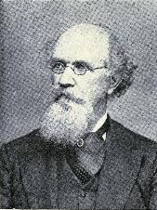
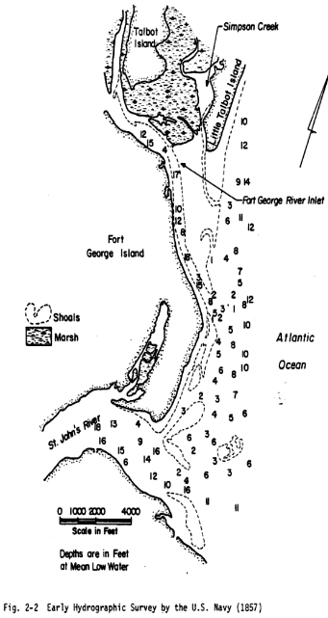
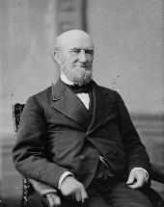
Dr. Abel Seymour Baldwin
Dr. Baldwin moved to Jacksonville in 1838 and served as the only physician within thirty miles.
It was during his medical visits up and down the river he began to observe the tides and currents and became convinced that closing Fort George Inlet would cause less sand to accumulate on the St. Johns Bar.
Dr. Baldwin was sent to Washington where he secured $10,000 from Congress on August 30, 1852, of this amount $827.17 was later returned to treasury.
The War Department sent Lieutenant Wright to Jacksonville in 1853 where he completed surveys and experimental dredging on the bar, ultimately recommending a single north jetty to protect the bar channel.
The Civil War put a stop to further activities during the years following.
Dr. Baldwin never lost his interest in the improvement of navigation in the St. Johns River. When the fame of world-renowned American civil engineer and inventor Captain James Eads spread over the country, Dr. Baldwin visited the Captain at Port Eads and induced him to visit Jacksonville. He came in 1878 and made a personal examination of the river and bar, deciding upon a system of jetties and deeper channel which everyone knows today.
Lieutenant Fisk was assigned officer in charge, November 1880, he opened an office on Fort George. This office was the beginning of a resident engineer in the Jacksonville area. Contract awarded 14 December 1880.
Dr. Abel Seymour Baldwin
Captain Eads

Slide 13

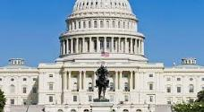

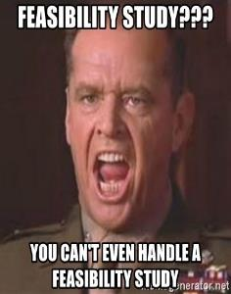
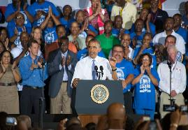
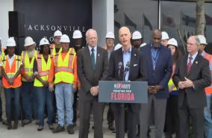
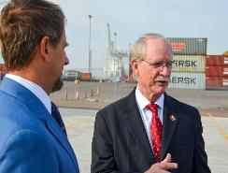
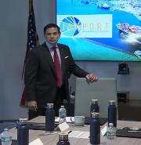
DEEPENING STUDY (WHAT’S IN THE SOUP)?
What's Required for a Corps Feasibility Study?
Non-Federal Sponsor: Jacksonville Port Authority
Study Authority: 1992 U.S. House of Representatives Resolution form the Committee on Public Works and Transportation
Appropriations: Study funded through completion in April 2014 (Federal and Non-Federal)
Clear Study Purpose/Problems/Opportunities: To evaluate Federal interest in alternative plans for reducing transportation costs at Jacksonville Harbor and the effects of the alternatives on the natural system, human environment and economic development.
Strong Support from Elected Officials: President Barack Obama issued “We Can’t Wait” Executive Order with accelerated completion of the study by 14 months.

Slide 14
KEY ASPECTS OF DEEPENING STUDIES
Recommended Plan
Why Continue Deepening the Channel?
Engineering
Economics
Environmental

Slide 15
WHY DEEPEN?

Slide 16
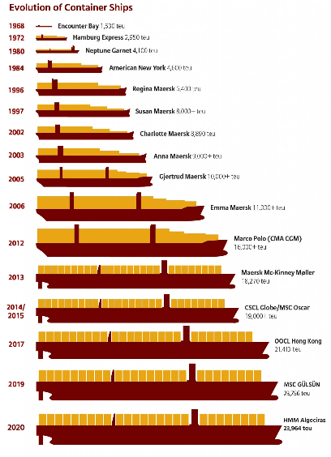

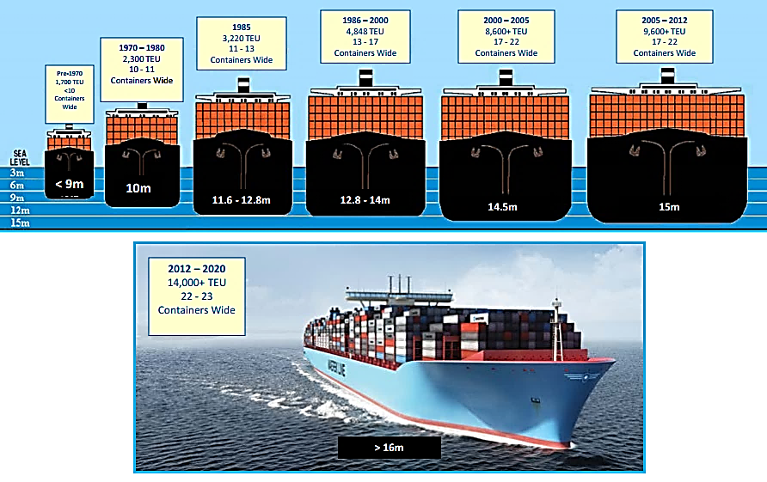
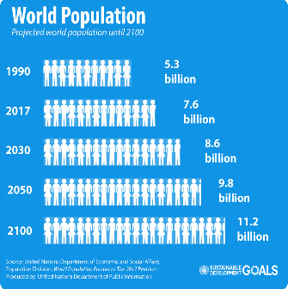
THE DEEPENING EQUATION
Growing World Population
Increased Demand for Commerce
Larger Ships to Meet Demand
Increased Draft Requirements for Federal Channels

Slide 17
ENGINEERING
Identification of Design Vessel: Largest ship(s) expected to use the project improvements on a frequent basis.
Ship Simulation & Report: Used to test design vessels with/without the project using Bar Pilots.
Design of General Navigation Features:
  Channel Depths needed (in 1-foot increments)
  Turning Basins (used to turn large vessels near terminals inbound/outbound)
  Jetties
Ship Wake Analysis: Demonstrate changes in wave action associated with deeper and wider channel (larger ships) will not cause increased erosion.
Dredge Material Characteristics and Disposal Capacity: Geotechnical core borings (rock/clay/sand), where is the material going (upland/offshore disposal).
Shoaling Analysis: Increase in Operations & Maintenance (O&M) volumes/cost due to increases in shoaling?

Slide 18
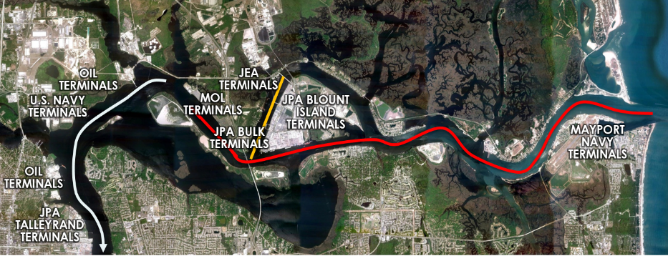
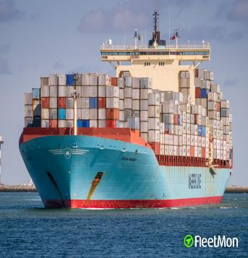
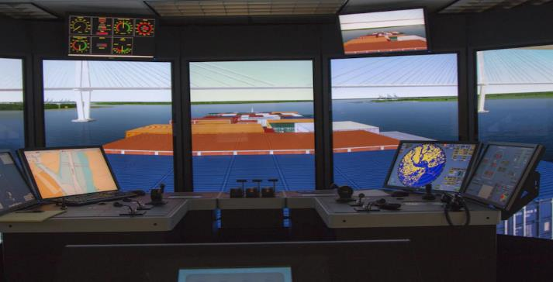
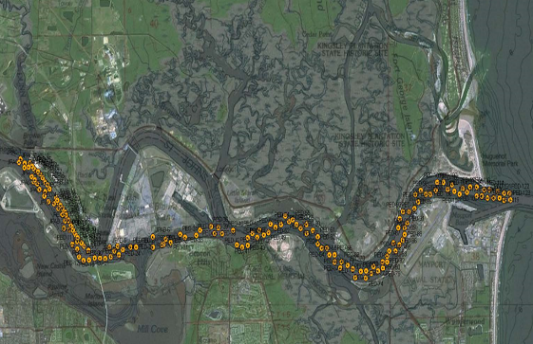
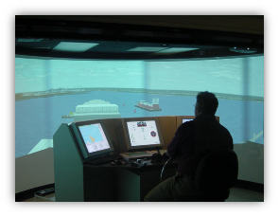
Design Segments for Jacksonville Deepening Study
Jacksonville Design Vessel for Ship Simulation (Susan Maersk)
Segment 1: Entrance Channel to River Mile 13 (selected)
Segment 2: River Mile 13 to River Mile 20 (screened out)
Segment 3: West Blount Island Channel (screened out)
Ship Simulator Completed in ERDC (Vicksburg)
Jacksonville Geotechnical Borings to Identify Material Characteristics

Slide 19
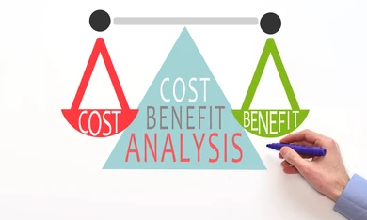
ECONOMICS FOR NAVIGATION 101
National Economic Development Plan (NED) – the plan that reasonable maximizes net benefits to the nation from cost savings
Calculation of Primary Project Benefits: Primary benefits in deepening projects involve transportation cost savings
  Vessels use capacity more efficiently
  Cargo moved on small number of larger vessels
  Reduced exposure to logistic delays
BENEFITS
COSTS
Must be greater than 1

Slide 20
ECONOMICS FOR JAX HARBOR
The economic benefits and costs were calculated in 1-foot increments from 40 feet to 50 feet using Harbor-Sym Modeling to analyze transportation costs, cost savings, cargo traffic levels, etc. to determine benefits over 50-year period.
Our Results…
45 feet maximized NED benefits and was selected as the NED plan
JAXPORT elected to select 47 feet as a Locally Preferred Plan (LPP) and this became the Recommended Plan
Benefit to Cost Ratio: 47 feet = 2.7 (for every $1 dollar spent, $2.70 is returned)!

Slide 21
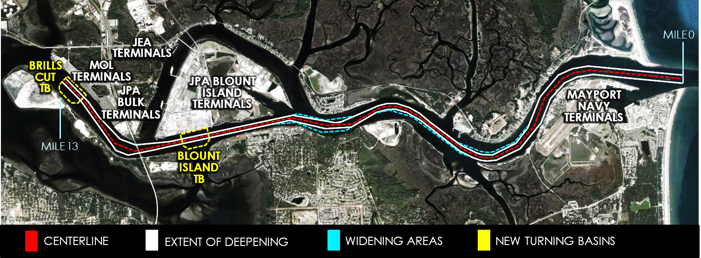
RECOMMENDED PLAN (47 FEET)
CIFF NOTES:
DEEPENING: Entrance Channel to River Mile 13 from 40 foot to 47 feet
WIDENING: Two Sections of Federal Chanel ~100 to 300 feet
NEW TURNING BASINS: Blount Island and Brills Cut ~2700 feet by 1500 feet

Slide 22
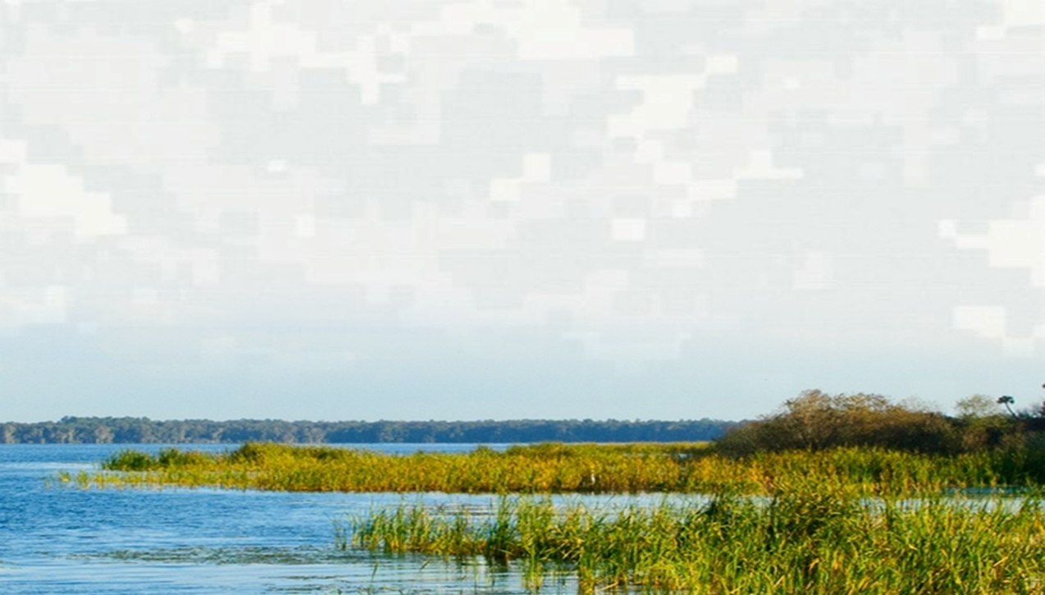
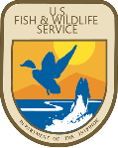
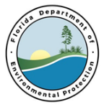
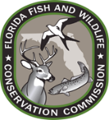





ENVIRONMENTAL COORDINATION
National Environmental Policy Act (NEPA)
  Analyze effects of the Recommended Plan on human environment, cultural resources and environmental mitigation if appropriate.
Federal & State Agency Coordination:
  National Marine Fisheries Service
  US Fish & Wildlife Service
  Environmental Protection Agency
  Florida Department of Environmental Protection
  Florida Fish & Wildlife Conservation Commission
  Florida Department of Historical Resources
Ensure Compliance with Environmental Laws:
  Migratory Bird Treaty Act 1918
  Fish and Wildlife Coordination Act 1934
  Clean Air Act 1963
  National Historic Preservation Act 1966
  Coastal Zone Management Act 1972
  Clean Water Act 1972
  Endangered Species Act 1973
  Essential Fish Habitat 1996
Environmental Impact Statement

Slide 23
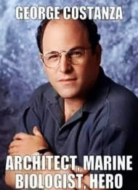
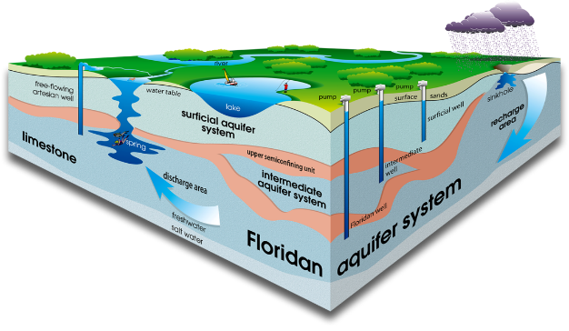
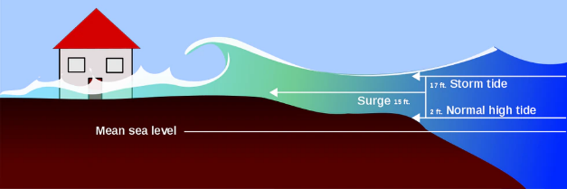
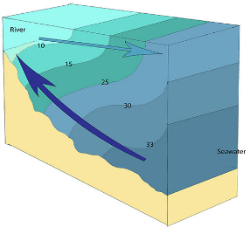

ENVIRONMENTAL EFFECTS
The PDT evaluated ~16 different potential effects to the environment using state of the art modeling and coordinated the results with federal, state agencies and the public.
Groundwater
Storm Surge
Energyeducation.ca
Salinity
University of Florida
Data Stream
Roger Williams University

Slide 24





ENVIRONMENTAL EFFECTS
The PDT evaluated ~16 different potential effects to the environment using state of the art modeling and coordinated the results with federal, state agencies and the public.
Submerged Aquatic Vegetation
Benthic Macro-Invertebrates
Phytoplankton
Wetlands/Marshes
National Park Service

Slide 25
ENVIRONMENTAL MODELING RESULTS
Environmental (16) Effects | Model Used | Results
Ground Water | USGS SEAWAT | Surficial Aquifer System (domestic well water): Little to no effect in any part of the surficial aquifer system Floridan Aquifer System (main source of potable groundwater): No risk to salinization
Tides | EFDC | Project has potential to elevate high tide cycles by 0.10 ft (1.2 inches) at Bar Pilot Station and 0.05 ft (0.6 inches) at Main Street Bridge. Overall project will not likely affect water levels upstream of Buckman Bridge.
Currents | AdH | Small decrease at Bar Pilot Station. 0 to 0.7 feet/second increase in some upstream areas.
Sea Level Rise | Historic, Moderate, Hight | No affect on 0.39, 1.0, or 2.0 feet rise by 2068.
Storm Surge | ADCIRC + SWAN | During 100-year storm event (9 ft. of water near Dames Point already), increase 0.25 to 0.5 ft in isolated areas near Bartram Island Disposal Area
Salinity (St. Johns River) | EFDC | -0.4 to +0.5 ppt change Dames Point to Buckman Bridge
Salinity (Tributaries) | MIKE 21 and ADCIRC | -0.4 to +0.5 ppt change in Timucuan marsh and 0 to +0.5 ppt change in Cedar/Ortega Rivers
Dissolved Oxygen | CE-QUAL-ICM | -0.3% to +0.1% change in bottom layer dissolved oxygen
Ship Wake and Bank Erosion | AdH | Maximum 1-foot increase ship wake along southern bank of Blount Island (near Bartram Disposal Site)
Submerged Aquatic Vegetation | SJRWMD Ecological Model | Minor salinity stress increase (180 acres affected by minor increase in salinity stress)
Fish Species | SJRWMD Ecological Model | Minor shifts in salinity and fish distribution (less than 5% species distribution)
Benthic Macro-Invertebrates | SJRWMD Ecological Model | Minor shifts in salinity
Wetlands | USACE Wetland Model | Minor salinity stress increase (395 acres affected by minor increase in salinity changes)
Phytoplankton | EFDC CE-QUAL | Minor shifts flushing and chlorophyll a., Little change in phytoplankton blooms
Water Quality | EFDC CE-QUAL | Minor shift in salinity
Air Emissions | Mid-Tier Emission Inventory | 5% to 10% reduction in emissions by year 2040 compared to without deepening/widening

Slide 26
ENVIRONMENTAL MITIGATION
Land for Conservation Purchase:
  Purchase of 43.77 acres of uplands and salt marsh wetlands adjacent to Timucuan Preserve
  Purchase of 577.92 acres of conservation lands within St. Johns River Blueway consisting of freshwater wetlands, uplands, and river shoreline
  Completed by Jacksonville Port Authority in 2017
Field Data Collection - Corrective Action Plan (CAP):
Conducted (1-year prior to construction, during construction, up to 10-years post construction)
  Water Quality Data: along River Main Stem and Tributaries: Measures salinity, tidal flow, water levels
  Submerged Aquatic Vegetation Data: Quarterly sampling to detect changes
  Wetland Data Collection: Sampling twice per year beginning and end of growing seasons
  Fish and Macroinvertebrate Data Collection: 50 samples each month in tributaries and main river
  Hydrodynamic Modeling: Setup and update model as needed to run simulations of changes from items listed above
The corrective action plan provides direction to evaluate whether project effects are exceeding those that were predicted by the models. If it is determined that additional effects are indeed occurring, then the plan specifies that additional compensatory mitigation may be implemented.

Slide 27


ENVIRONMENTAL MONITORING

Slide 28


SALINITY MONITORING
Data collected at 15-minute intervals

Slide 29



CONSTRUCTION OVERVIEW

Slide 30
DREDGE MATERIAL DISPOSAL (ODMDS)
6.5 Miles

Slide 31




CONSTRUCTION EQUIPMENT
Hopper Dredge
Cutter Suction Dredge
Clamshell Dredge
Excavator Dredge

Slide 32



SUMMARY (SUCCESS!)
Feasibility Study Completed April 2014, Construction Began April 2018, Construction Completed May 2022
Total Cost of Design/Construction: $419,522,000 ($195,629,000 Federal and $223,893,000 Non-Federal)
Funding Partners USACE, JAXPORT, FDOT, City of Jacksonville and SSA Atlantic
12 million cubic yards dredged
and transported to ODMDS
Total Environmental Monitoring Cost $9,474,765 w/commitment for up to 10-years post construction
7 SAV Monitoring Stations, 15 Freshwater Stations, 6 Fish Monitoring Areas, 41 USGS Data Collection Sites
Project finished under budget and 6 months ahead of schedule!
Enough to fill the Epcot Ball 138 times

Slide 33























SUCCESSFUL TEAMWORK!
DELIVERING THE MISSION!
Thank You!

