Slide 1
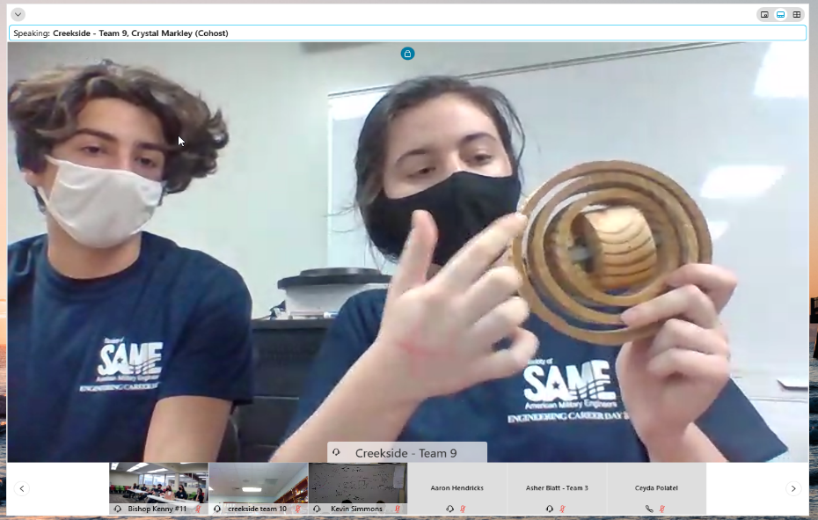
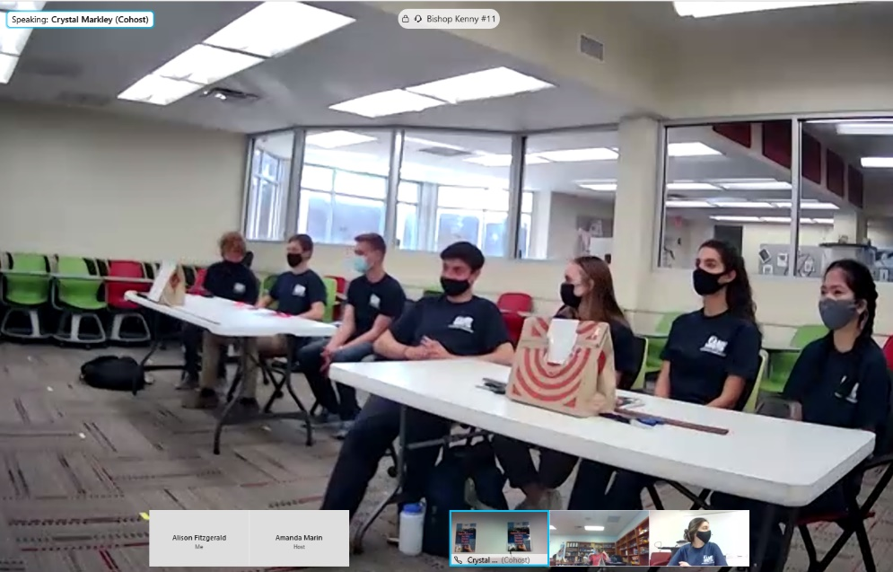
Engineering Career Day 2021
SAME Jax Post
A team of USACE Jacksonville District volunteers and Society of Military Engineers members coordinated and participated in the SAME Engineering Career Day event held virtually on 26 February.
Objective 1d: Support the Engineer Regiment
Six schools and 13 teams participated in a take-home challenge to design a gyroscope. Judges tested the projects by assessing the amount of time the gyroscopes rotated as well as the aesthetics of the project.
Objective 4d: Build ready and resilient people and teams

Slide 2
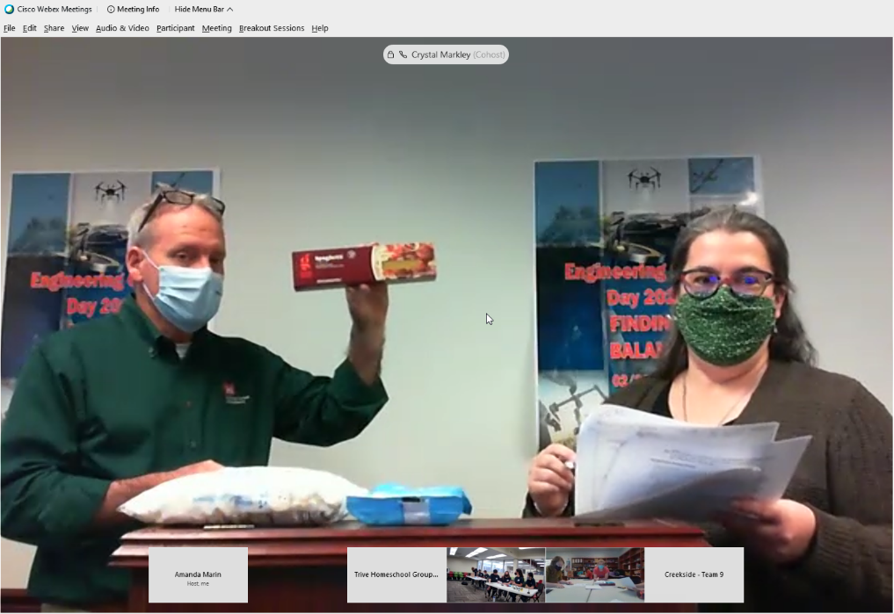
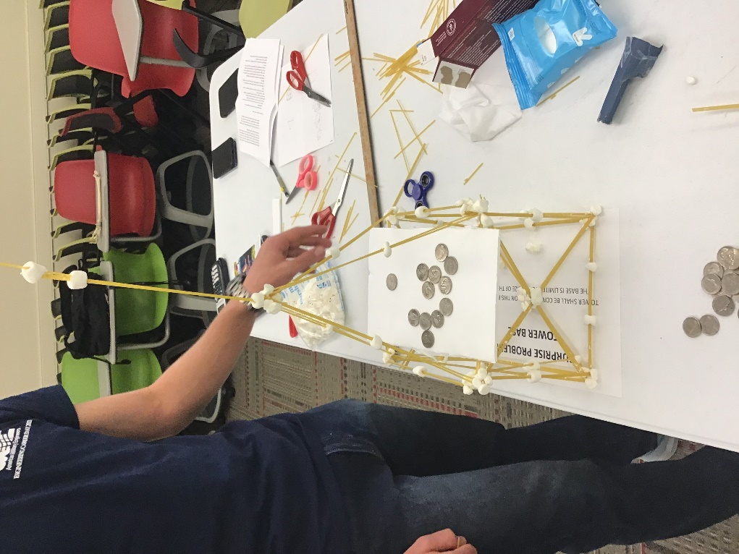
Engineering Career Day 2021
SAME Jax Post
Teams also completed a surprise problem to build and load a tower made of spaghetti and marshmallows.
Objective 1d: Support the Engineer Regiment
Objective 4d: Build ready and resilient people and teams

Slide 3
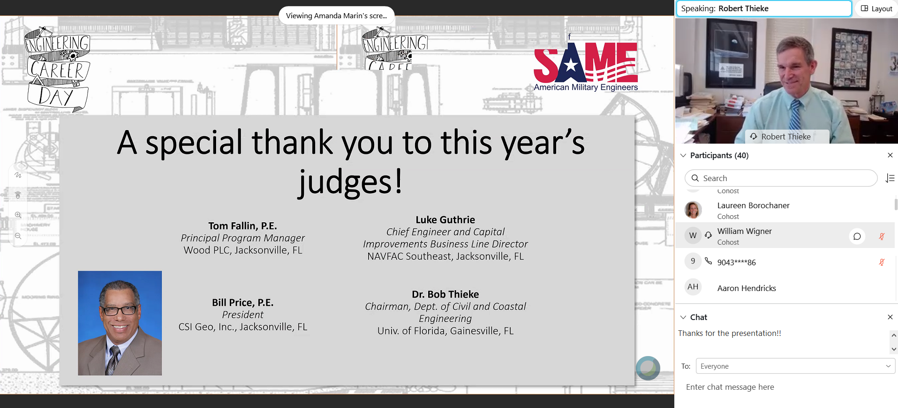
Engineering Career Day 2021
SAME Jax Post
Judges participated virtually and represented industry, academia, and government.
Objective 1d: Support the Engineer Regiment
Objective 4d: Build ready and resilient people and teams

Slide 4

Engineering Career Day 2021
SAME Jax Post
In addition to SAME, several local member firms assisted in sponsoring the event.
Objective 1d: Support the Engineer Regiment
Objective 4d: Build ready and resilient people and teams

Slide 5
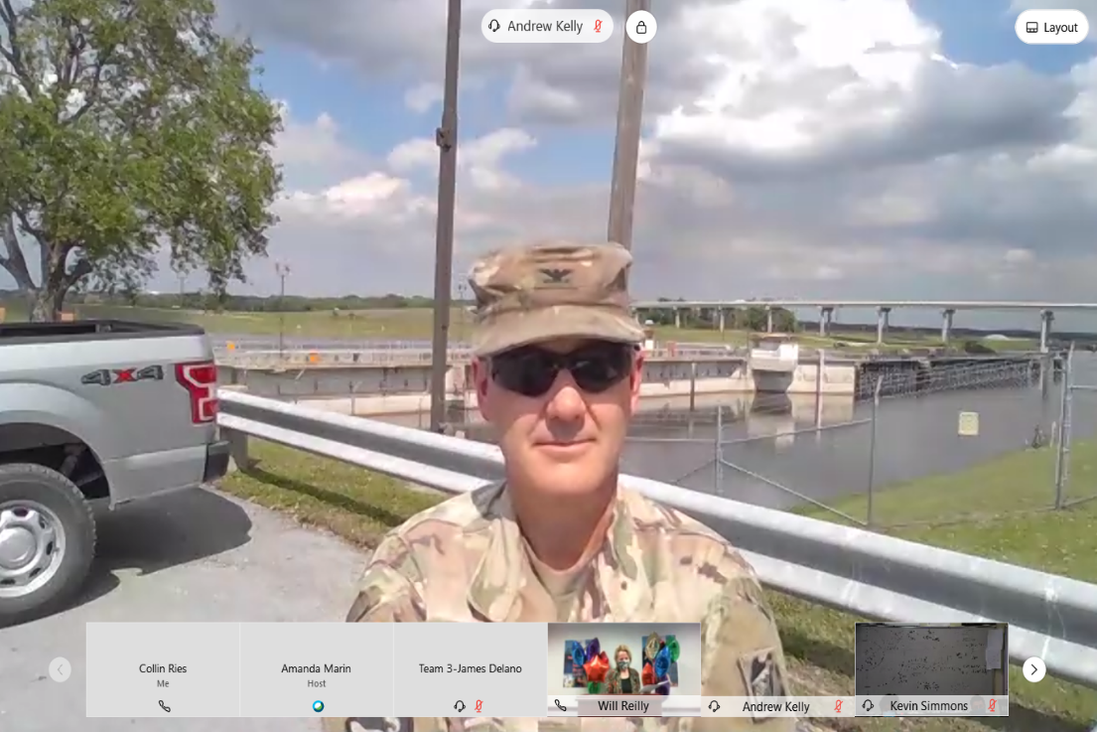
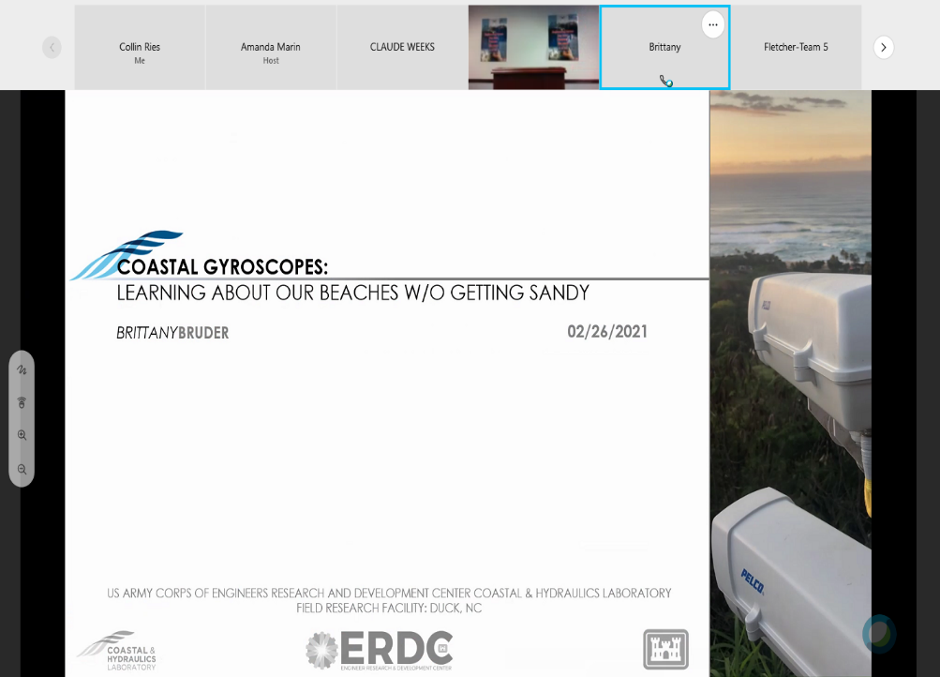
Engineering Career Day 2021
SAME Jax Post
Guest speakers for the all-day event included USACE Jacksonville District’s Colonel Drew Kelly (live from Herbert Hoover Dike) and ERDC’s Dr. Brittany Bruder.
Objective 1d: Support the Engineer Regiment
Objective 4d: Build ready and resilient people and teams

Slide 6
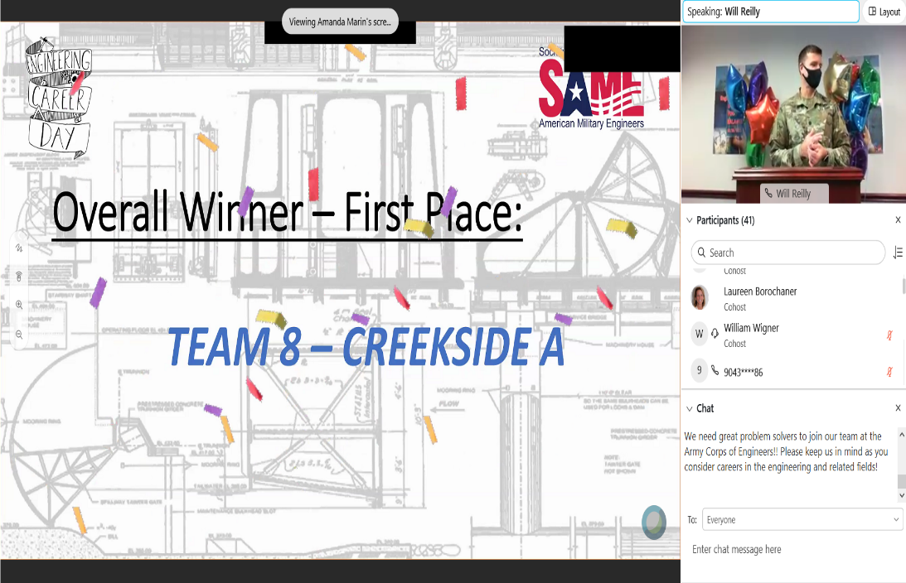
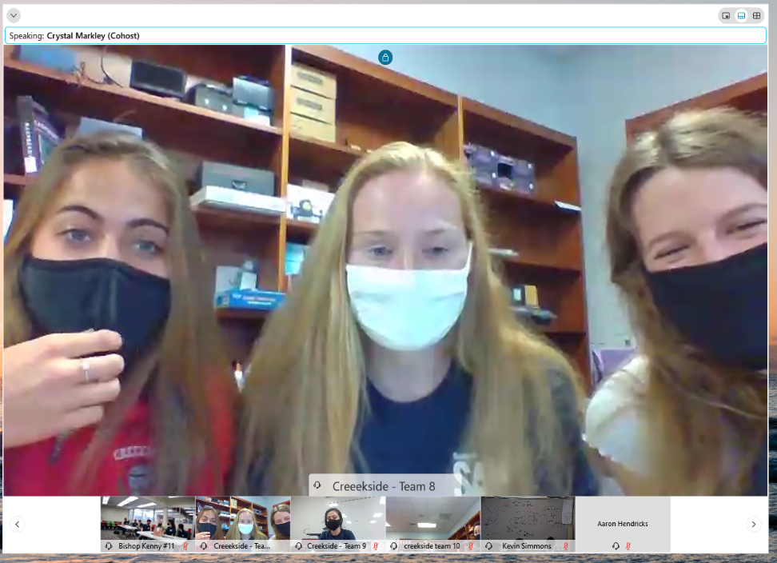
Engineering Career Day 2021
SAME Jax Post
USACE’s LTC Joe Sahl provided the welcome and closed the event by recognizing the winning teams.

Slide 7
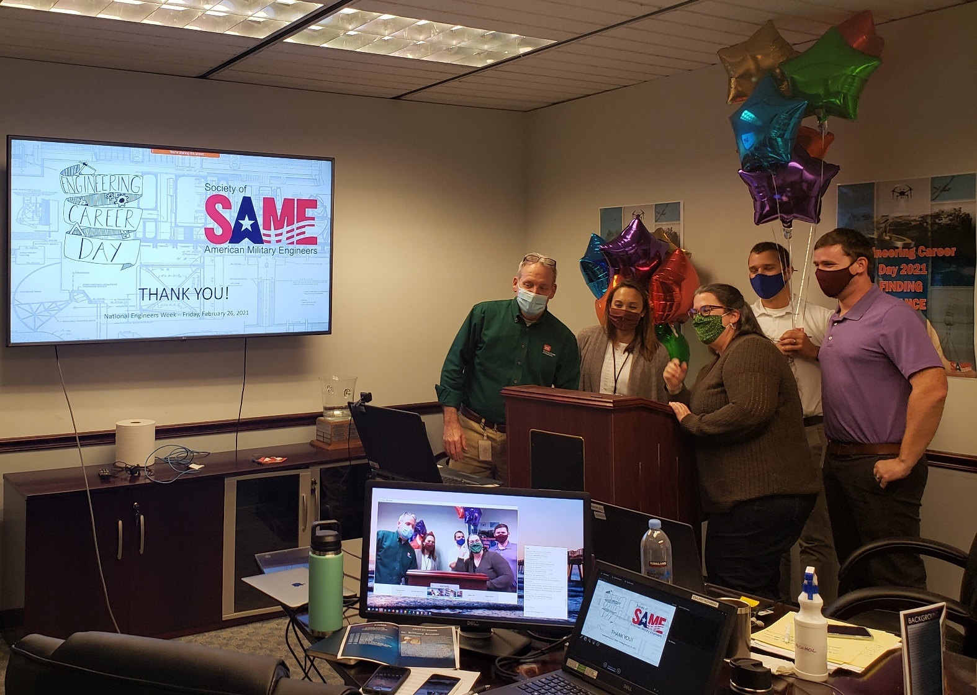
Engineering Career Day 2021
SAME Jax Post

